Slide 1
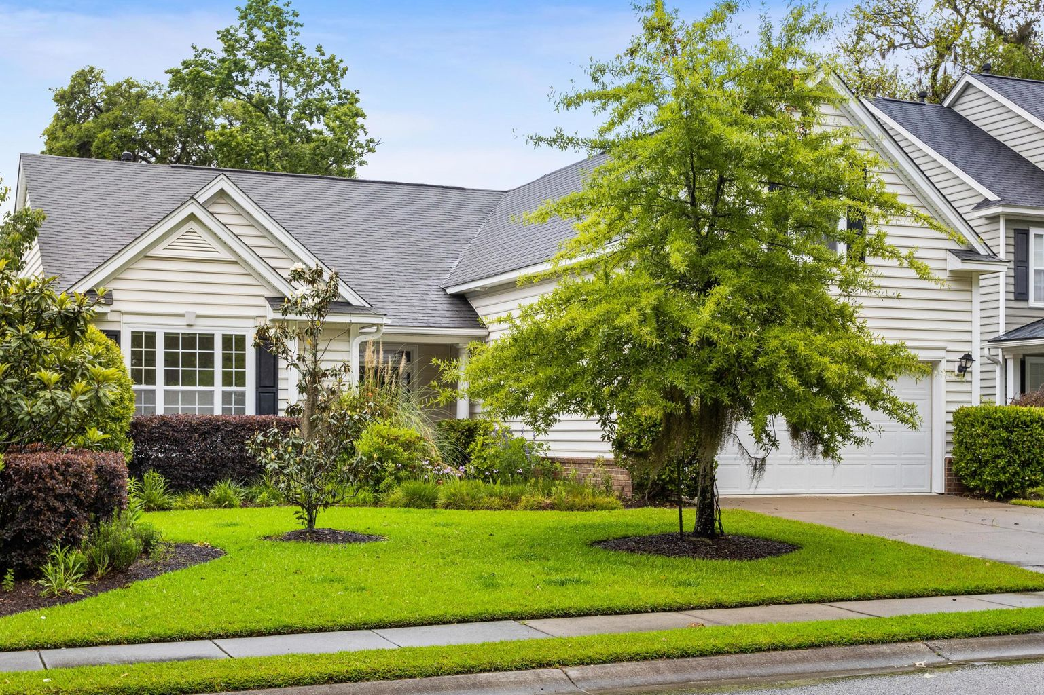
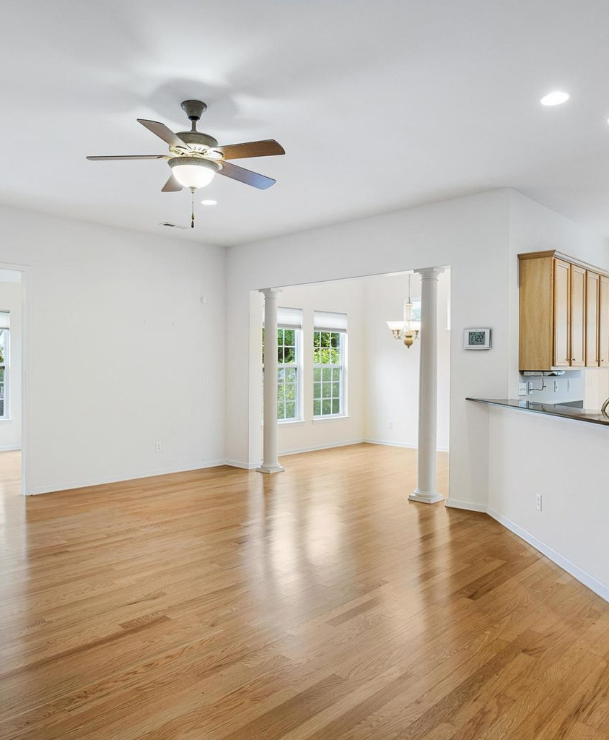
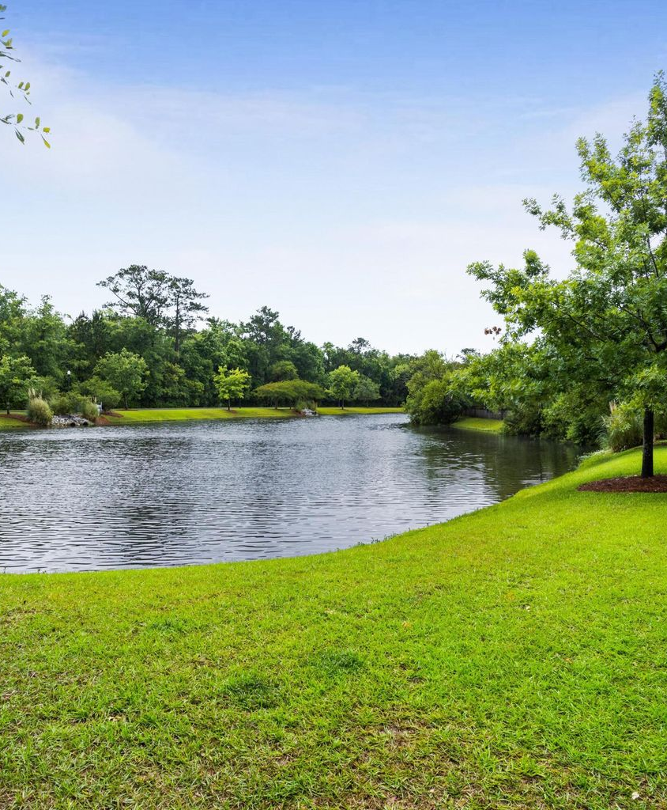

2944 Amberhill Way
OPEN HOUSE SAT & SUN MAY 22nd & 23rd FROM 1-3
Carolina Bay
Charleston, SC 29414
$419,000
MLS# 21012853
4 Beds
3 Baths
2,520 SqFt
Open the door to a truly Great Room with hardwood floors that opens onto the Kitchen, the Dining Room and the Sun Room. Natural light pours through the backyard windows revealing a habitat for birds and butterflies that blossom into color and flight! All rooms are on the first level except FROG/Bonus Room/4th bedroom/ with its bath. Master Bedroom overlooks the backyard. The two additional bedrooms are separated from the Master.
Yard is filled with native plants that support birds Hummingbirds, blue birds and butterflies are prolific, This is a quiet horticulturists' dream.
***Along the left side of house is the expansive lake with its flocks of ducks, geese, turtles and schools of fish that enhance the natural beauty of the location. *** The community pool and play area are across the street. C.B. amenities include pools, a large central park, walking trails, a large dog park, a dock with a walkway to Henry Tecklenburg Drive.
SEND YOUR CIENTS AND COME BY
TO SEE THIS LOVELY HOME!
Kay Kennerty
REALTORⓇ
843-345-5011
Kay@AgentOwned.com
AgentOwned.com
Notes:
DO NOT ALTER LAYOUT. YOUR FILE WILL BE RETURNED OR EDITED IF IT IS RECEIVED ALTERED.

