Slide 1
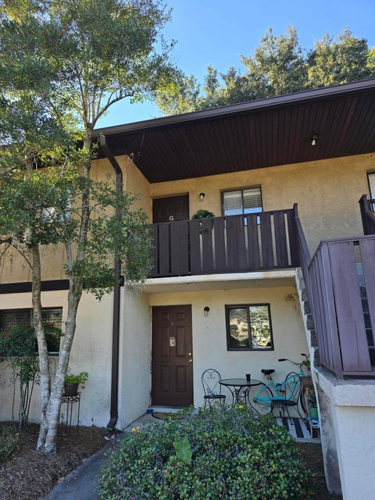
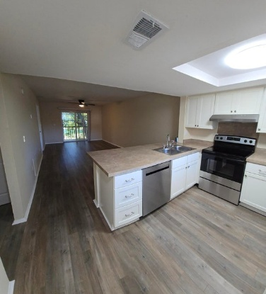
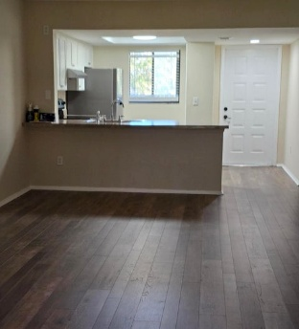
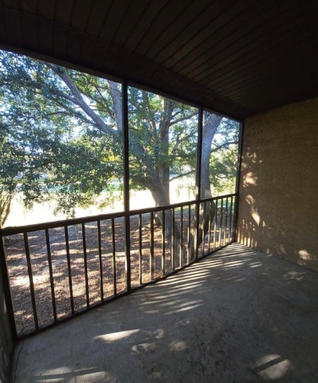
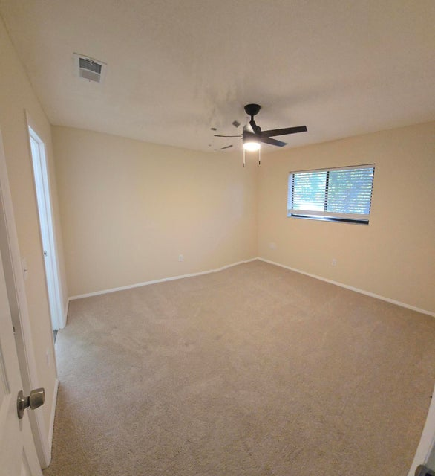
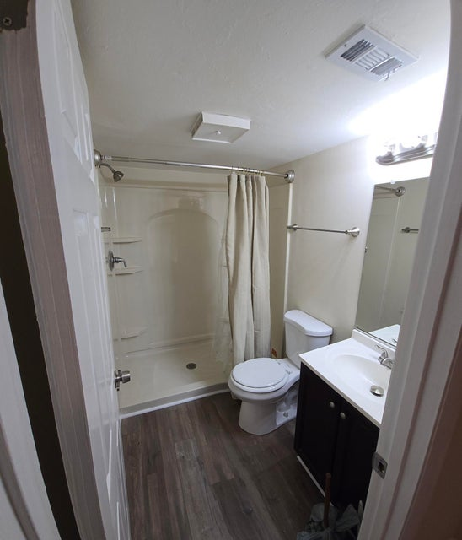
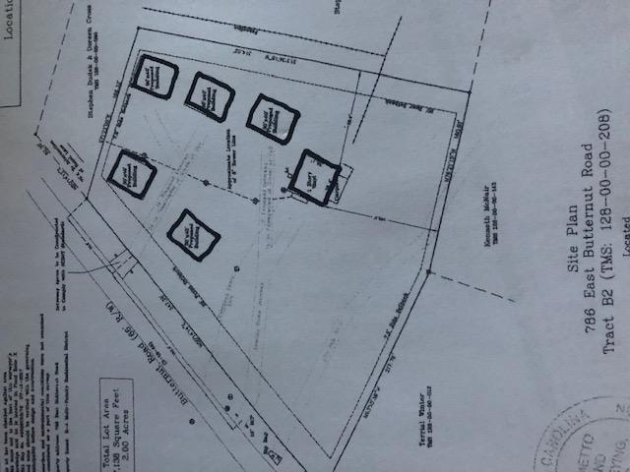
$15,000 PRICE REDUCTION
Vacant ~ Move-in Ready
2945 Dove Haven Court G
Dovefield | Charleston, SC 29414
MLS# 25029589 | $210,000
$40,000
Price Reduction!
Enjoy Lowcountry living in this beautifully renovated 2BR/2BA second floor condo in the preferred Dovefield community of West Ashley. This unit overlooks a fairway of Shadowmoss Golf & Country Club's scenic 18-hole course, offering elevated views; framed by mature oaks.
Inside you will find fresh paint, new waterproof flooring and brand-new stainless steel appliances The spacious split floor plan offers a private primary suite at the rear and a separate guest bedroom and bath at the front.
Unwind on the screened porch, cool off at the community pool and enjoy quick access to I-526, shopping, dining, medical facilities and downtown Charleston.
DRAFT
2 Blocks from The Crosstown
3 Blocks from The Citadel
6 Blocks from MUSC
2.5% Buyer’s Agent Commission
Rick Willis
843-327-3017 rwillisteam@gmail.com The Group, LLC

