Slide 1
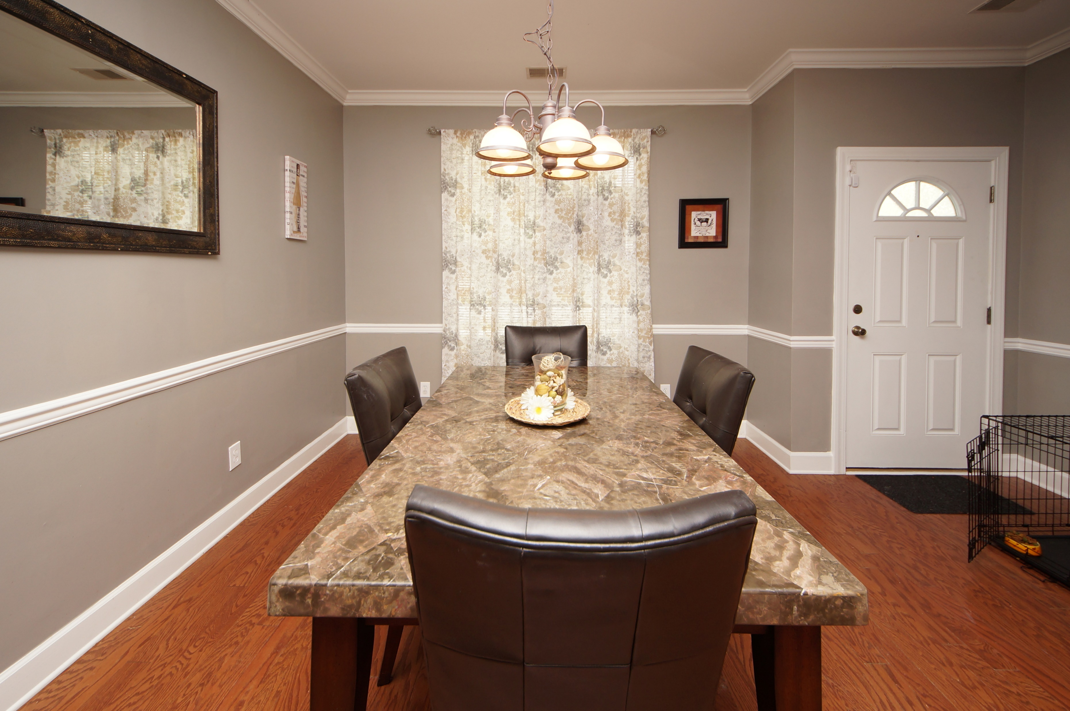
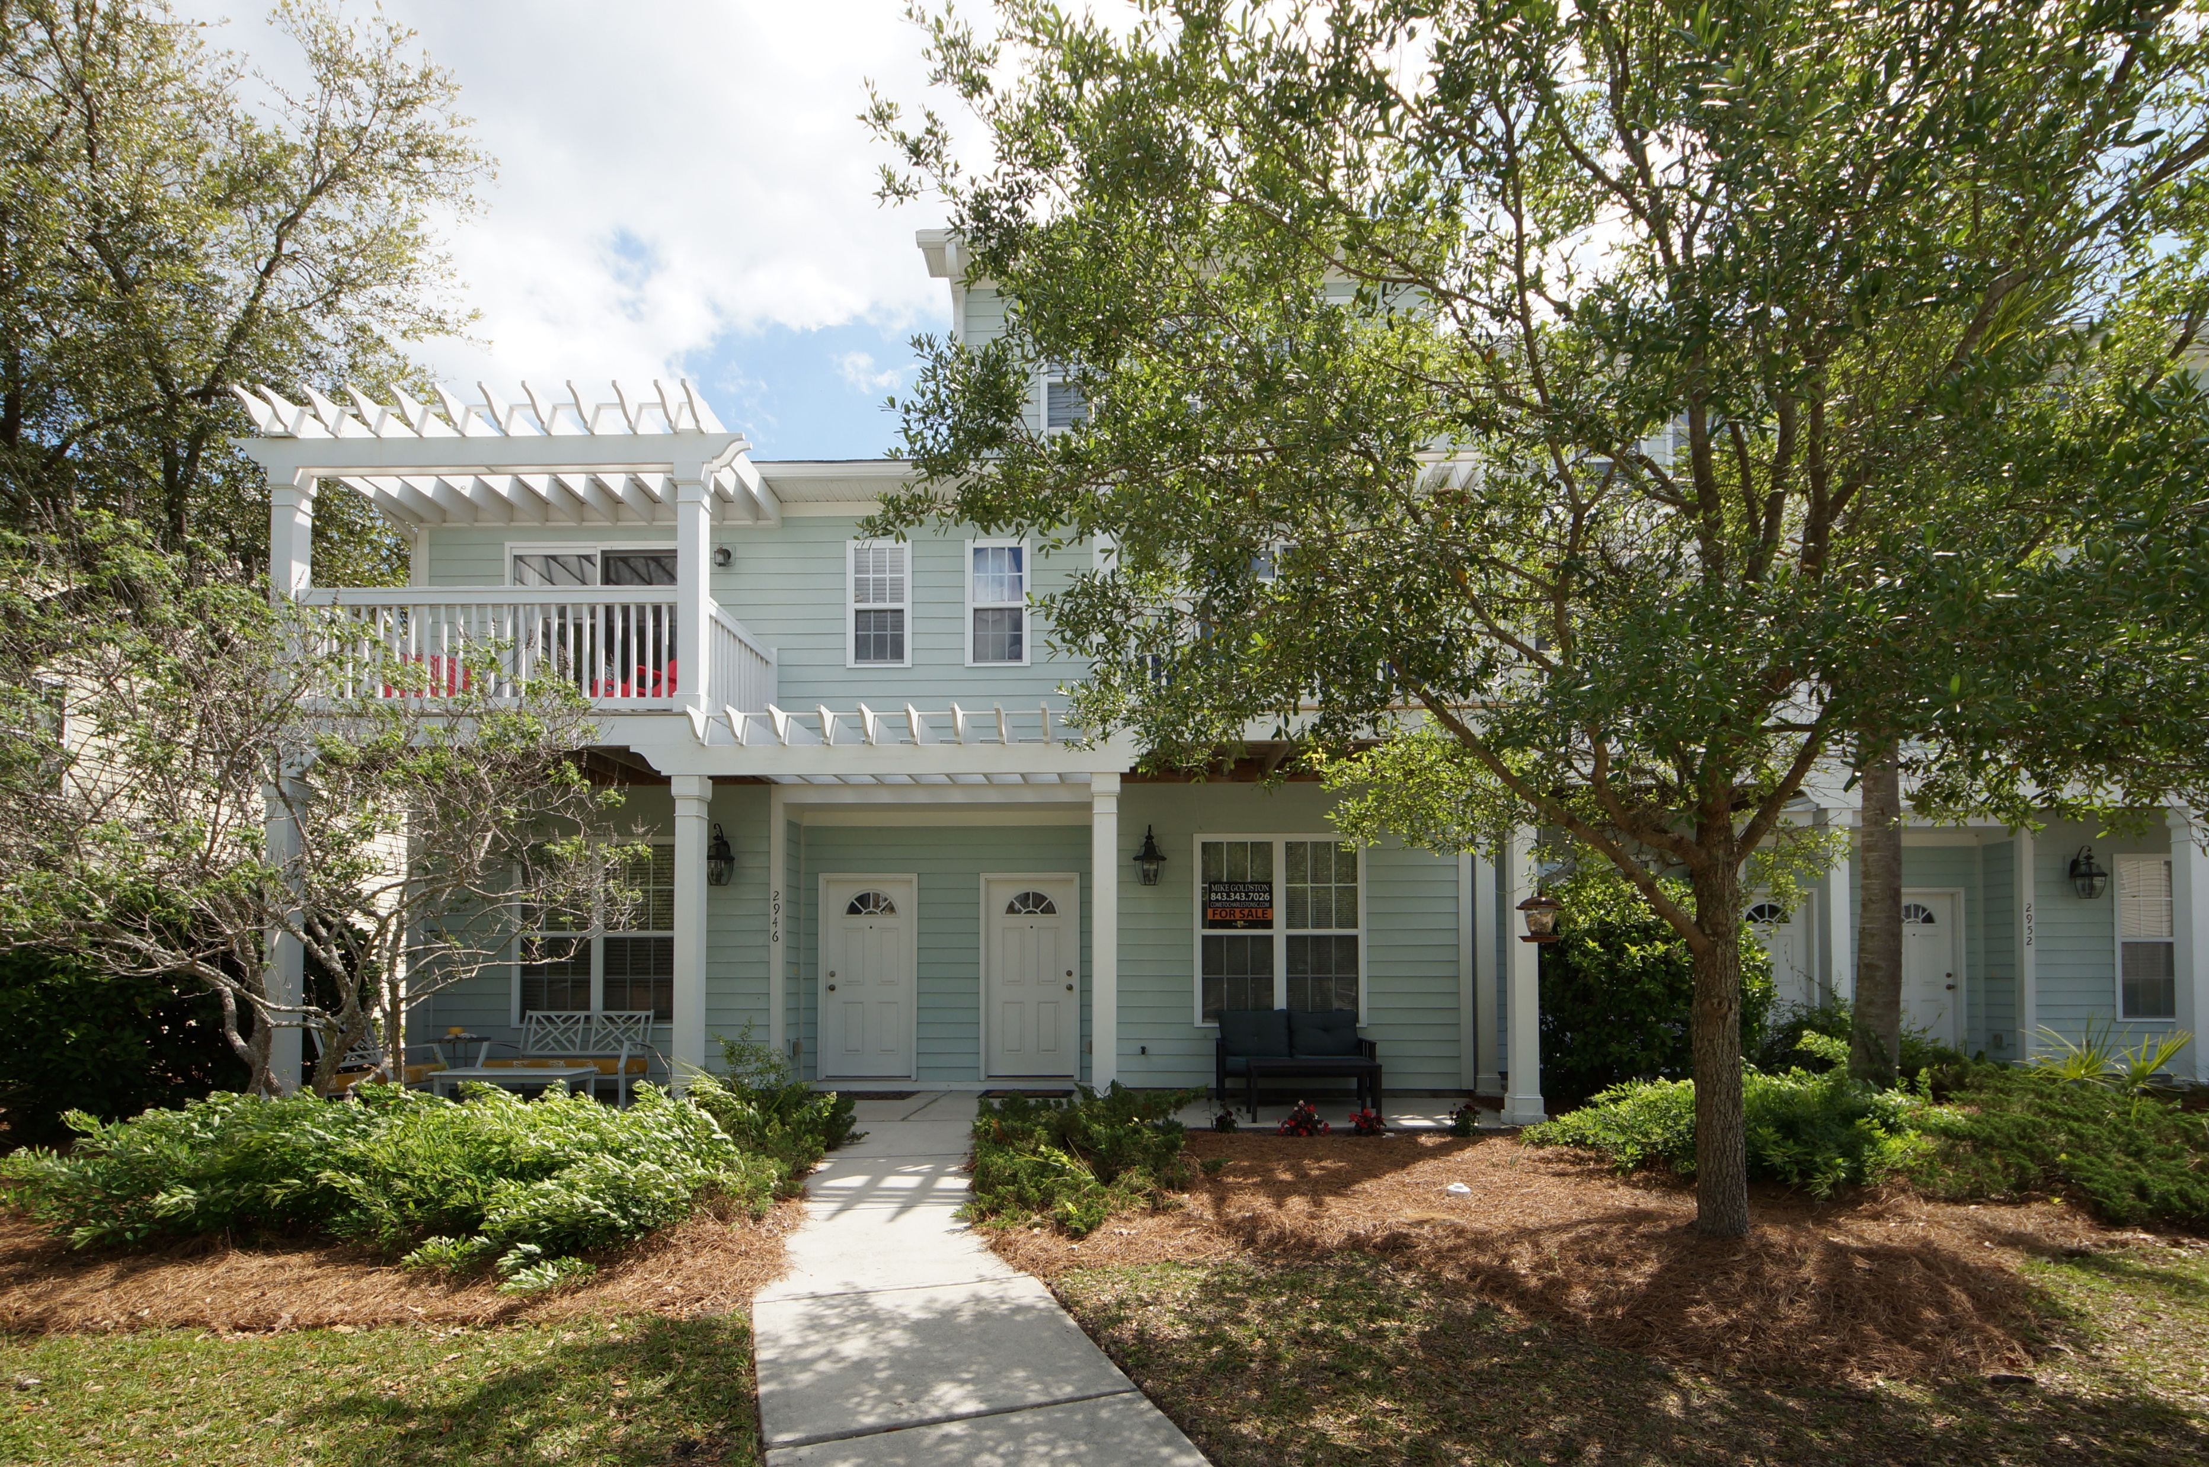
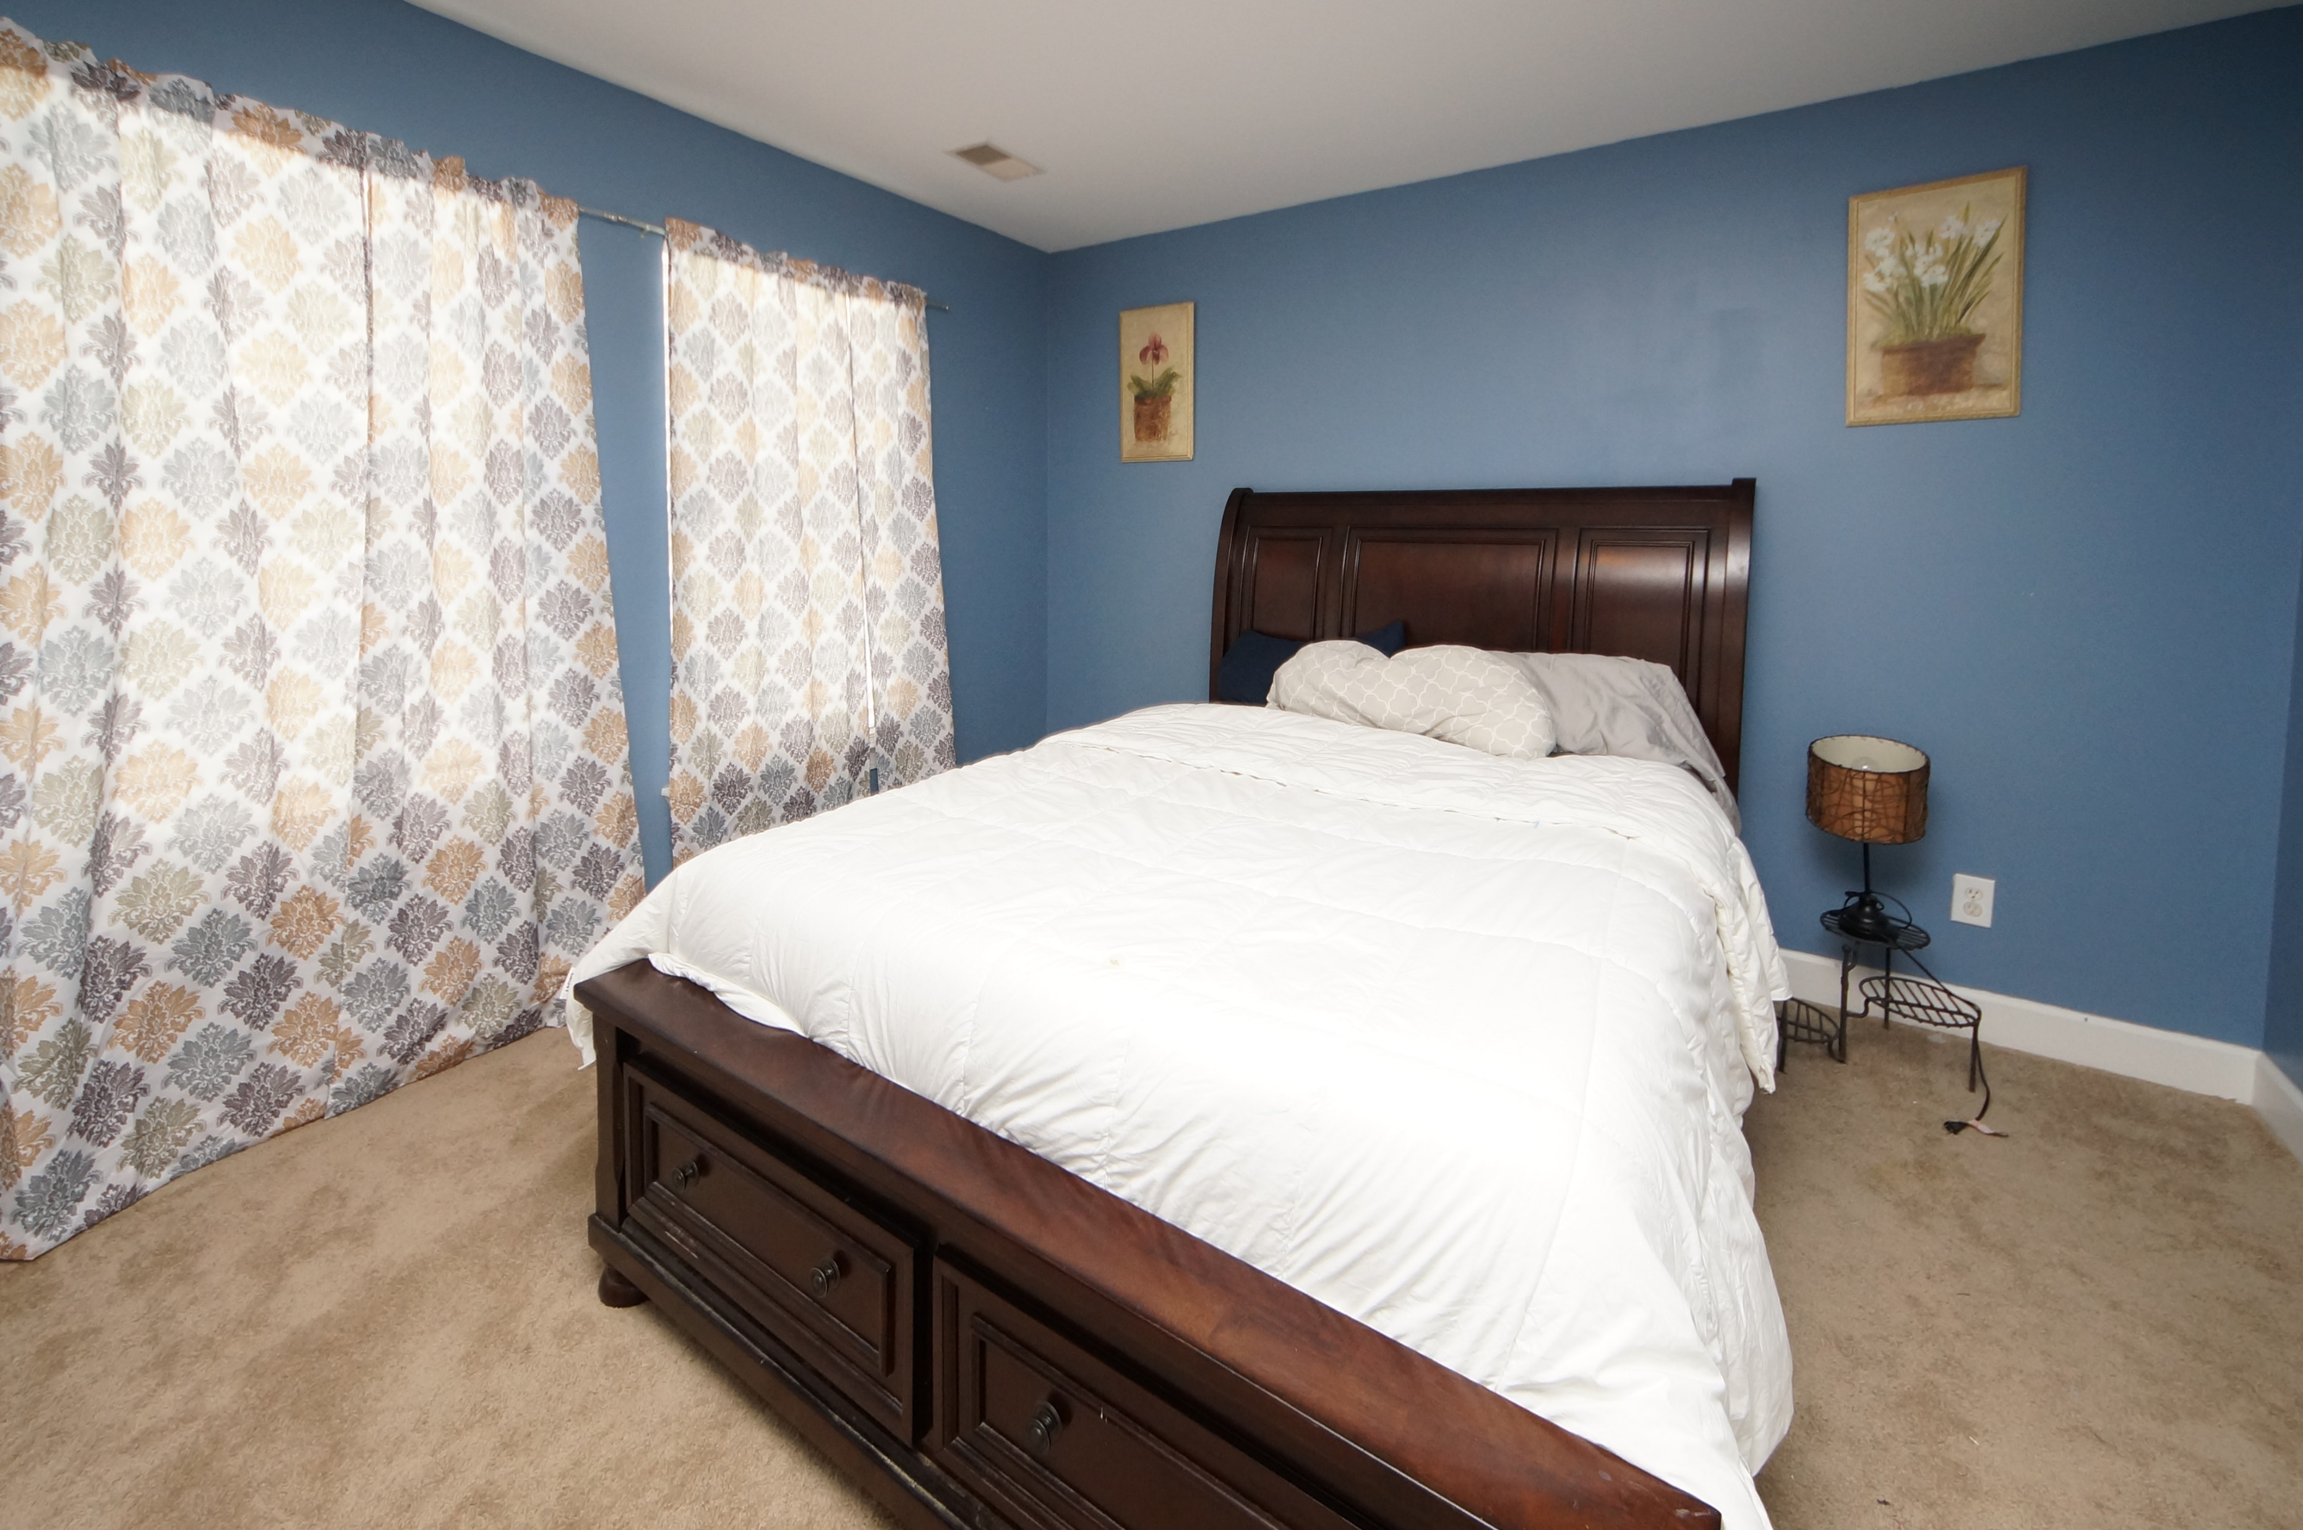
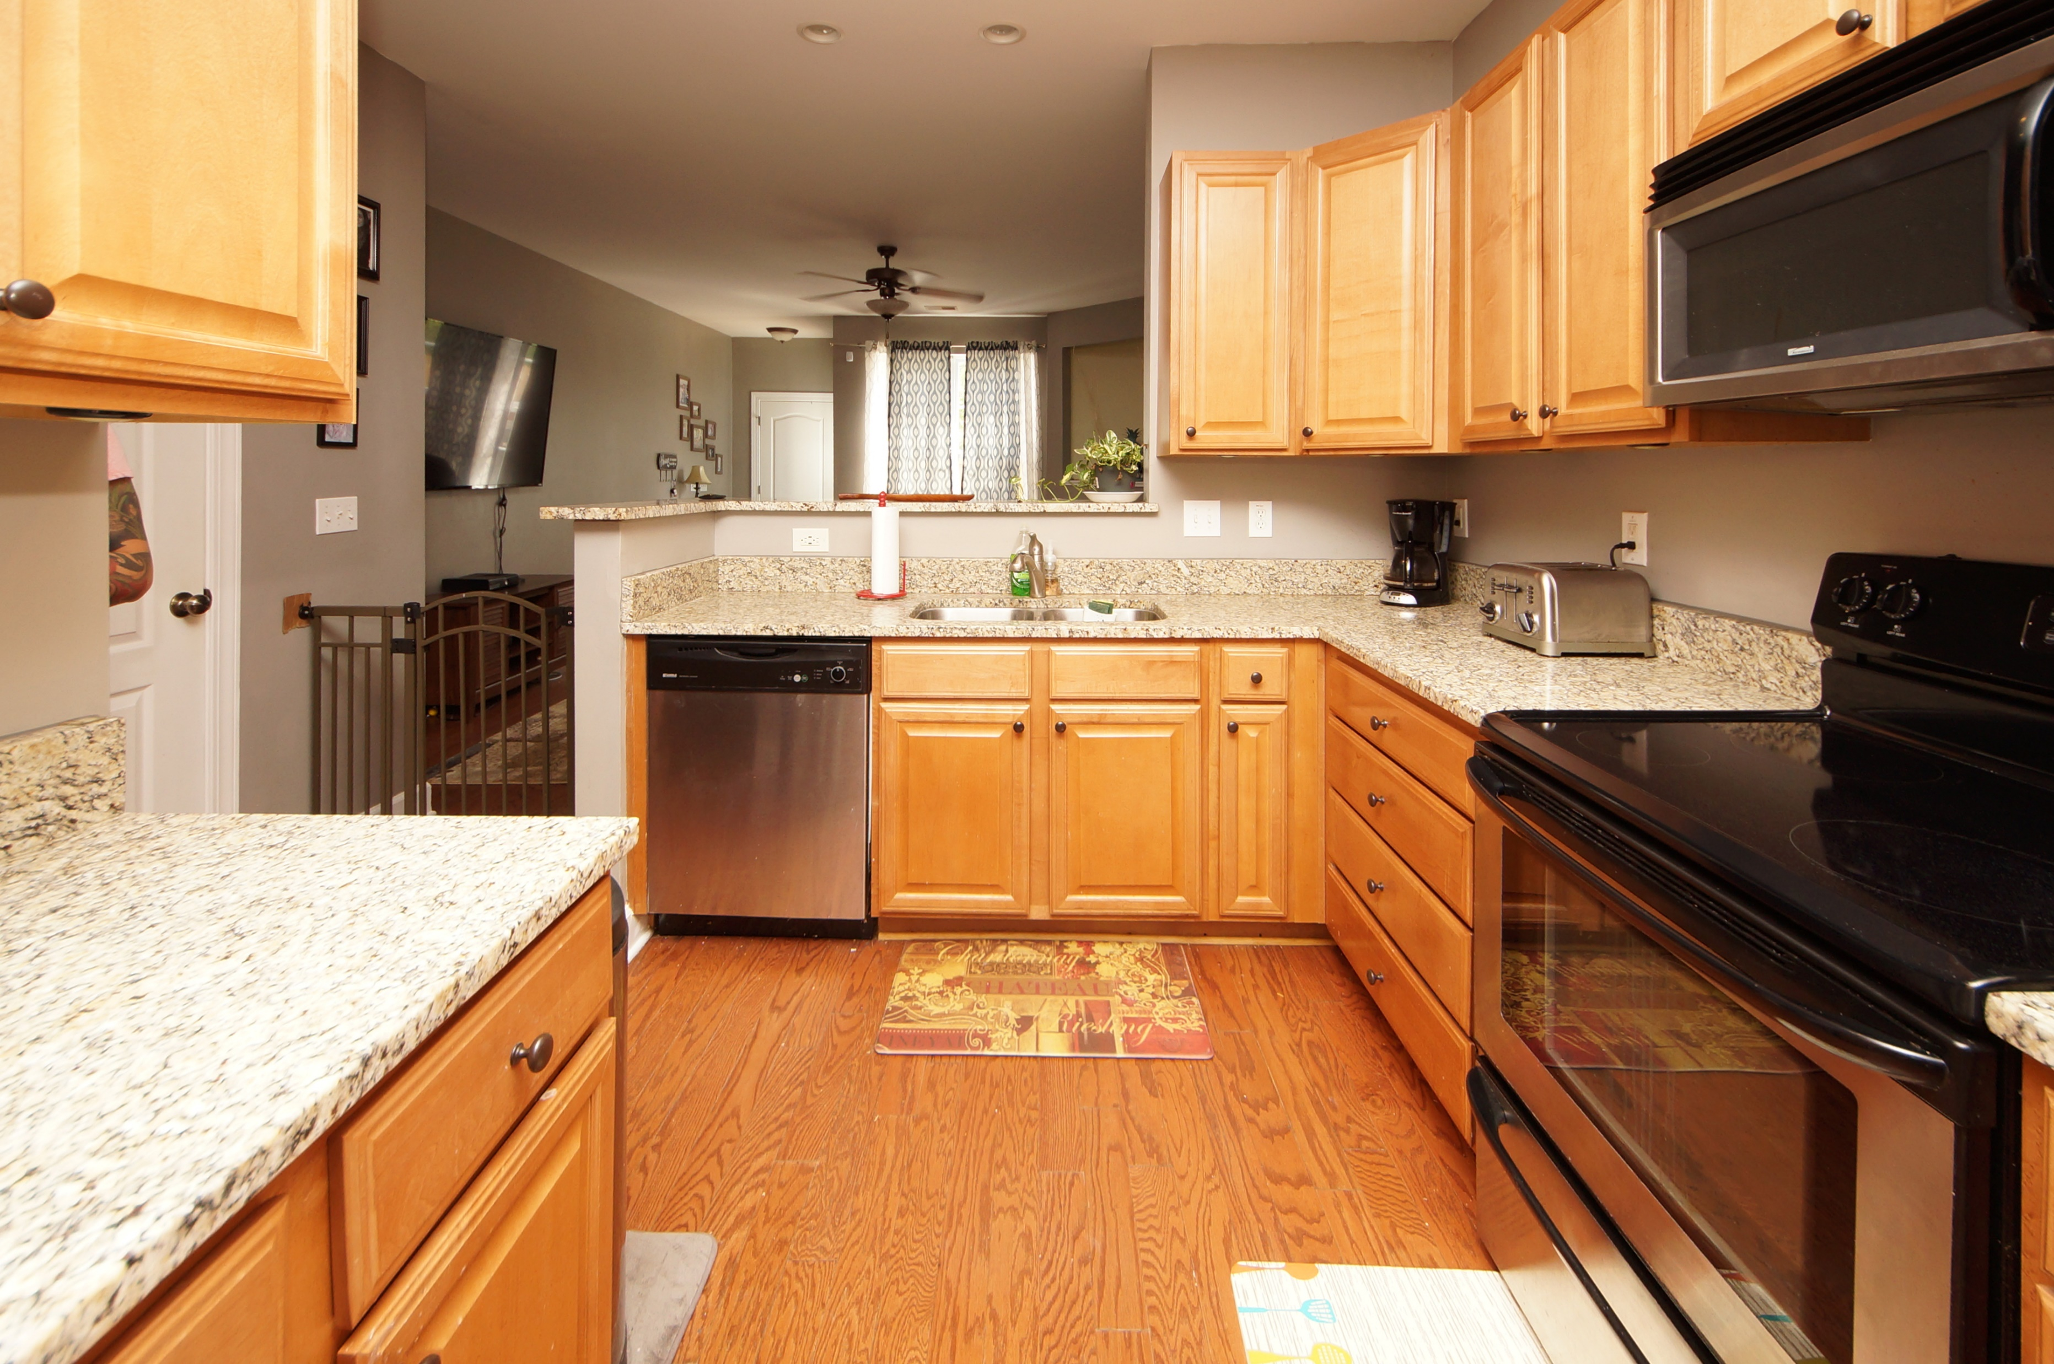
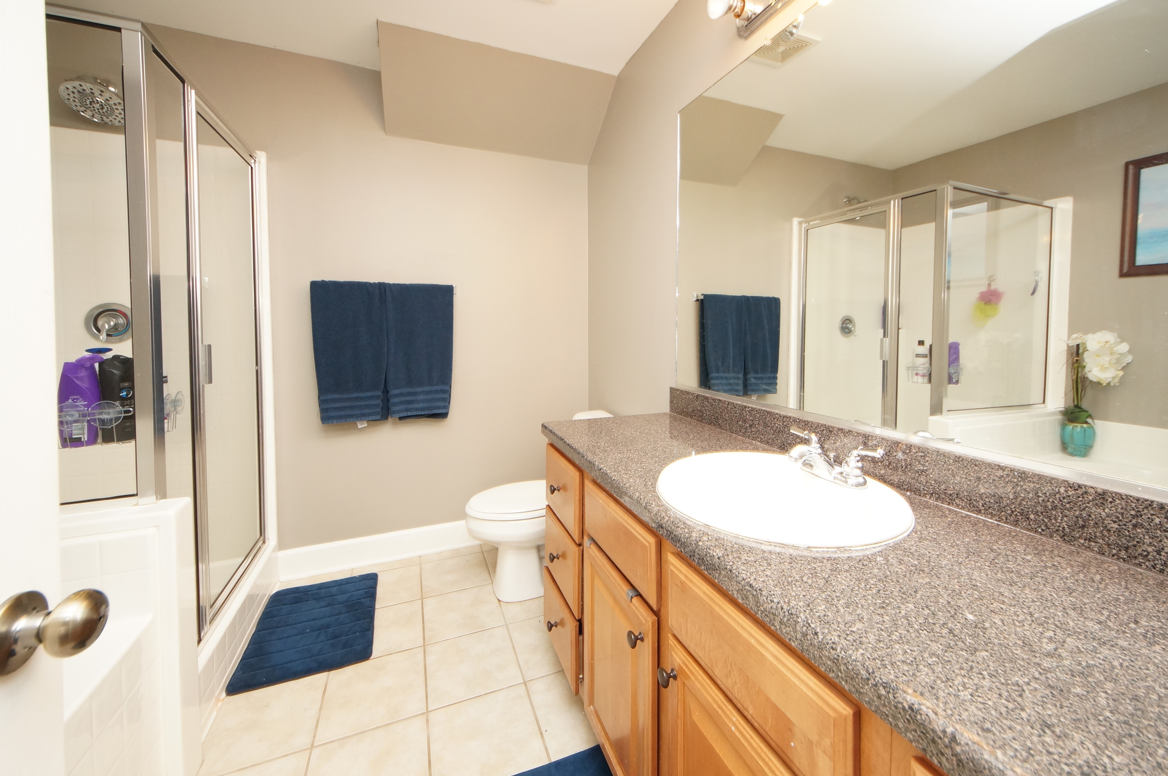
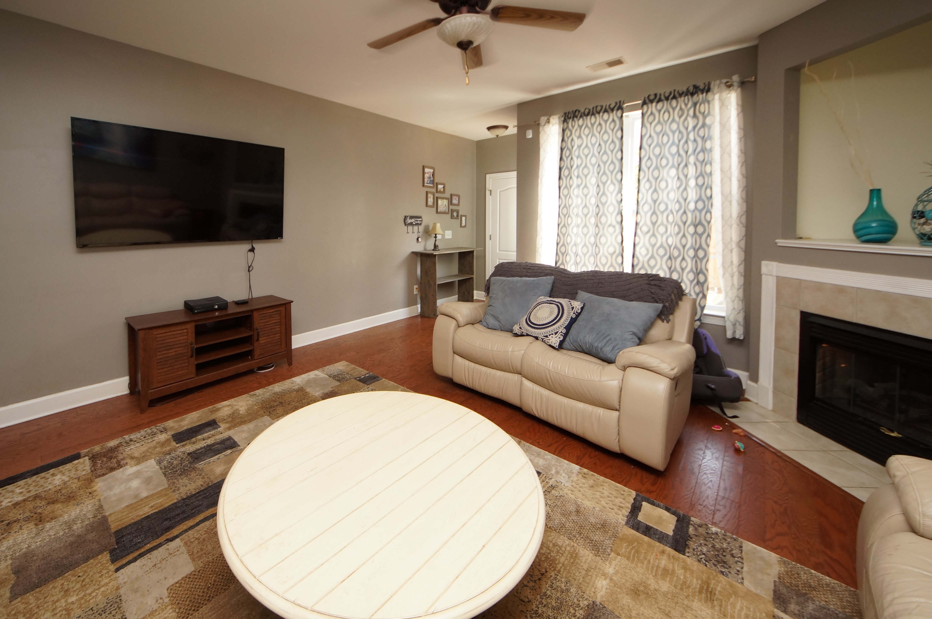
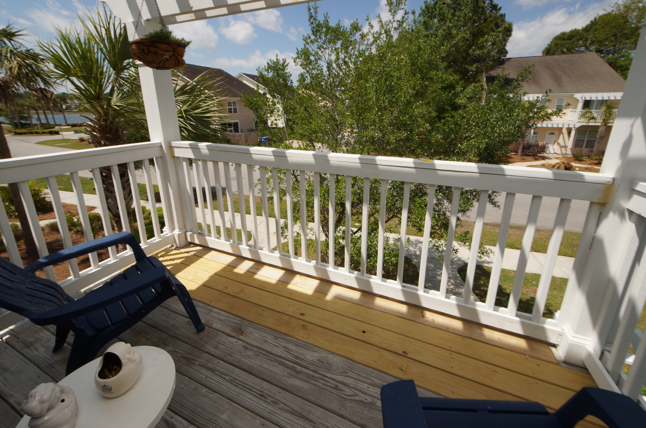
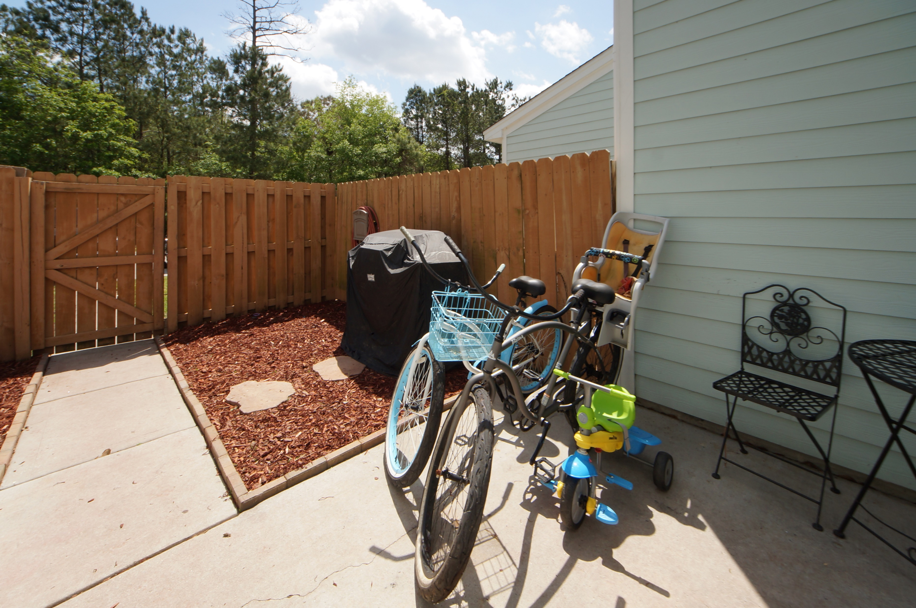
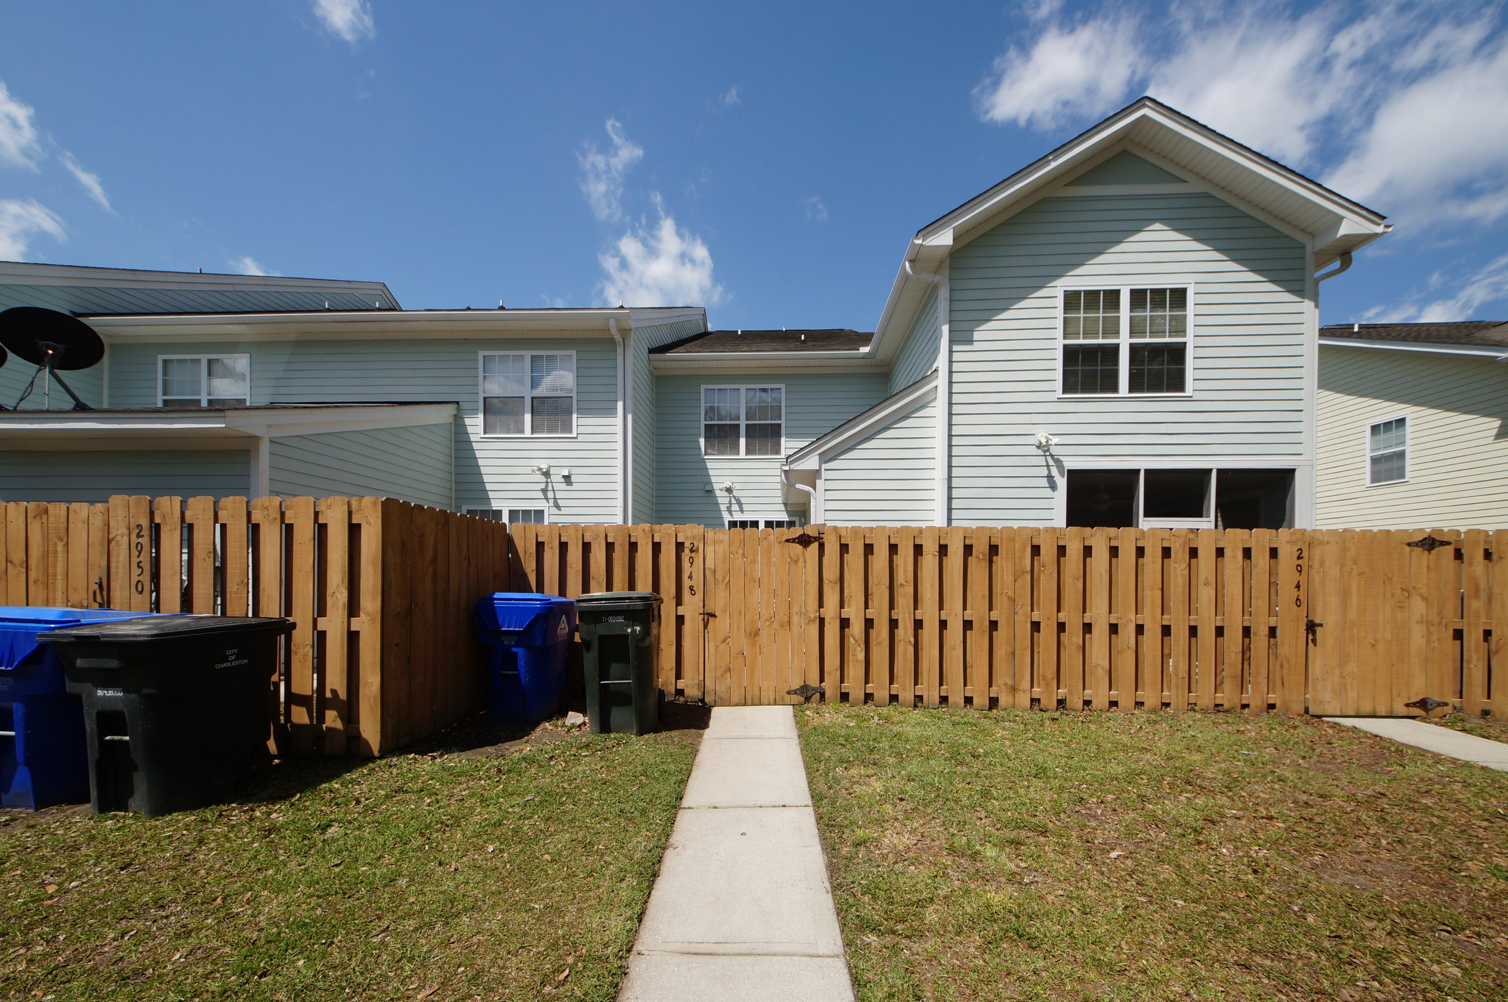
Whitney Lake ~ Just Reduced to $234,995!!
2948 Sugarberry Lane
Johns Island, SC 29455 ~ MLS# 18011103 ~ $234,995
Great upgrades in this 3 bedroom 3.5 bath townhouse. Granite counter tops, wood floors throughout the 1st floor, 42" maple cabinets and stainless steel appliances add so much to this home. The master suite on the 2nd floor includes a balcony so you can enjoy the lake views privately. A second bedroom with a full bath and laundry closet complete the 2nd floor. On the 3rd floor there is another bedroom with a full bath. This community is centered around a 25 acre lake where residents can kayak, paddleboard or enjoy the view.
Mike Goldston, Realtor
mikesellscharleston@gmail.com | 843-343-7026 | www.cometocharlestonsc.com
Brand Name Real Estate | 4 Carriage Lane, Suite 106 | Charleston, SC 29407

