Slide 1
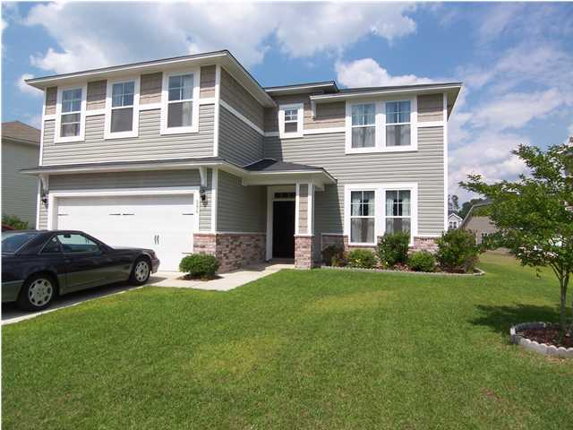
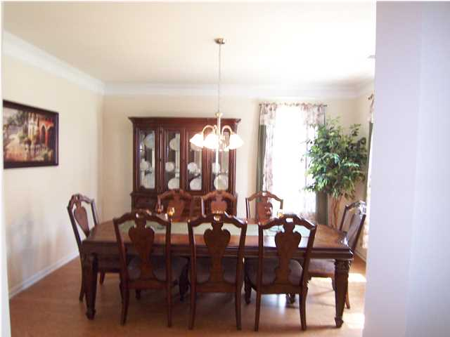
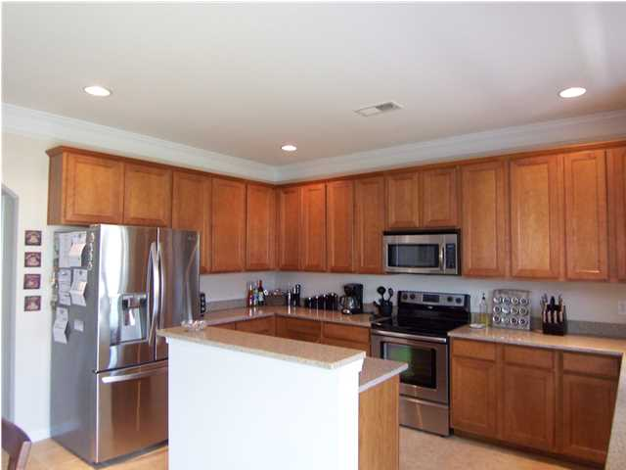
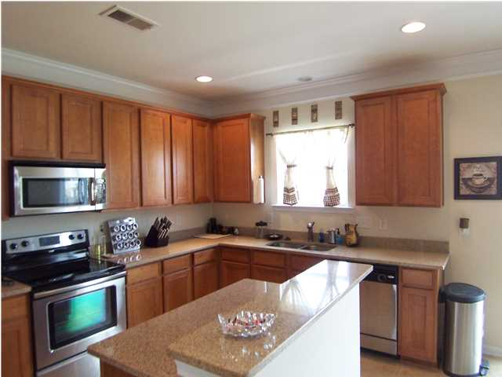
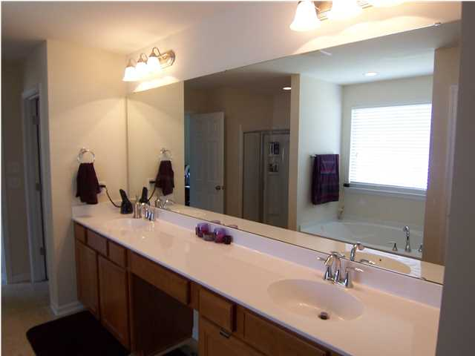


294 Oglethorpe Cir Spring Grove Moncks Corner, SC MLS# 1414577 $269,900 5 Bedrooms 3 Baths 3,368 sf
Ceramic Tile in all baths, laundry, and Kitchen. Hardwood Floors in Foyer, Extended Foyer and Formal Dining Room. Kitchen Boasts 42" Maple Cabinets, Granite Countertops, Stainless Appliances, Bartop, Large Eat-in Area, and Recessed Lights. Master Bedroom is 19.25 x 16.75 and features dual Walk-in Closets. Master Bath has dual Vanities, Separate Shower and 5' Garden Tub, Raised Vanities, and Linen Closet. Double Crown Molding Throughout 1st Floor and Single Crown Molding Throughout 2nd Floor. Truly a MUST SEE!!ENERGY STAR CERTIFIED Homes. 14 SEER HVAC, Low "E" windows and doors, thermal barrier roof sheathing, engineer sealed exterior sheathing, ducts tested and sealed, and tankless water heater. Raised vanities and 9 foot ceilings on first floor standard.
Kathryn Wray
O 843-737-0708
M 843-408-1548
kwrayrealtor@gmail.com

