Slide 1
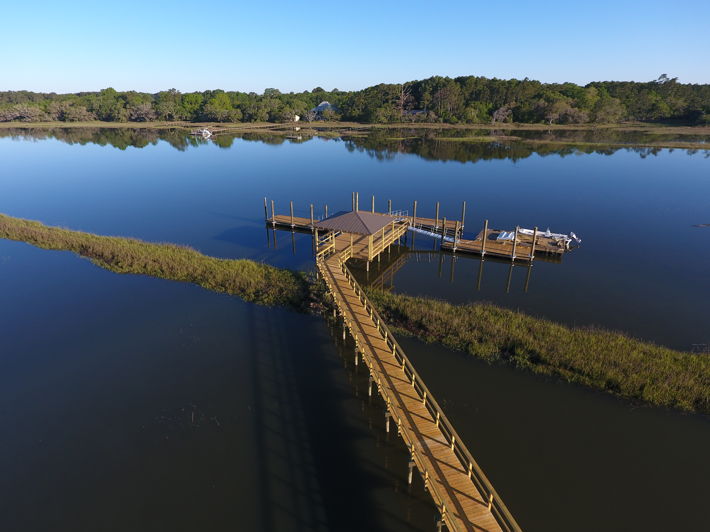
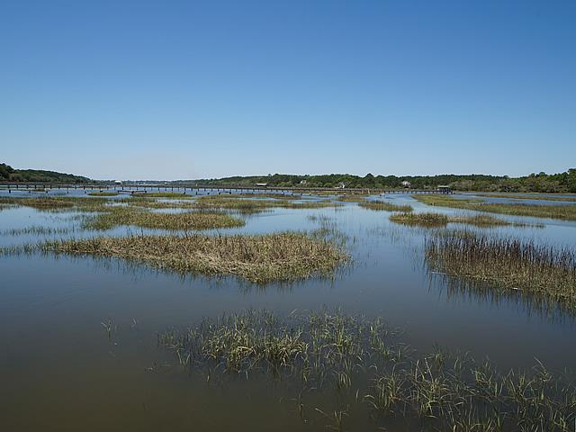
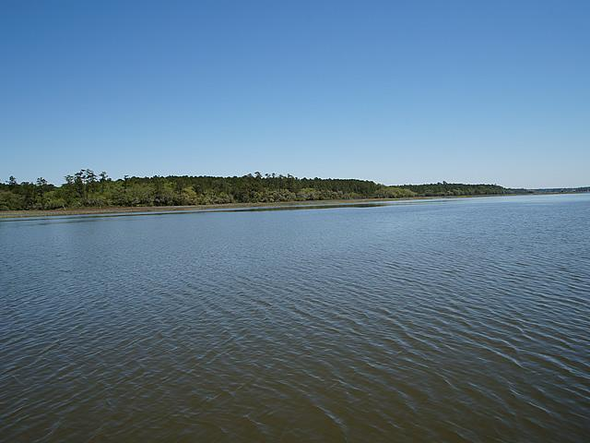
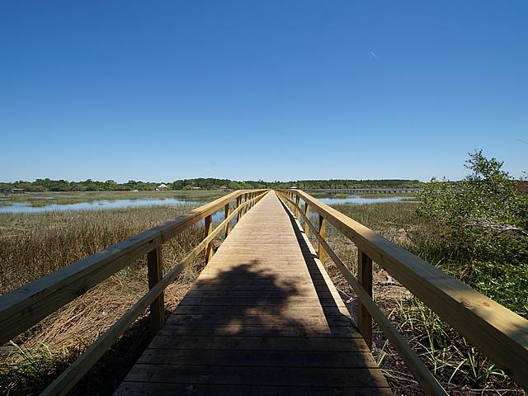
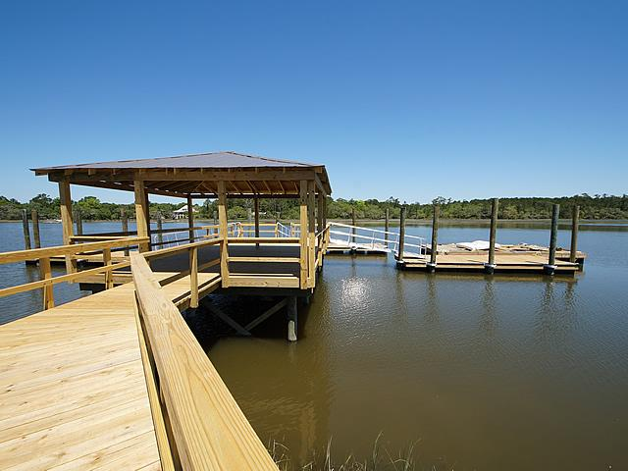
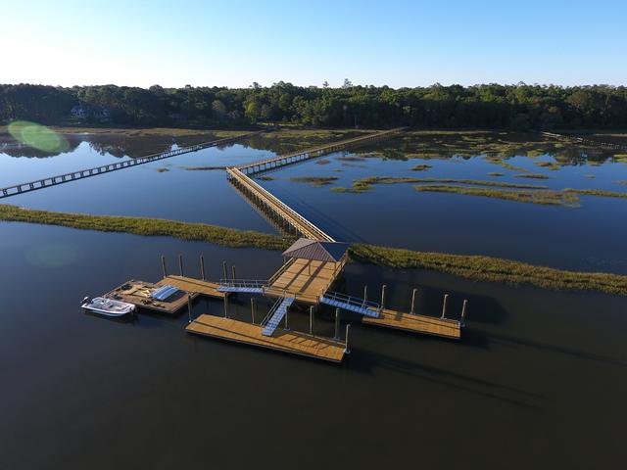
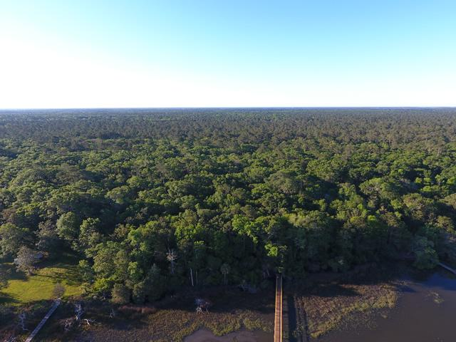
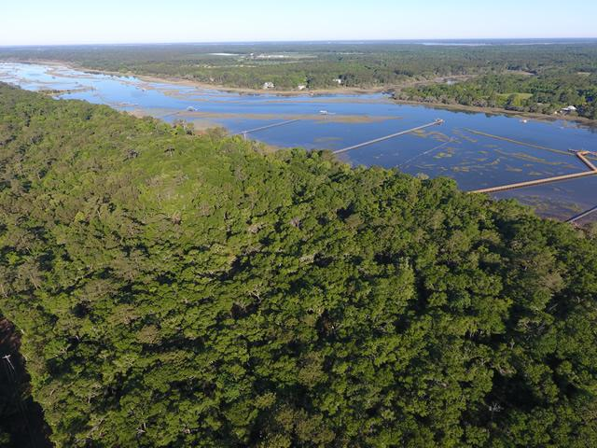
Deepwater Paradise!
15+ acres total with 9.79 high acres.
2952 Bohicket Road
Johns Island | MLS# 16023893 | $1,729,000
Great opportunity for a developer. Approx. 320+ feet of frontage on Bohicket Creek. Beautiful land covered with Grand Oaks. Enjoy gorgeous sunsets over Bohicket Creek. Wonderful land for private retreat or up to 9 Single Family Homesites. All due diligences available including the following: Boundary Survey, Topo Survey, Soil Survey, Septic field layout, Multiple lot layouts from 9 lots on down, Engineering for entire 9 lot community. There is a 20x40 fixed pier with a 20x20 covered roof. There 3 docks that have been constructed; 2 docks are 30', & 1 dock is 50'. Unbelievable opportunity for estate homesite/retreat, and or multiple homesites up to 9 total. Full set of engineer plans available.
Charles Salmonsen
M (843) 224-0300 | O (843) 388-6613 | charles@salmonsen.com
Salmonsen Realty | 864 Lowcountry Blvd Ste B | Mt Pleasant, SC 29464

