Slide 1
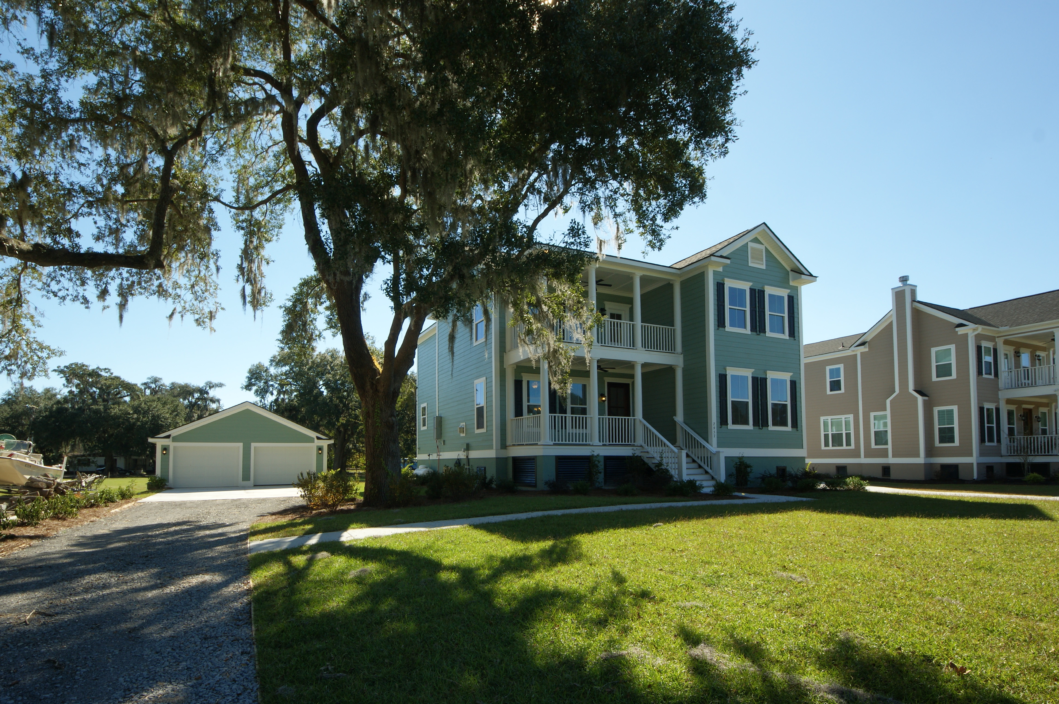
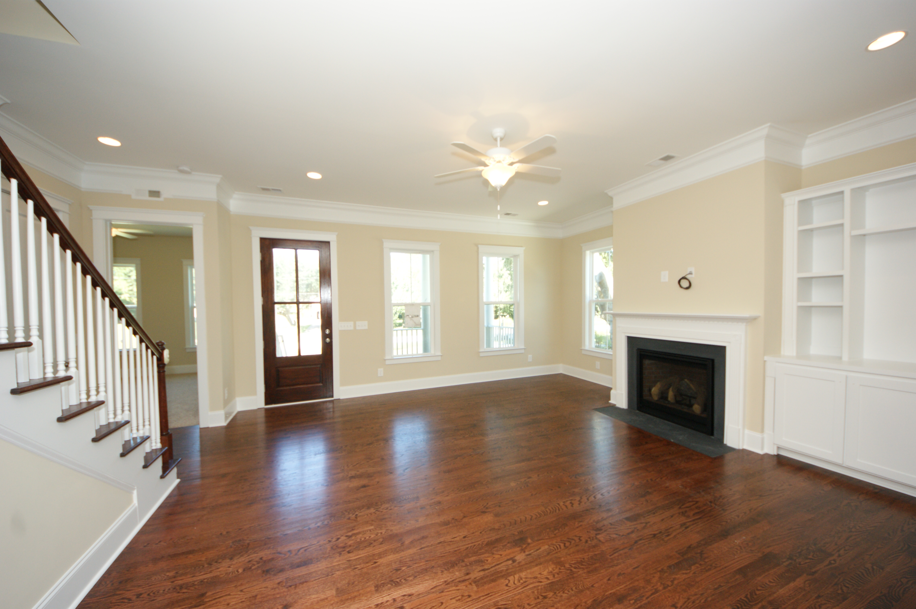
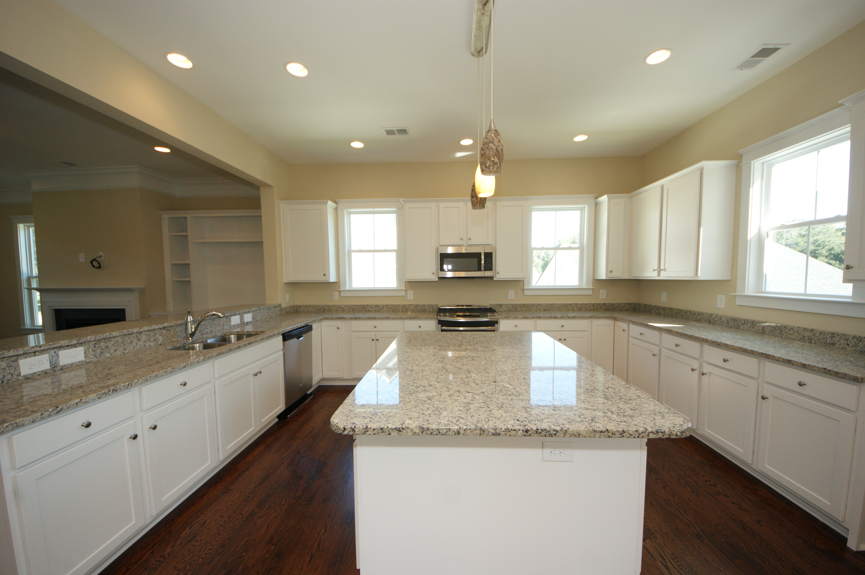
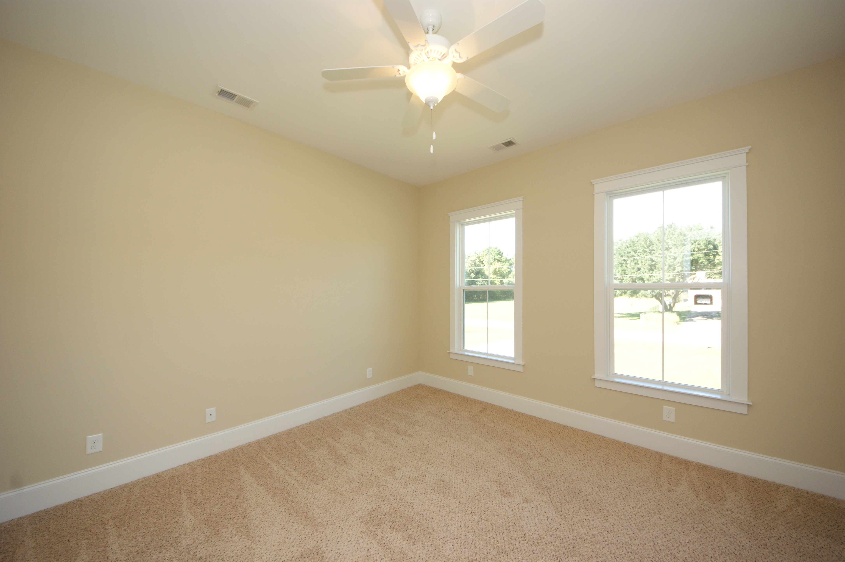
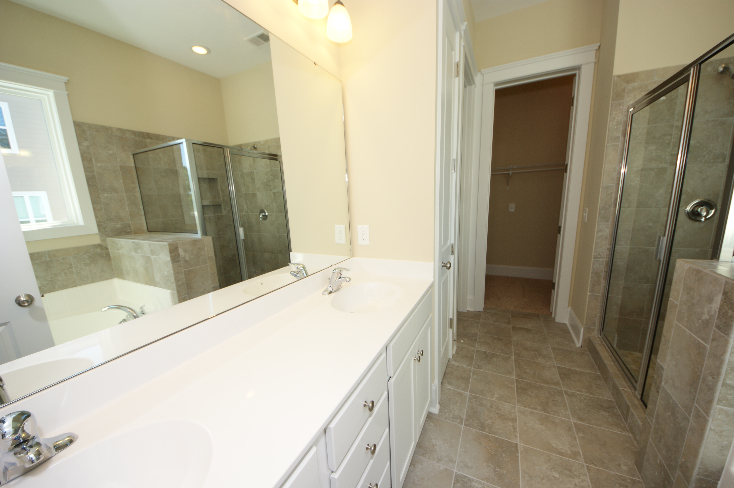
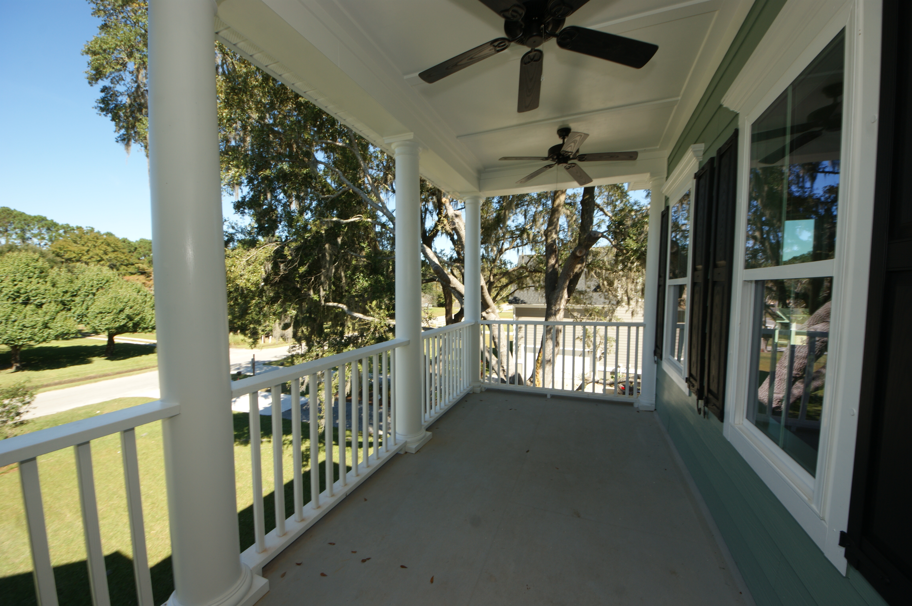
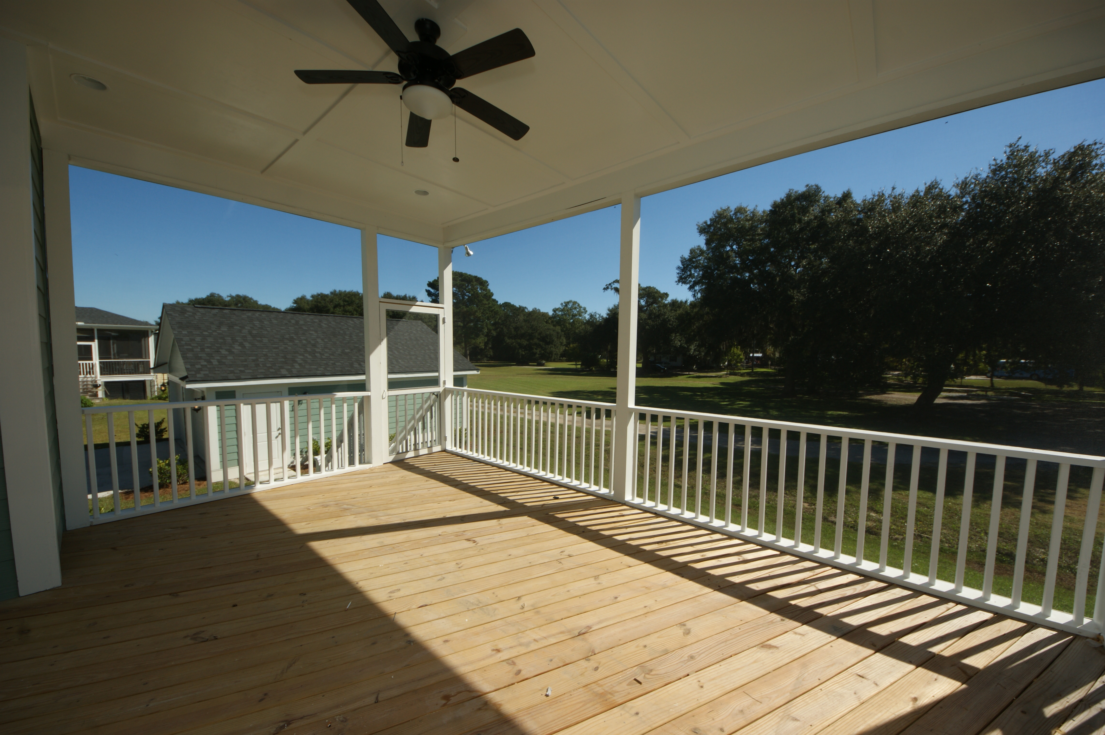


2957 Bluff Lane Bluff Estates ~ Mount Pleasant, SC 29466 MLS# 1320863 ~ $459,900
55 and Better!
Ready NOW!
NEW CONSTRUCTION in Mt. Pleasant that can't be beat! This is our Allendale IV floor plan which features 5 bedrooms and 3 full bathrooms with addition to a powder room. This well planned home boast the Master suites located on the main level with 4 additional bedrooms upstairs. The open floor plan is very inviting and is great for entertaining! All homes in Bluff Estates features smooth ceilings throughout the home, 10 foot ceilings on first floor, 8 foot smooth panel doors downstairs, oak hardwood flooring throughout the main living areas downstairs, fireplace with gas hook up, and Sherwin Williams paint. The kitchen features included are 42' cabinets w/ crown molding and brushed nickel hardware, granite countertops w/ double stainless steel under mount sink, Moen drip less faucets and stainless steel appliances. Exterior features included are fiber cement siding with Sherwin Williams Historic Charleston color palette, insulated vinyl single hung tilt windows and professionally landscaped sodded yard. All homes are energy efficient including Rinnai gas tankless hot water heater and 13 seer puron energy efficient heating and air systems.
Maria Woodul, ABR, CRS, SFR
Broker Associate
843.297.1836
MWoodul@carolinaone.com
www.MariaWoodul.com
Carolina One Real Estate
2713 Highway 17 North
Mt. Pleasant, SC 29466

