Slide 1
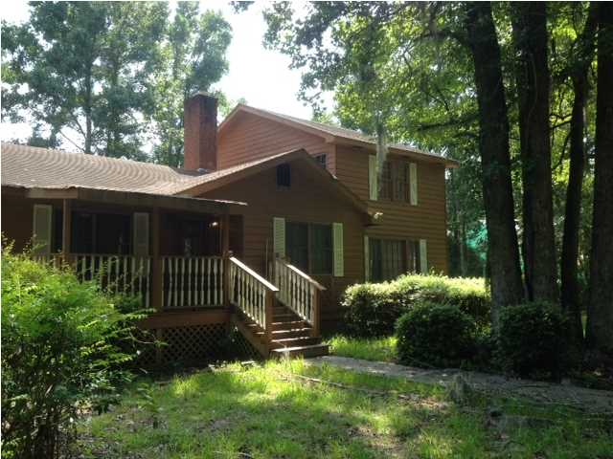
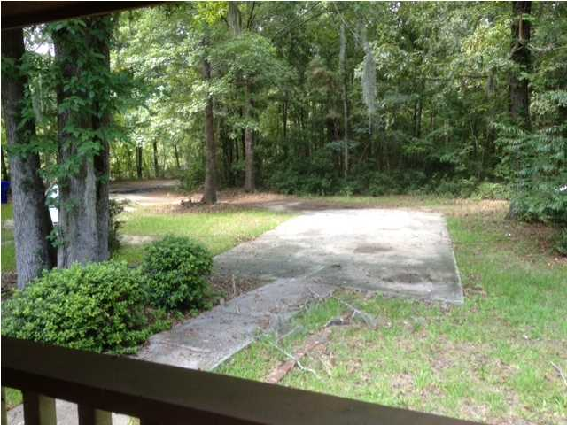
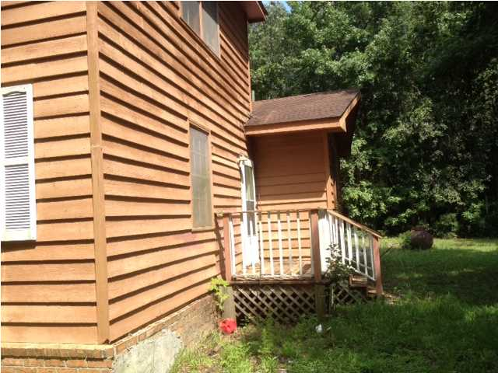
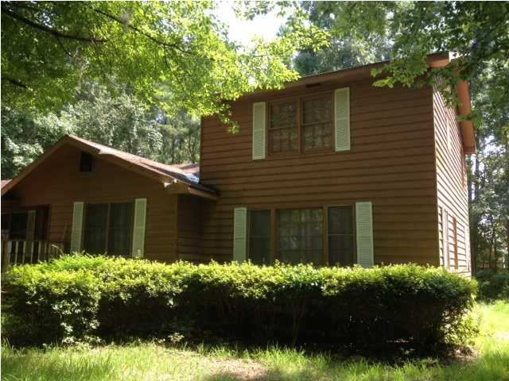

2957 Murraywood Rd Murraywood Johns Island, SC MLS# 1421459 $225,000 4 Bedrooms | 3½ Baths | 2,836 sf
Open House Lunch ~ Friday, Oct 3 from 11 - 1
Handyman Special… Bring your hard hats!
Open House Lunch ~ Friday, Oct 3 from 11 - 1
Handyman Special… Bring your hard hats!
Handyman Special reduced from the tax assessment of the Charleston County Tax Assessor's office this beautiful property is tucked away from Murraywood Road and is a recorded 3.25 acres on the tax map. Located close to the Maybank Highway and River Road on Johns Island you'll think you are in the middle of the forest as you turn into the driveway and are greeted by two brick columns at the main entrance that say, "Welcome Home!" Privacy and location are two features of this Johns Island secluded land treasure. Located at the front right corner of the property is a lagoon ready to be stocked with fish for your quiet afternoons of making memories. The home structure is about 2800 square feet and is in need of renovation, so this property is price accordingly. There are beautiful hardwood floors and a double fireplace on the first floor. A very large kitchen, living room, family room, dining room, laundry area, 2.5 bathrooms, and three bedrooms are also located on the first floor. The second floor bedroom and bath are added features of this home. Come on out and enjoy living in the tranquility and stillness of the country, but just minutes from the excitement and thrill of downtown Charleston!
Susan & Greg Day
843-900-0477 | 732-757-2904 charlestonbyday@gmail.com
www.charlestonbyday.com
AgentOwned Realty Co. Premier Group, Inc. | 824 Johnnie Dodds Blvd | Mt Pleasant, SC 29464

