Slide 1
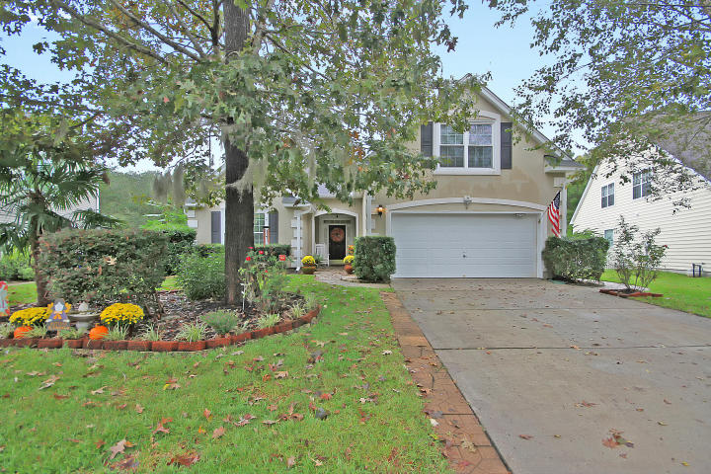
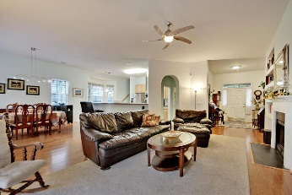
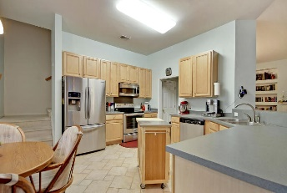
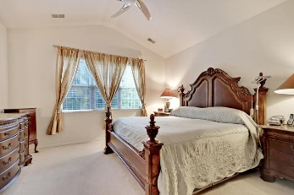
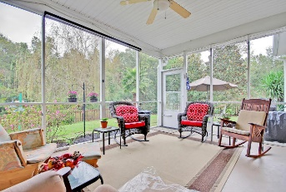
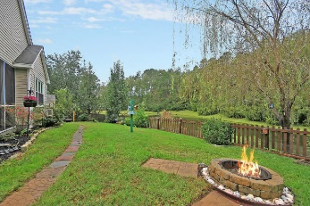


JUST LISTED!
295 Cabrill Drive
Grand Oaks Plantation
Charleston, SC 29414
MLS# 17028914
$309,900
This Amazing ranch style home is situated on a quiet tree-lined street and is surrounded by a large, private, fenced pond/water front lot. This Remarkable home with a beautiful wood flooring, stunning 10+ft smooth ceilings and upgraded lighting fixtures has 4 large bedrooms including the spacious master bedroom suite located on the first floor that offers a huge walk-in closet and a master bathroom with double vanities, a soaking tub and a separate walk-in shower (the FROG is the 4th bedroom). The modern kitchen with a useful breakfast area, ceramic flooring, upgraded built-in Stainless appliances and crafted 42" cabinets. The formal dining room offers gorgeous wood flooring. A private living room/office is available as a flex room. The awesome Gathering room is spacious, offers stunning 10+ ft. ceilings, a cozy fireplace and is perfect for entertaining. There is a walk-out to the valuable screened-in porch and to the unique patio. Both can be used for relaxing and outside entertaining. The yard is professionally landscaped and offers many fruit bearing trees and incredible views of the water and wildlife (ducks, geese, deer, birds.) Do You Recognize a Good Buy? Bring your Checkbook! Age, sqft, taxes, acreage, HOA dues, and schools are approximate buyer to verify any and all information deemed necessary.
Mason Thurber
(843) 709-5109 – C
(843) 576-2699 – O
mason@theeverettgroup.net
RE/MAX Pro Realty, 9209 University Blvd, Charleston, SC 29406

