Slide 1
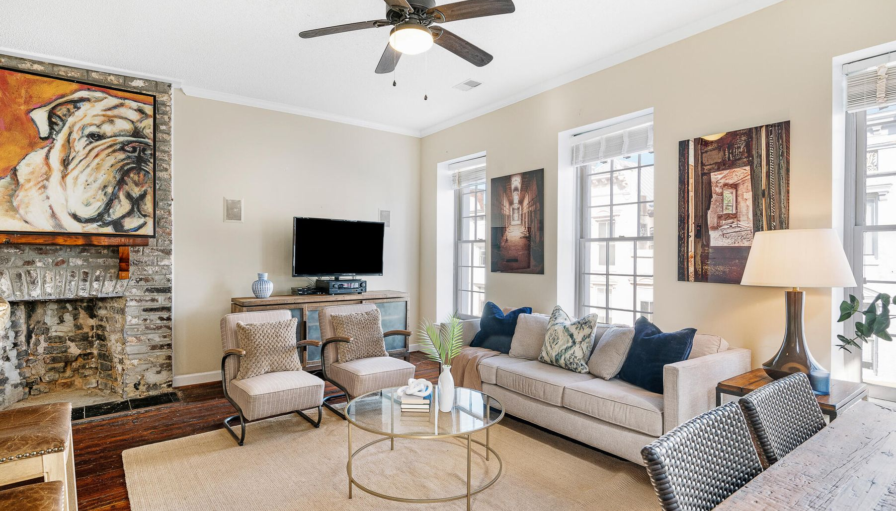
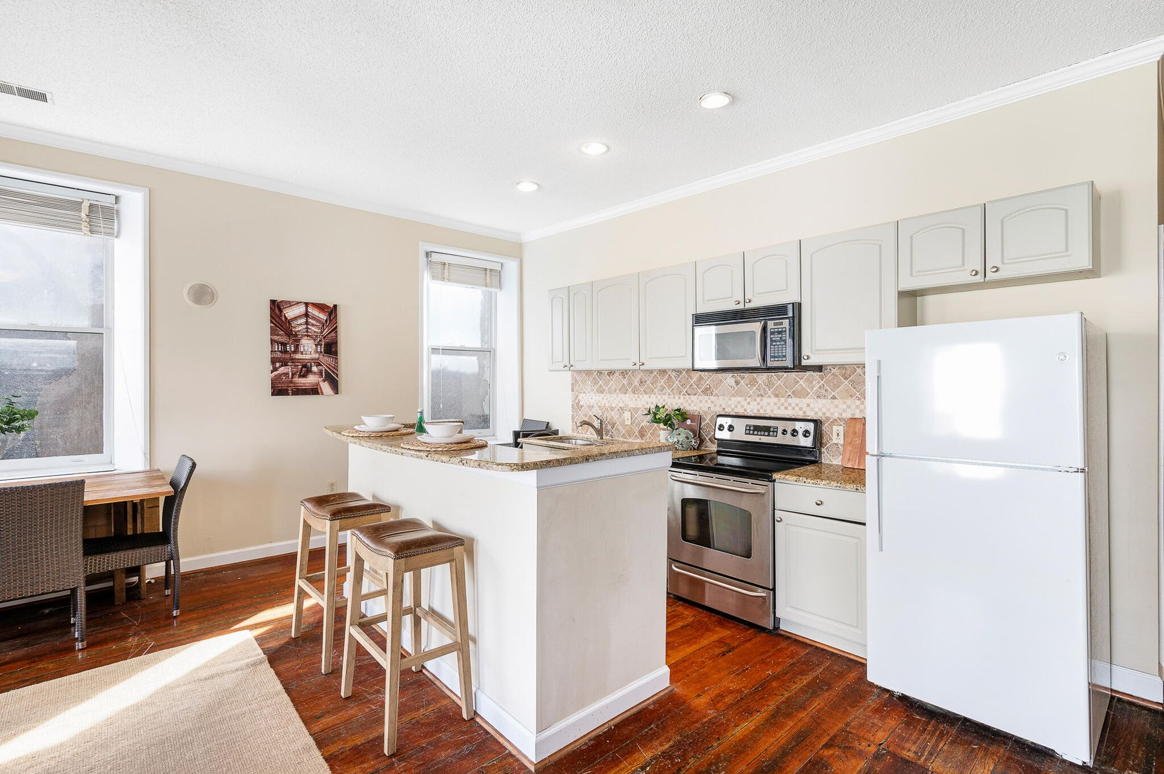
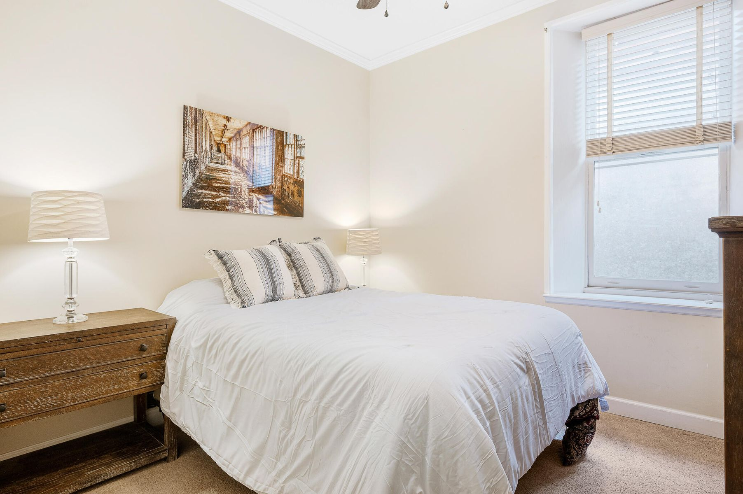
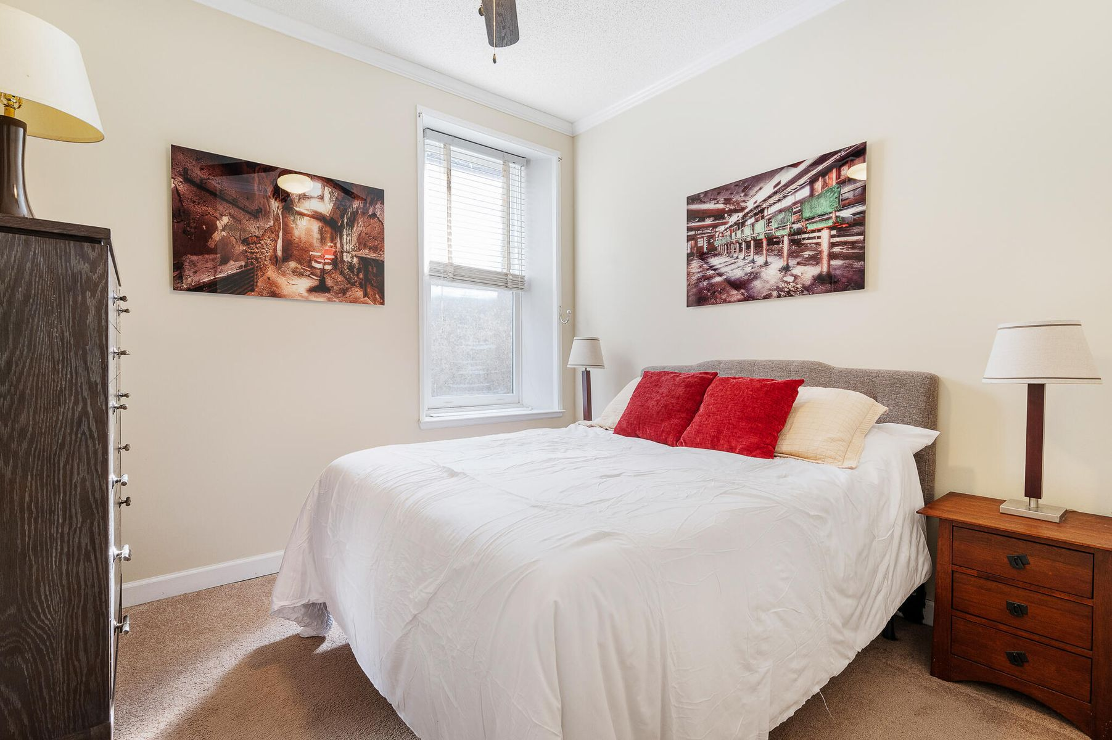
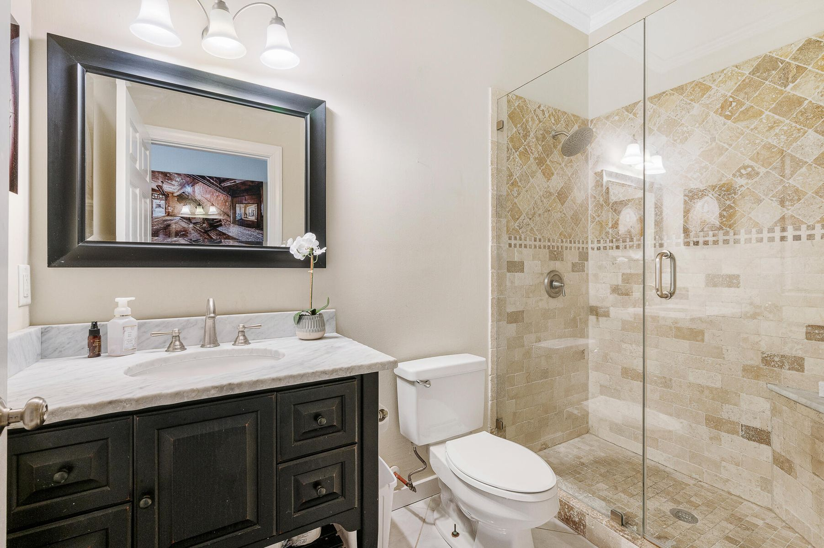
Back on Market - Show & Sell!
295 King Street B3
Charleston, SC 29401 | MLS# 24000386 | $615,000
Enjoy all of that Historic Downtown Charleston, voted Best In The U.S. for the 11th year in a row, has to offer within walking distance! This fully furnished 2 bedroom condo (with the exception of the owner's personal items & wall art/pictures), is located in the heart of Downtown Charleston. It doesn't get any better than this location providing easy access to all the award-winning fine dining, shopping, entertainment, schools, hospitals, and employment opportunities. And it is a great location for College of Charleston students! It features a renovated kitchen with stainless steel kitchen appliances, granite countertops, and ceramic tile backsplash. The bathroom has also been renovated with travertine tile and a seamless shower.
Shanel Pierce
843-779-5523 | shanel.homesales@gmail.com
Salmonsen Realty | 864 Lowcountry Blvd Ste B | Mt Pleasant, SC 29464

