Slide 1
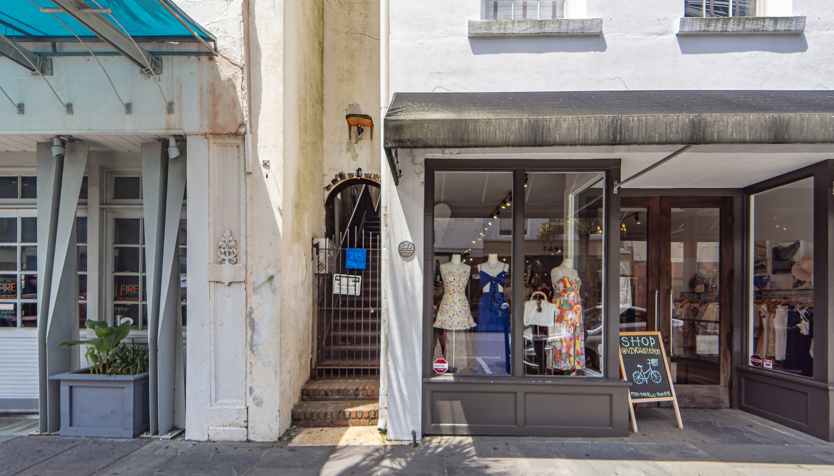
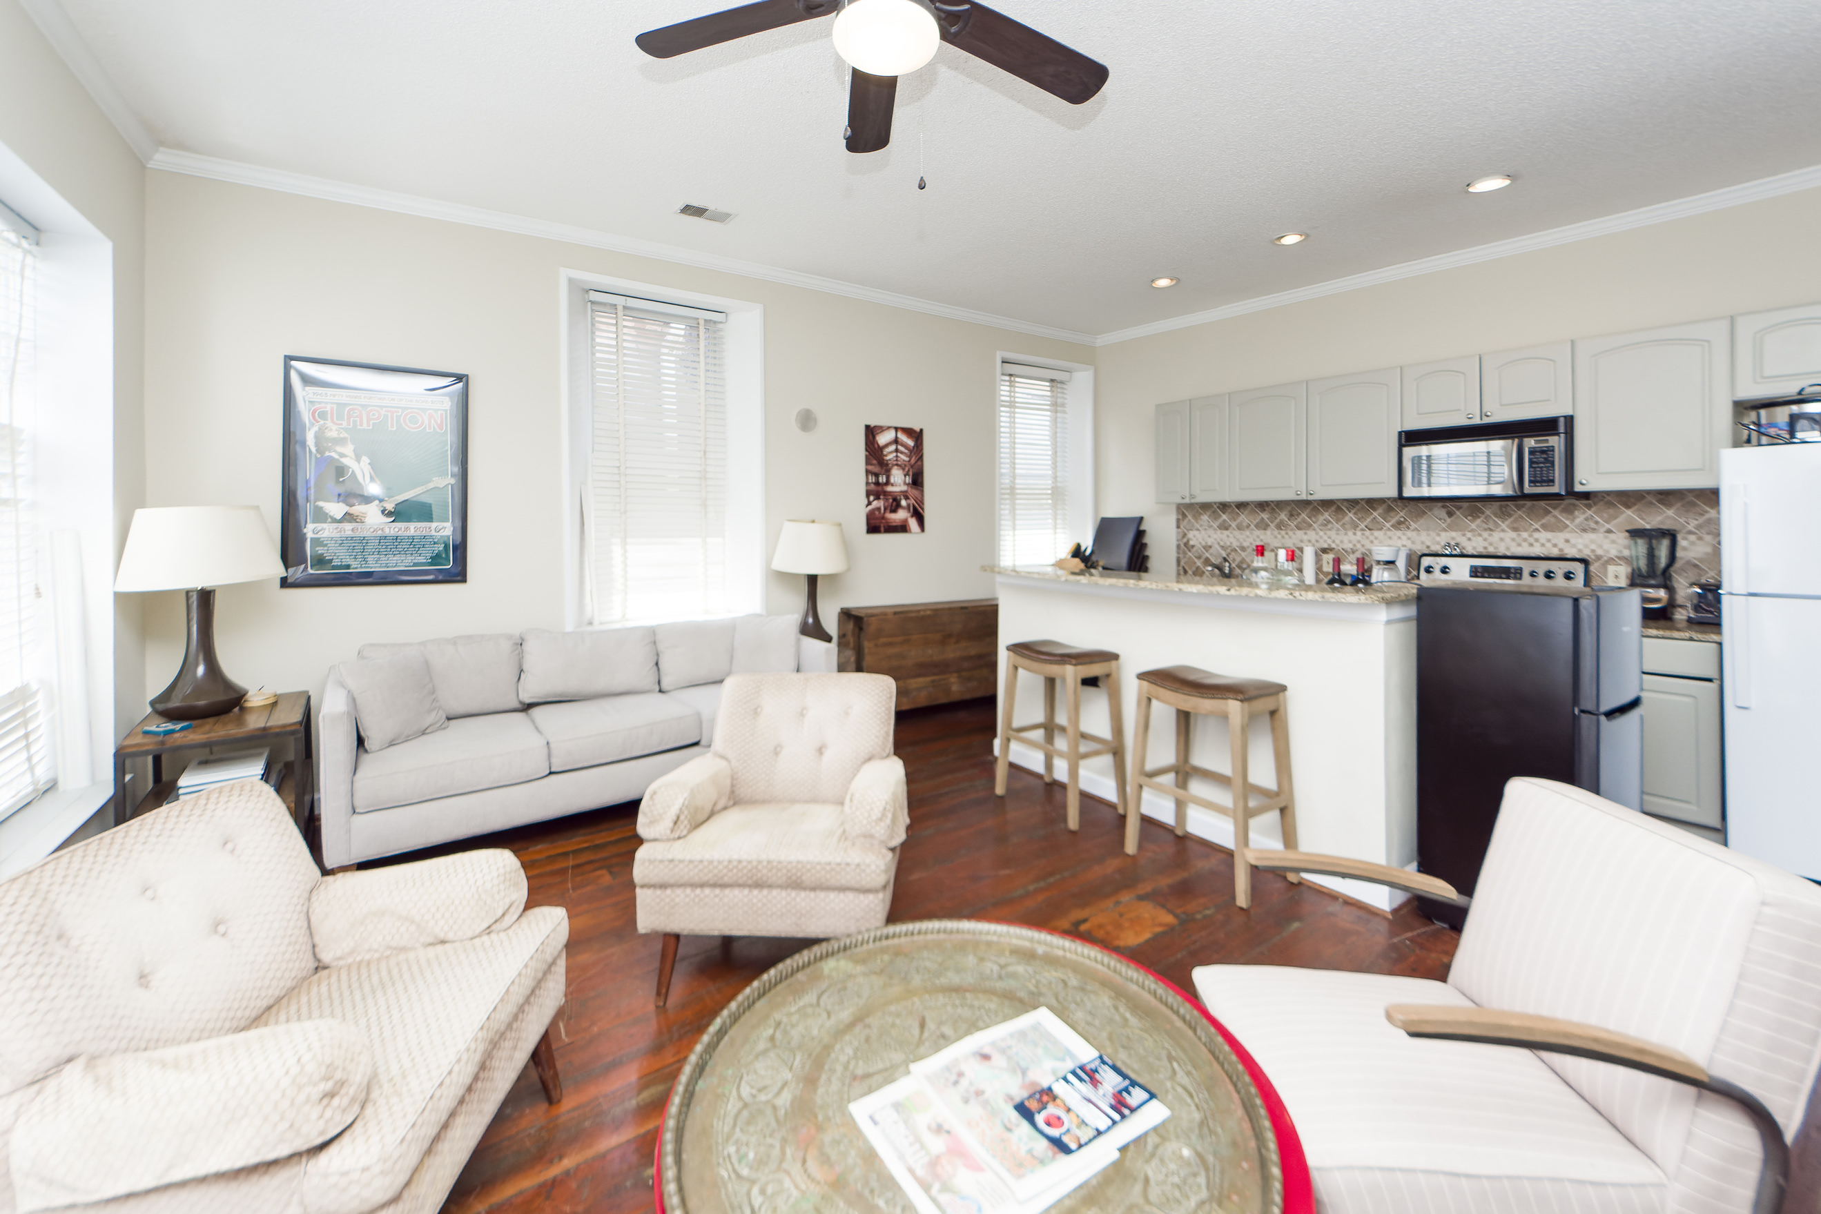
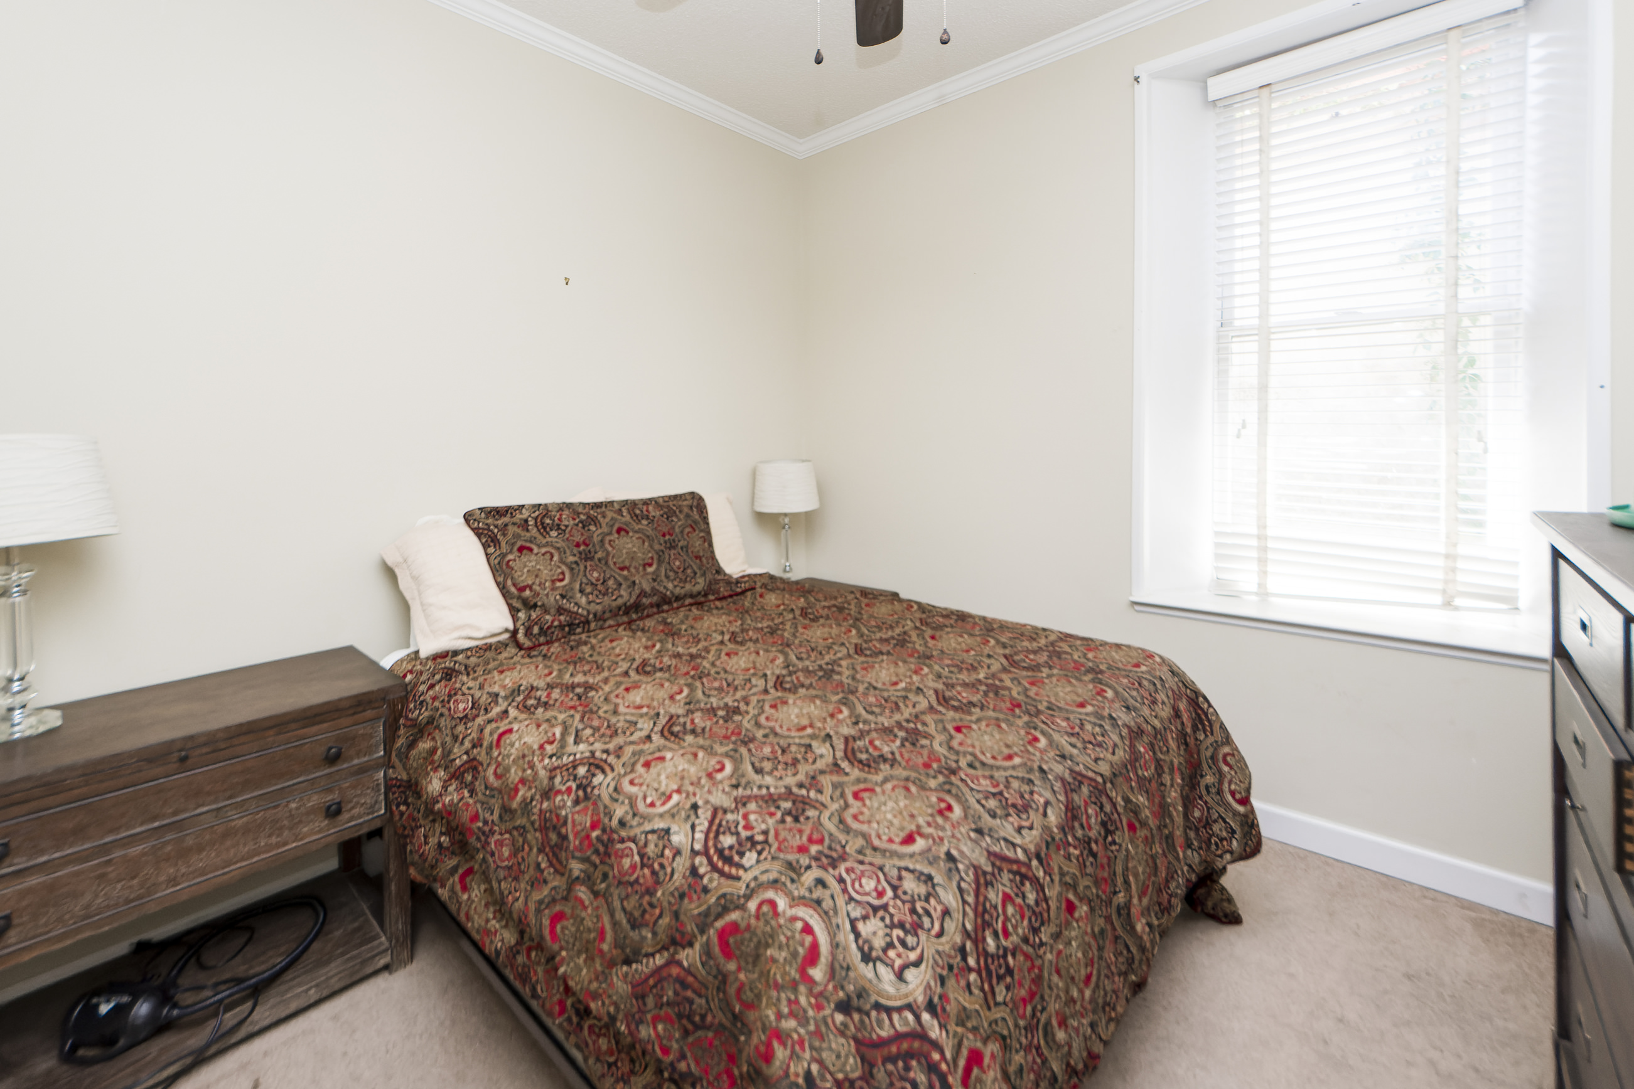
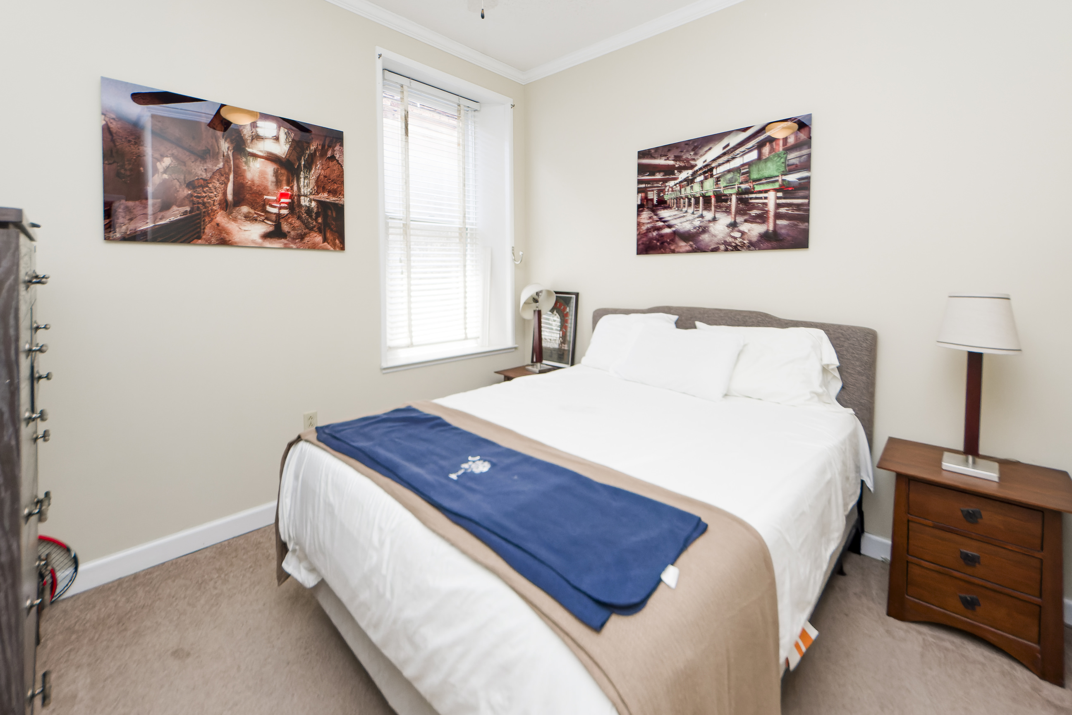
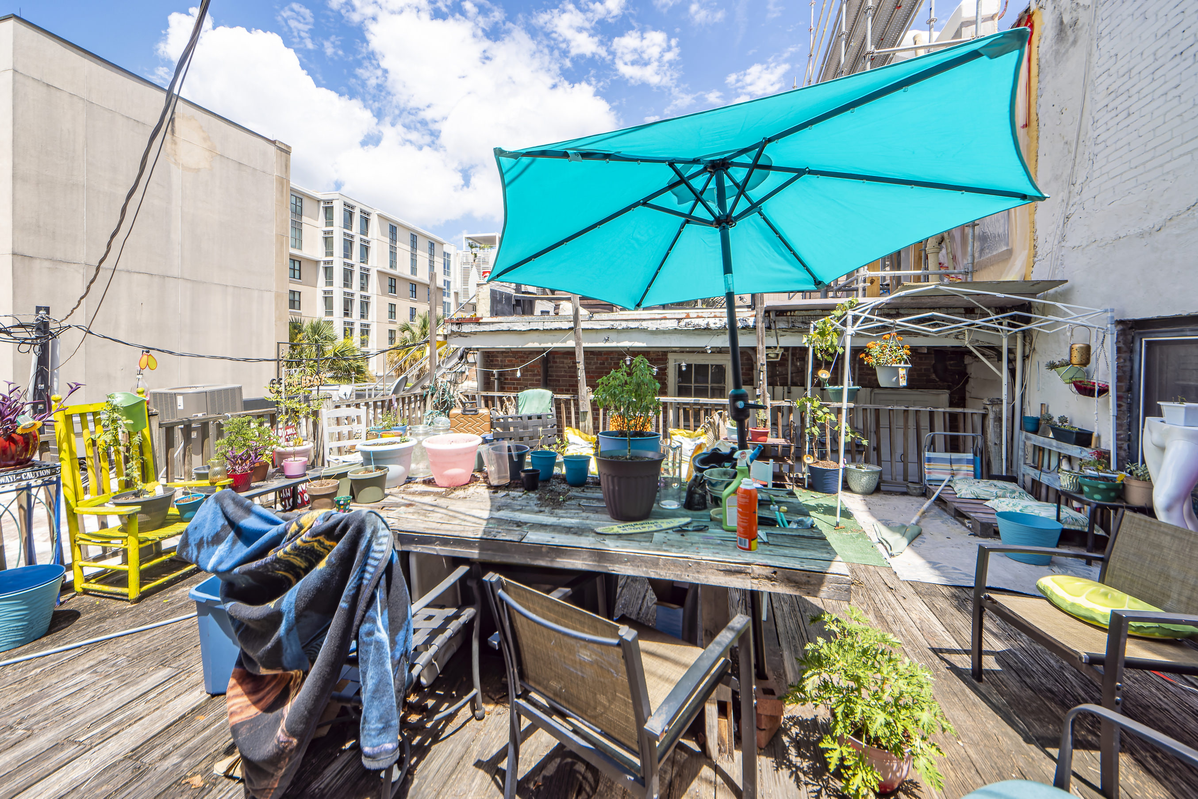
Just Listed - Show & Sell!
295 King Street B3
Downtown | Charleston, SC 29401 | MLS# 23016354 | $749,000
This 2 bedroom furnished condo (with the exception of Owner personal items & wall art/pictures), located in the heart of Downtown Charleston. Access to all fine dining, shopping, entertainment, schools, hospitals, employment, & great location for College of Charleston students. Renovated kitchen with stainless steel kitchen appliances, granite countertops, & ceramic tile backsplash, renovated bathroom.
Slideshow Tour
Charles Salmonsen
M (843) 224-0300 | O (843) 388-6613 | charles@salmonsen.com
Salmonsen Realty | 864 Lowcountry Blvd Ste B | Mt Pleasant, SC 29464

