Slide 1
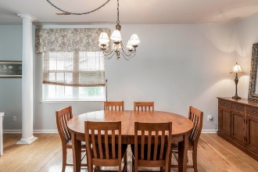
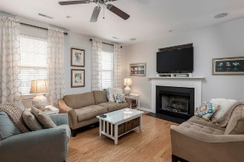
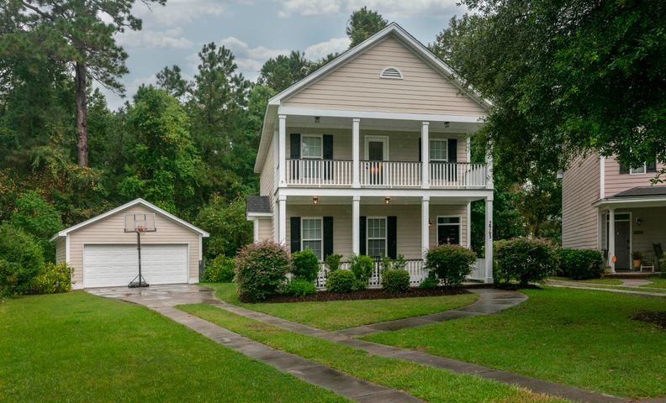
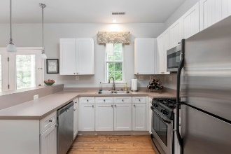
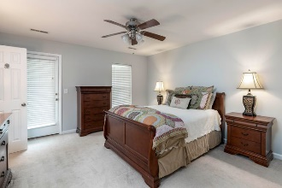
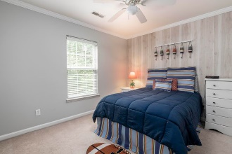
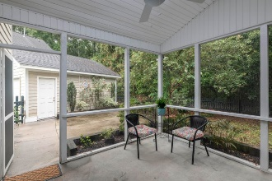


2963 Split Hickory Court
Barberry Woods · Johns Island
MLS# 20025270 · $319,900
OPEN HOUSE
Sunday, December 6th, 1-4pm
Talk about a homerun! This single family home in Barberry Woods is just over the Stono River Bridge in Johns Island. It's location is convenient, yet secluded, with a great neighborhood feel. The double front porches welcome you to your home. Upon entering, you will first notice the house has been freshly painted throughout! You are greeted by an open floor plan with hardwood floors. A gas fireplace is a nice touch to the living area and the columns add natural separation from the dining area. The dining area flows nicely into the kitchen, which has a large pantry with enough space for all your party platters, crockpots, etc. The screened back porch is ideal for entertaining and relaxing with a newly installed ceiling fan. The property is fenced and backs up to 5 acres of wooded HOA owned green space. Upstairs, you'll find all three bedrooms including a large owner's suite with private access to the full front porch that is perfect for morning calls or coffee. The secondary bedrooms and laundry is also upstairs. I didn't even yet mention the 2 car garage! This home is a must see and will not last long!
Rodney Hancock
(843) 437-1347
rodneyhancock08@gmail.com mortgageprofessionalsonline.com
AgentOwned Charleston Group
902 Savannah Hwy
Charleston, SC 29407
Real Estate ● Mortgage Insurance ● Business Brokerage

