Slide 1

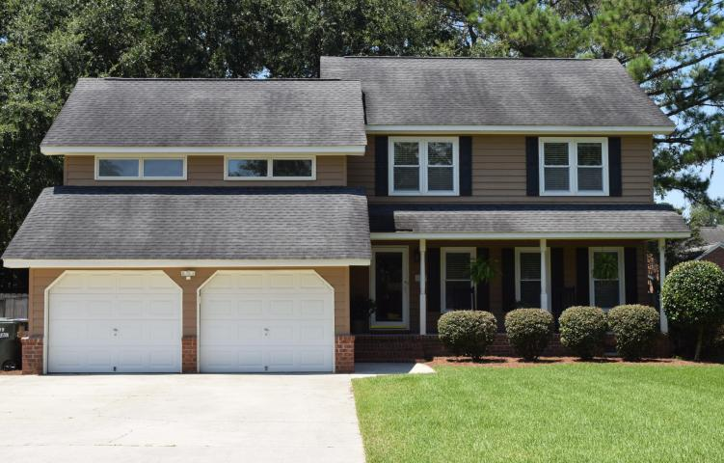
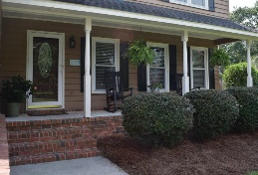
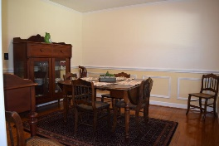
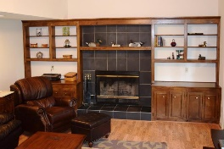
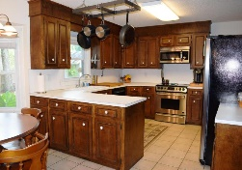
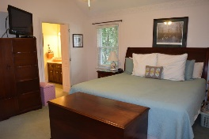
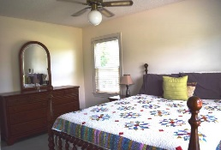
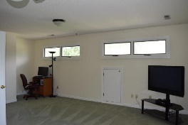
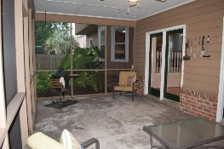
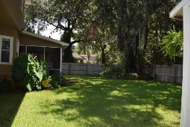
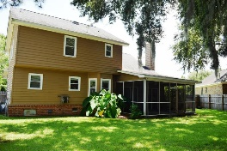


Realtor Open House & Luncheon Wednesday, August 30, 2017 ~ 11:30-1
2967 Foxhall Road
Hickory Hill Plantation • Charleston, SC 29414 • MLS# 17020435 • $297,900
Convenient and Desirable neighborhood! Close to shopping, dining, hospitals I526 and downtown. Well maintained home. New HVAC in 2013, Roof replaced in 2007. Kitchen has solid wood cabinets, stainless appliances, tile flooring eat in area has bay window overlooking large privacy fenced yard. Separate dining room with hardwood floors. Great room has wood flooring, cozy wood burning fireplace surrounded by built in bookshelves. Double french doors from great room lead to a large screened in porch where you can enjoy the serene trickling water from water fall pond in backyard. Master bedroom has large walk in closet and master bath. 2 more spacious bedrooms plus large FROG could be man cave or extra bedroom. The spacious 2 car garage has room for cars and workbench and lots of storage plus driveway has extra concrete pad to store boat or RV. Minimal HOA. So YES you can keep your boat or RV close to you!
Christina Garvin
(843) 270-7667 | cgarvin63@gmail.com
Elaine Brabham and Associates, LLC • 1890 Sam Rittenberg Boulevard, Suite 217 • Charleston, SC 29407

