Slide 1
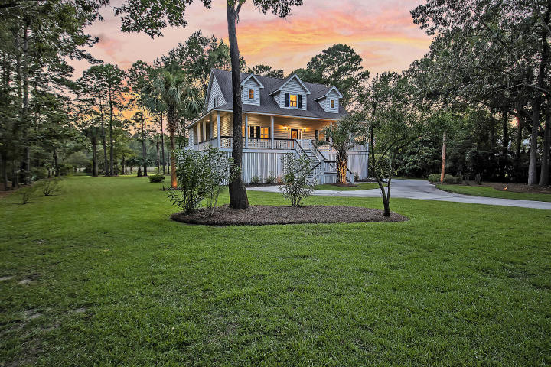



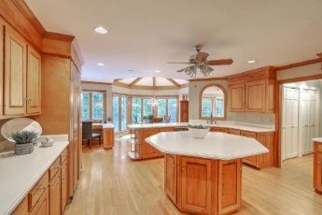
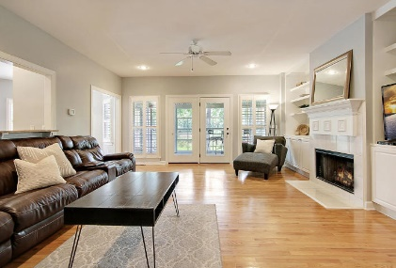



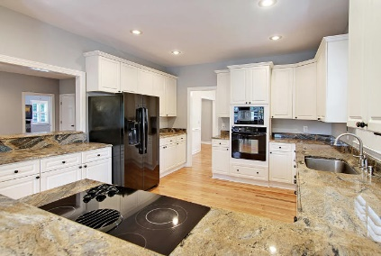

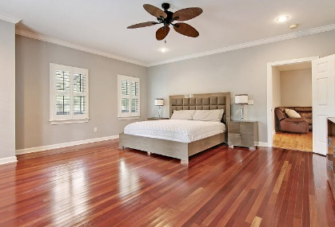
Parkshore Marshfront
$25K Price Reduction!
Motivated Seller!
2970 Pignatelli Crescent
Dunes West ~ Mount Pleasant, SC 29466 ~ MLS# 20021476 ~ $674,999
Backing to the marsh with a gigantic backyard in Dunes West, this stunning custom elevated home is move-in ready and offers amazing outdoor living spaces. Deeply set back on the lot with a long driveway and tropical landscaping, you're greeted by an inviting wrap-around front porch. Inside gleaming hardwood floors lead into the spacious living room with its fireplace and built-ins, chair rail molding in the dining room and the kitchen that boasts granite counters, breakfast bar seating and a bay window at the eat-in area. The master suite has tremendous space to spread out, a walk-in closet and en-suite bath with dual vanity, jetted tub and walk-in shower with built-in seating. The four seasons room overlooks the marsh and is highlight of the home. Don't miss out on this home!
Additional features include:
Three bedrooms and a full bath on the upper level
Fenced-in backyard
Deck
Dog washing area, bar area and workshop in the garage
Fresh paint
New fence
Gated community offers golf, pools, tennis center, club house, fitness center and walking trails
Close to shopping, dining, schools, area beaches, and Downtown Charleston
Book your showing today!
Nate Gainey 843-513-2038
nate@mattoneillteam.com
Christopher Smith 843-267-0735
christopher@mattoneillteam.com

