Slide 1
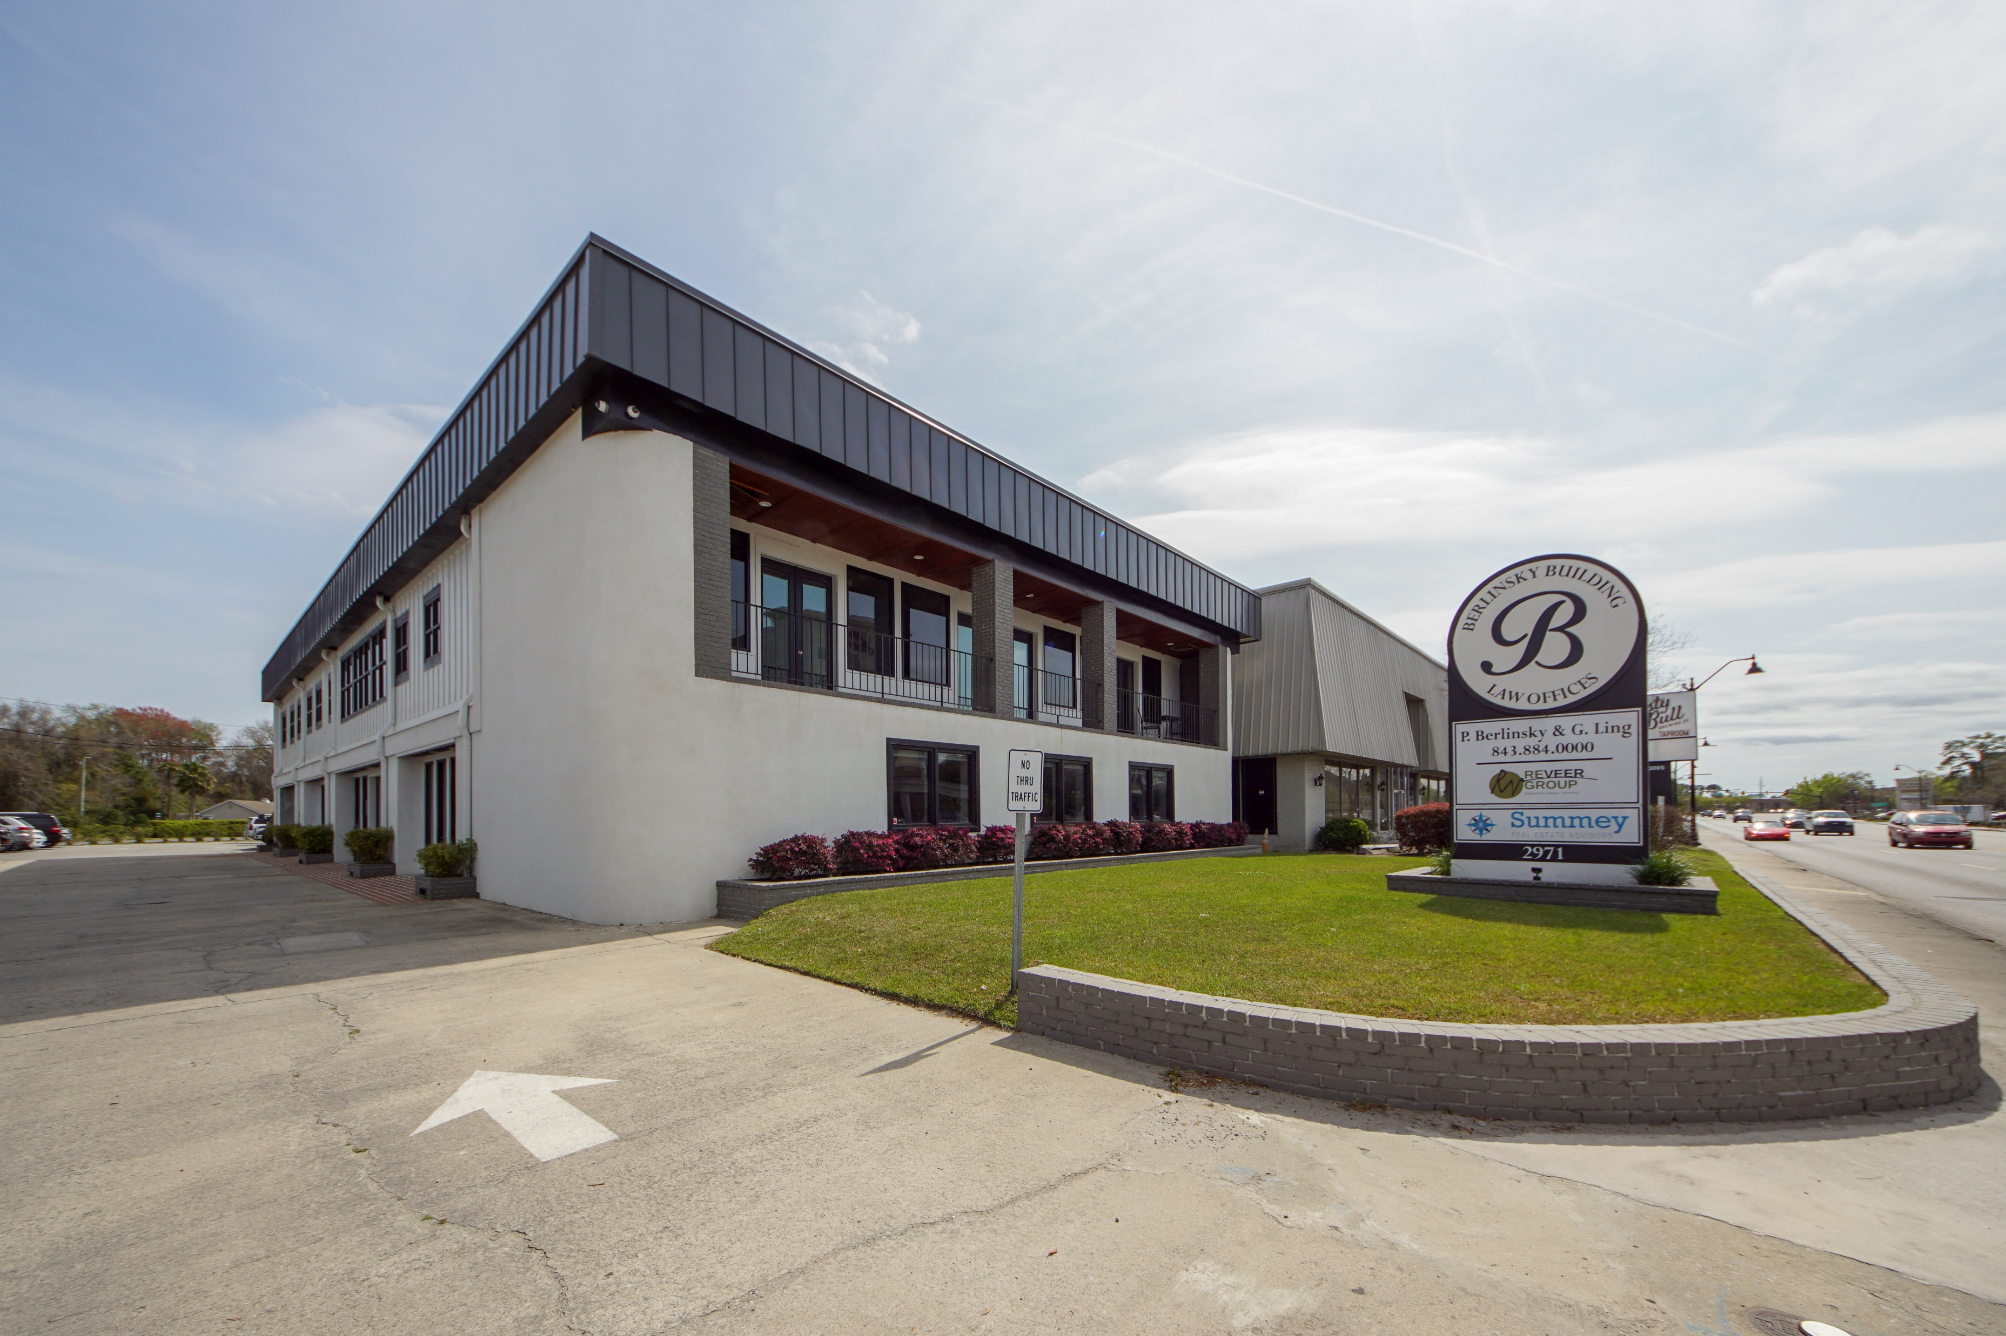
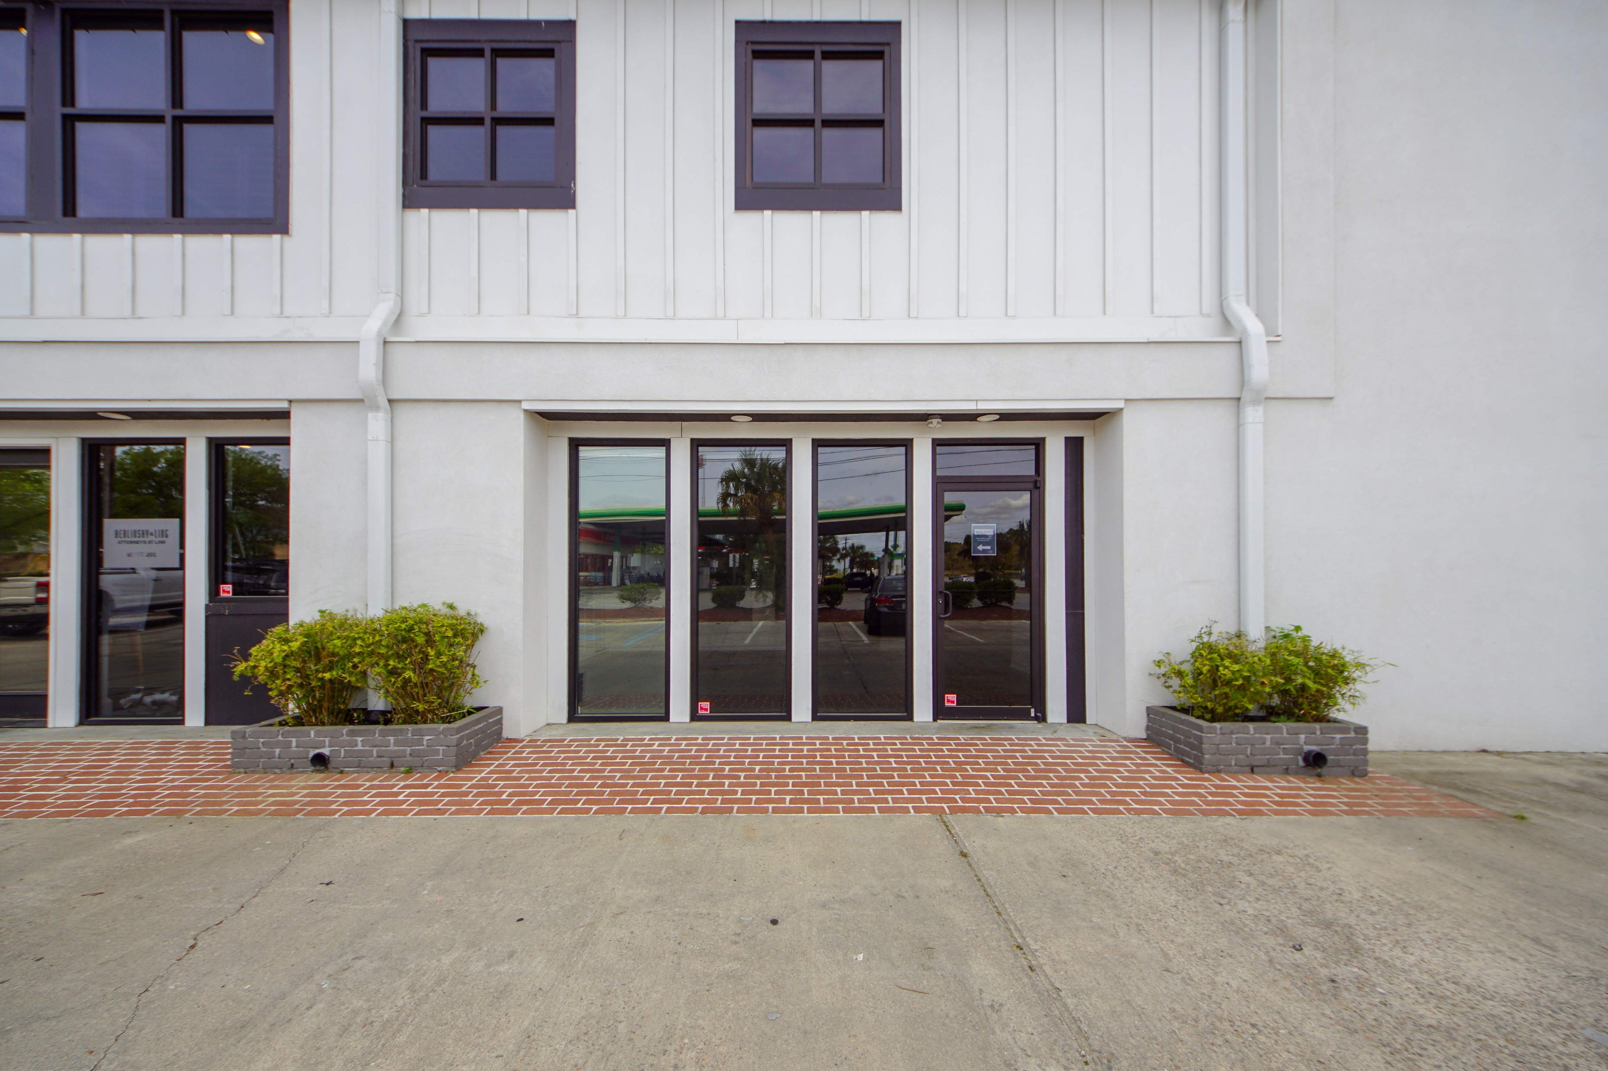
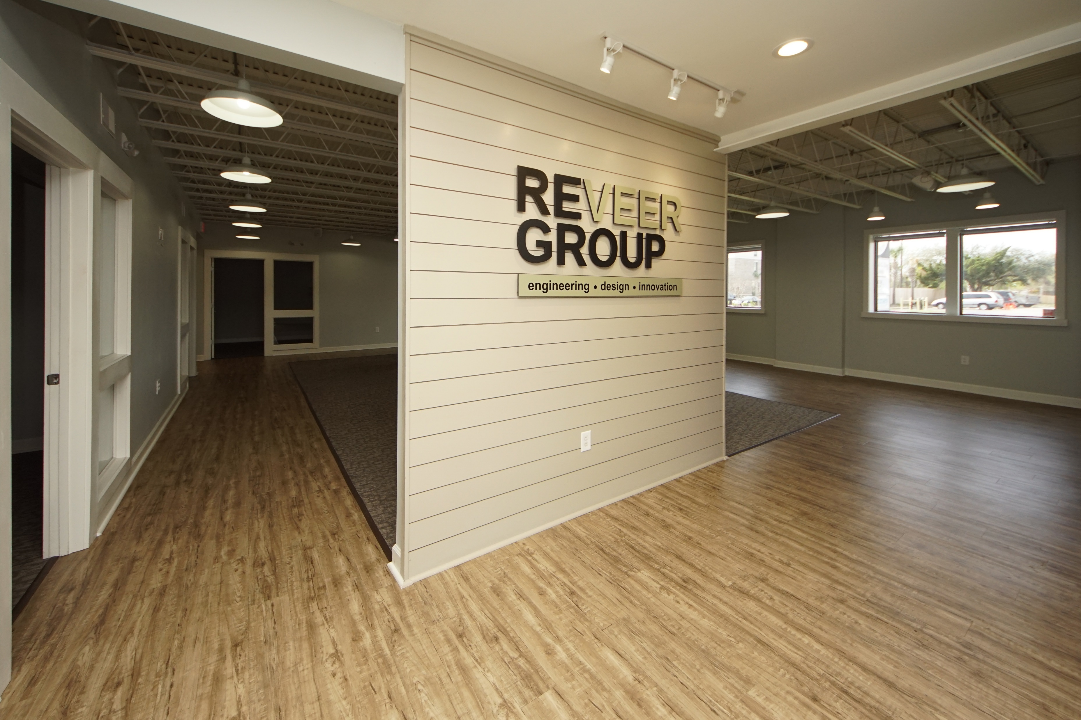
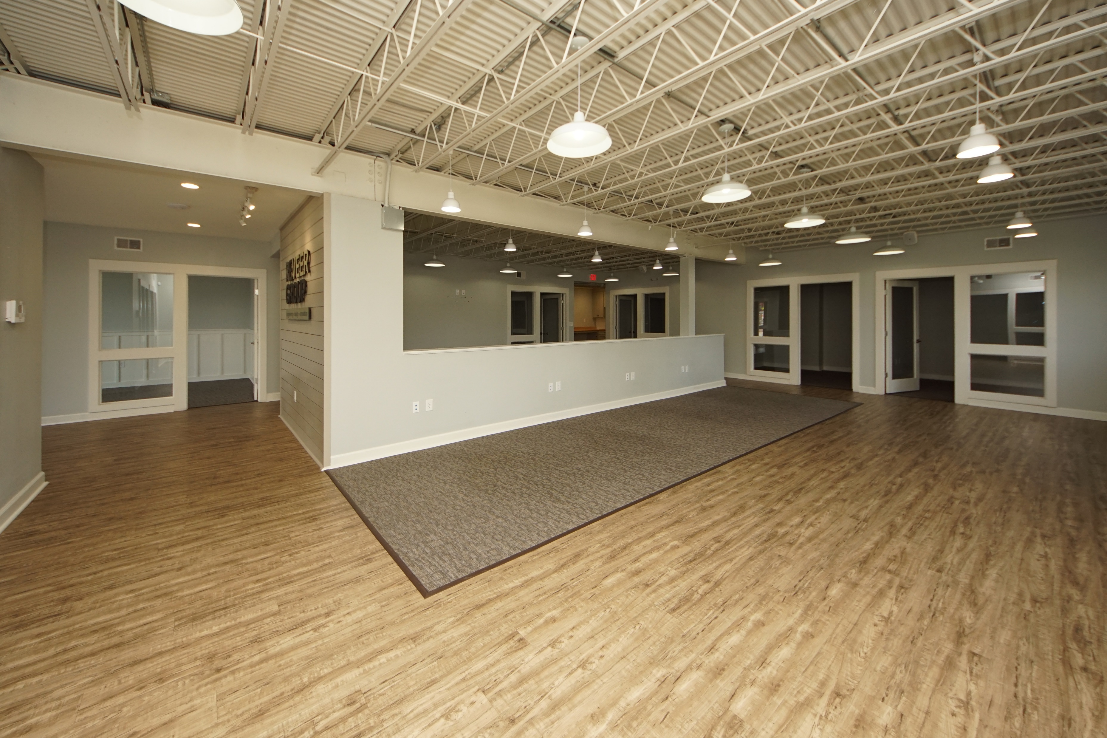
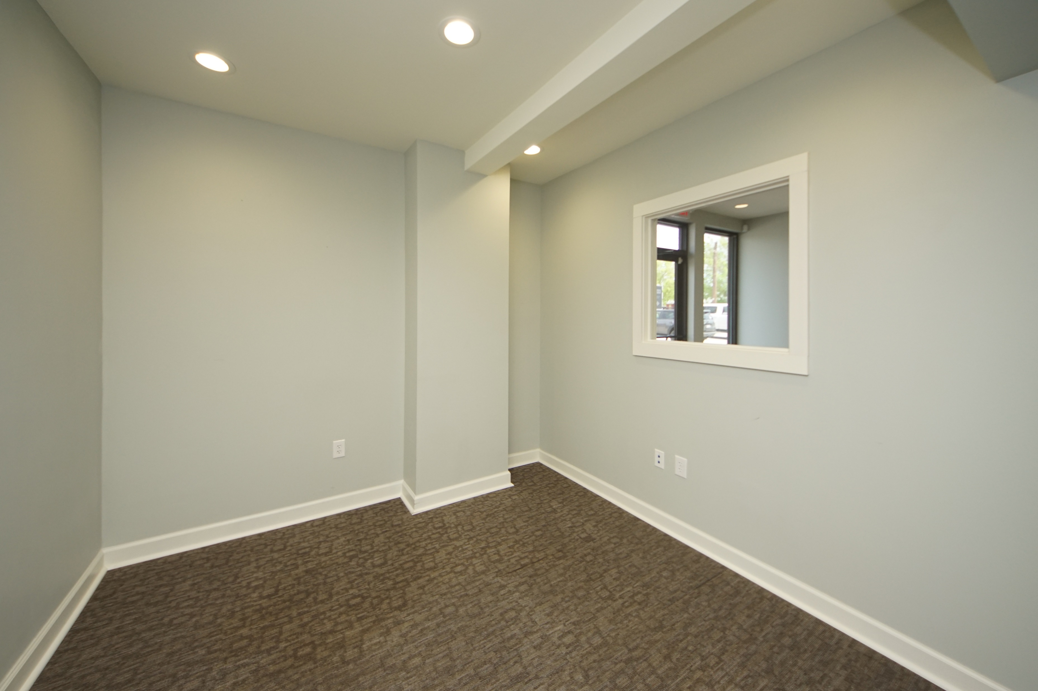
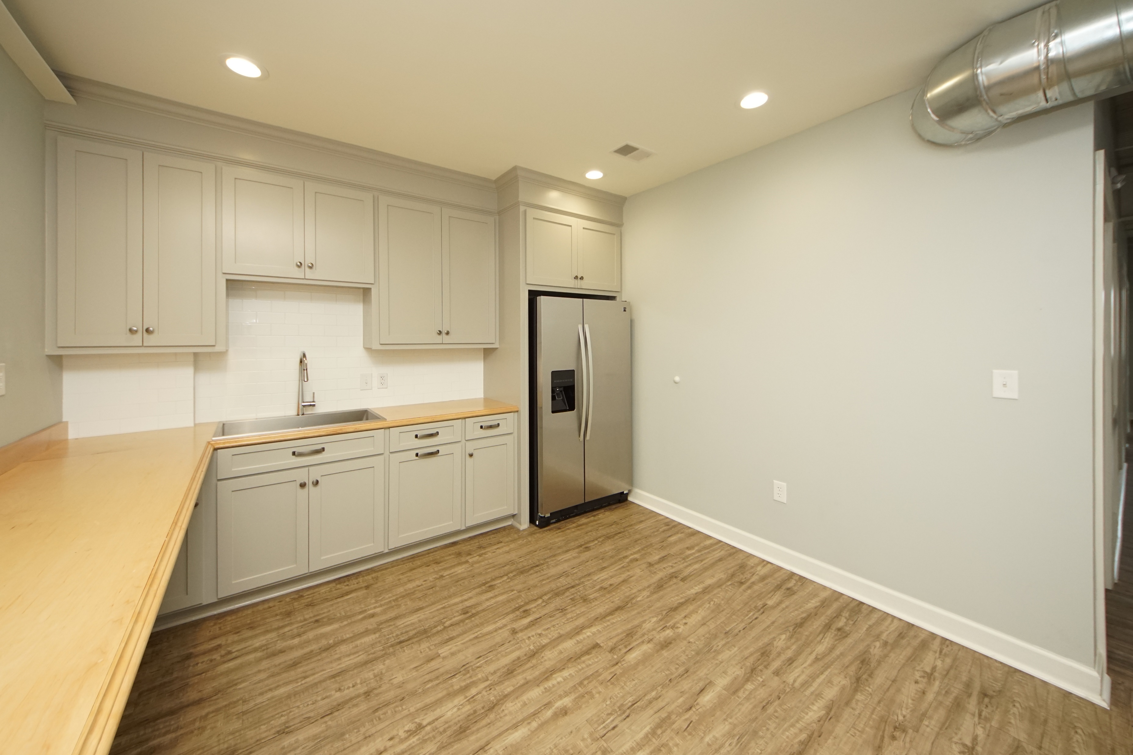
Commercial Property For Lease
High Traffic Area ~ Easy Access to I-26
2971 W Montague Ave
North Charleston, SC, 29418
MLS #30394194 | $5,000/Mo
Renovated building, unit consists of 7 individual office spaces with conference room, kitchen & break room, over 1000 sqft space for mixed space, & his & her bathrooms. Great location in the heart of North Charleston near Boeing, City Hall, Tanger Outlet, & has plentiful parking. $5, 000 per month includes taxes & building insurance. Electric & water/sewer are not included. Tenant must purchase own content insurance & provide proof. Unit is approximately 2700 sqft as per Landlord. Landlord is looking for 3-10 year lease.
Charles Salmonsen
M (843) 224-0300 | O (843) 388-6613 | charles@salmonsen.com
Salmonsen Realty | 864 Lowcountry Blvd Ste B | Mt Pleasant, SC 29464

