Slide 1
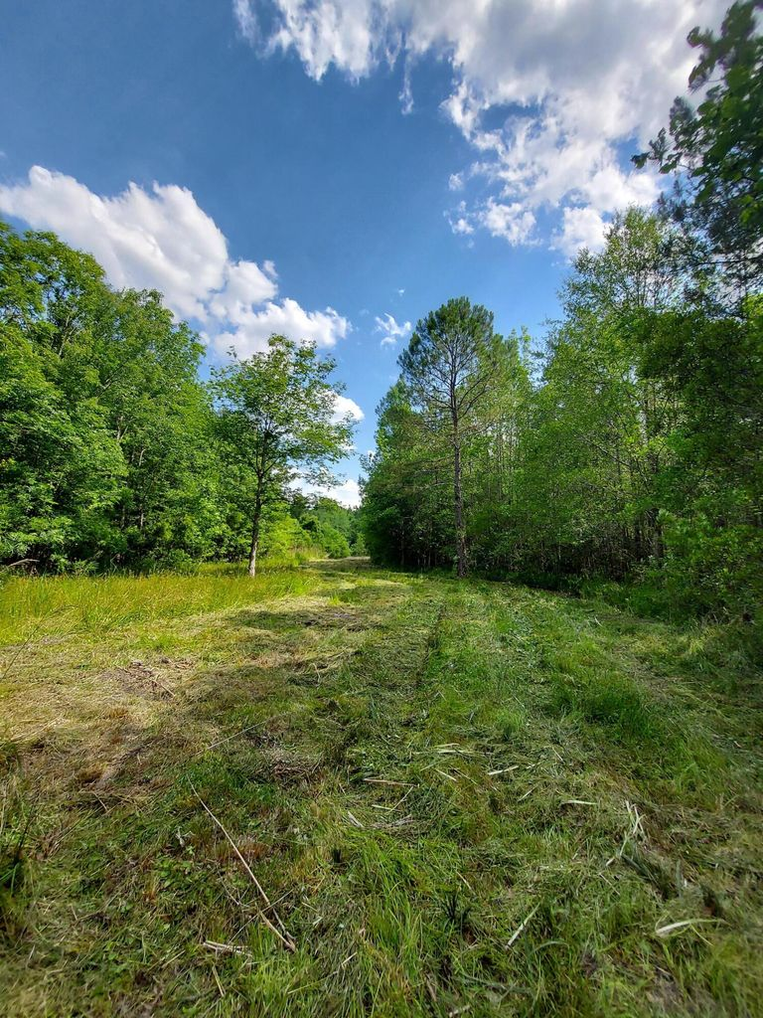
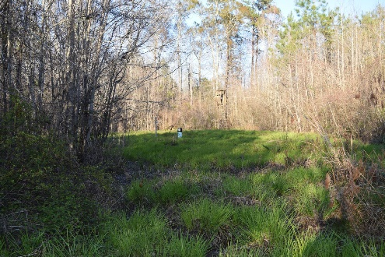
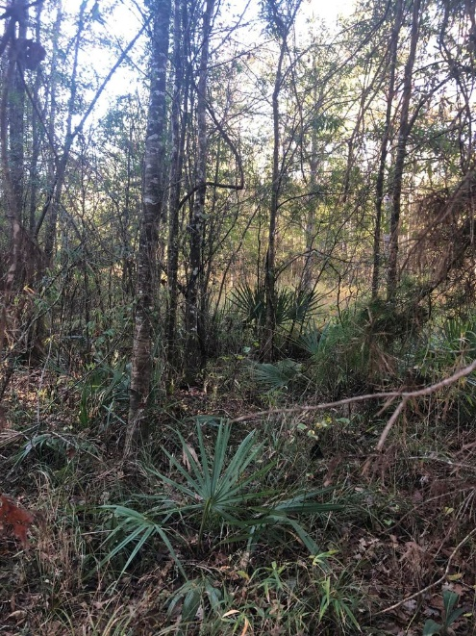
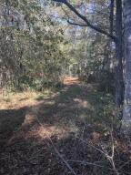
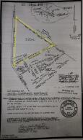


2973 Rhode Drive
Cottageville | MLS# 22029711 | $90,000
HUNTER’S PARADISE
Welcome to your 9.2 acres of serenity! This property is an open canvas to make it what you have been dreaming of! Build your dream home with seclusion, have farm animals, go off roading on your four wheeler, side by side, go carts or dirt bikes. Dig a pond for fishing! Want to go fishing or float in the Edisto River? There are a couple of boat landings within minutes. Set a tree stand for hunting! Plant fields for farming. NO HOA, Manufactured/Mobile Homes ok! Do ALL of the above, it's all possible here and still be within 25 minutes to Summerville. Have the peace and quiet of the country but not too far away from civilization.
Kelly Rozier
(843) 209-3129
kellywrozier@gmail.com
Brand Name Real Estate
4 Carriage Lane Suite 106
Charleston, SC 29407

