Slide 1
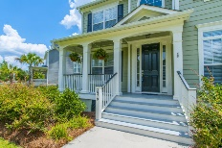
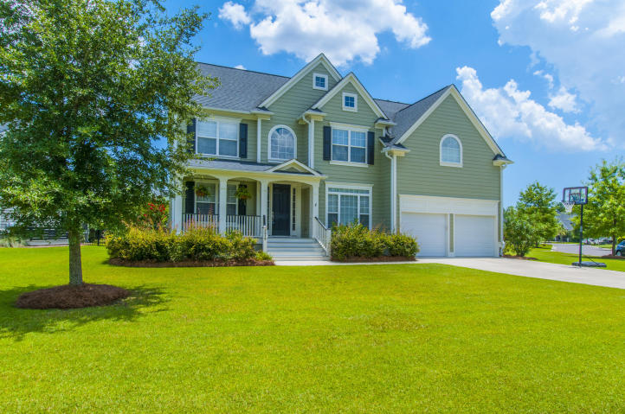
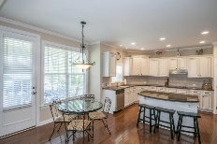
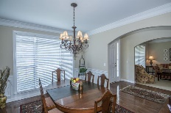
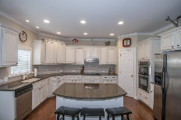
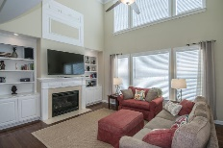
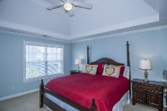
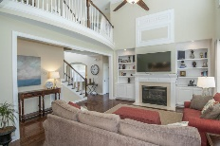
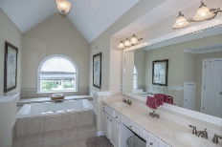
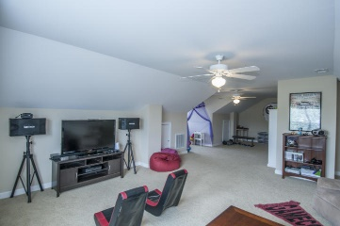
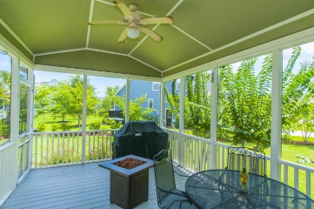
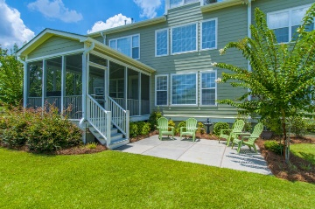
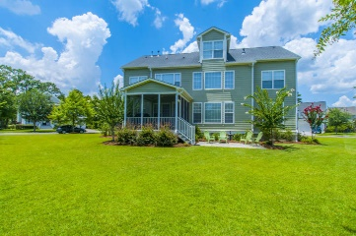


2979 Riverwood Drive
Mount Pleasant, SC 29466 ~ MLS# 16018780 ~ $589,000
Best value in Marsh Cove. Move in ready Don't miss it!
$50,000 Price Reduction
This beautiful bright and spacious home is a sure bet and a tremendous value! With a freshly painted exterior and a carefully manicured lawn this home boasts great curb appeal! Inside has also been well maintained and offers a very open floor plan featuring hardwood flooring throughout the foyer, dining room, family room and kitchen. Light floods the 2 story foyer and offers a balcony view of the second story. Your formal dining and living room/office flank the foyer on both sides and lead you directly into the vaulted great room with expansive ceilings featuring dual exposed banisters, balcony and built-in bookshelves on both sides of the fireplace. The eat in kitchen has room for a table as well as additional seating at the island. The kitchen also boasts granite countertops, stainless steel appliances, and upgraded cabinets. Also perfect for guests or a live in extended family member is a first floor bedroom with adjoining full bath. The second floor offers the laundry, 3 secondary bedrooms and a large master suite. 2 of the bedrooms share a jack and jill bath. The master retreat has a sitting area, vaulted tray ceiling, and dual closets. The en suite also features a vaulted ceiling, large walk in shower, separate jacuzzi tub, and an oversized dual vanity. Continuing up to the third floor you will find what could be the 6th bedroom with adjoining full bath. This spacious room is also a perfect teen hangout, play room, media room or rec area. This home has a space for everyone in the family at an exceptional price. The backyard has been landscaped for privacy and is great for taking the entertaining outside. Enjoy casual time together on your oversized screened porch and patio. Don't miss your chance to see this move in ready home for yourself! Dunes West is a gated golf community offering many amenities including golf and athletic memberships, pools, clubhouses, tennis courts, play parks, boat storage, and a boat/kayak ramp at the back of the neighborhood. Marsh Cove is convenient to both the front and rear gates for quick access to shopping, dining, schools, and parks. You are also only 30 min. to downtown Charleston and 20 min. to the beach! Come make this home your own and enjoy the best that Mt. Pleasant has to offer!
Additional items to note: home has security system, irrigation system, and is smoke and pet free.
Melodie Smith
(843) 408-5067 M
melodie.smith@carolinaone.com
www.melodiesmithrealestate.com

