Slide 1
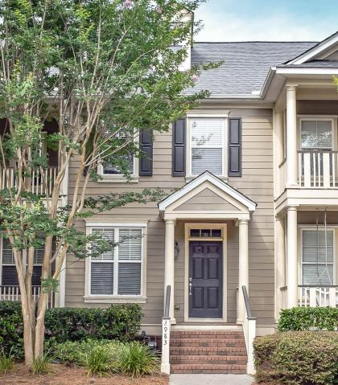
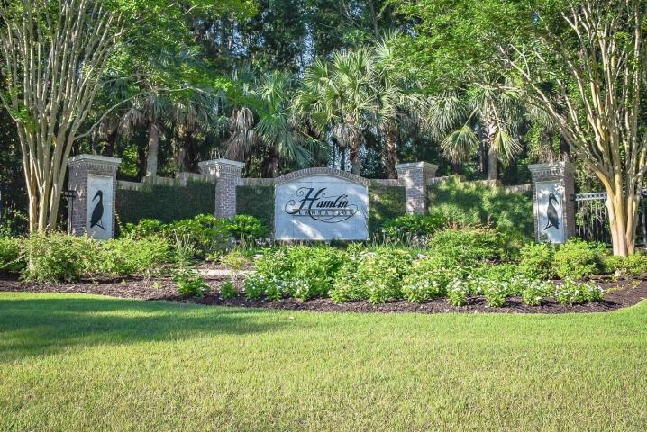
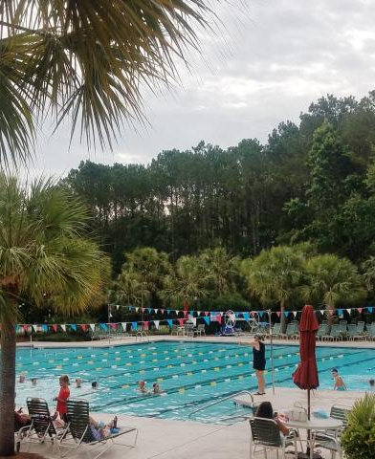
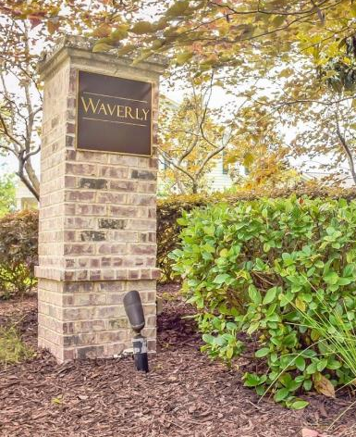
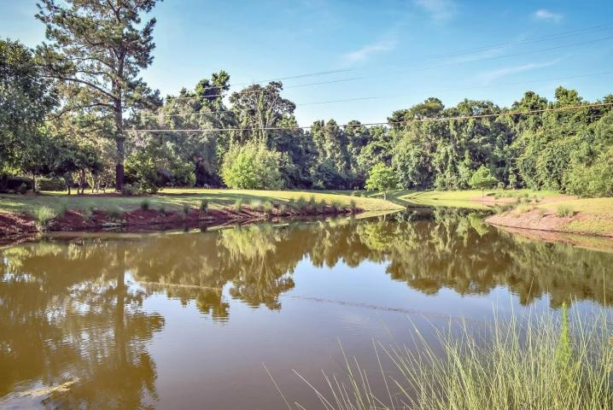
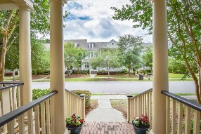
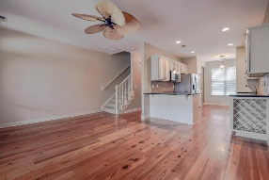
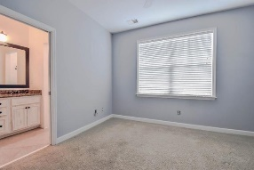
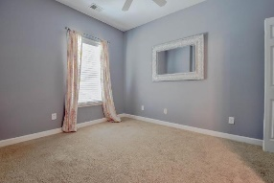
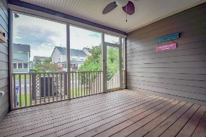
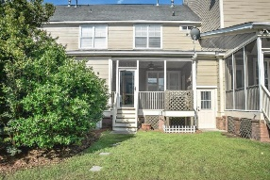


See why this one is not like the others...
2983 Treadwell Street
Hamlin Plantation | Mount Pleasant | MLS# 17017115 | $258,500
This beautiful townhome has been freshly painted and is full of UPGRADES.
Heart of Pine floors from the Old Cigar Factory, custom cabinetry, built in wine rack, granite countertops, under-mount sink, stainless appliances, high-end palm leaf ceiling fan, 9’ ceilings, frieze carpet and all of the wonderful amenities that Hamlin Plantation has to offer. Pool, tennis, workout facilities, walking trails and more. Spend less time working in the yard and more time enjoying this amazing community. Minutes to the beach, shopping and downtown. This unit truly stands out from the others in the neighborhood and won’t last long.
Welcome home to 2983 Treadwell St! Thank you.
Whitley Boyd
(843) 324-4761
w.boyd@agentowned.com
www.PropertiesofCHS.com
AgentOwned Preferred Group | 824 Johnnie Dodds Blvd | Mt Pleasant, SC 29464

