Slide 1
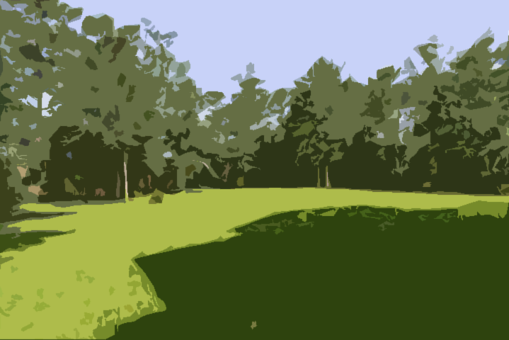
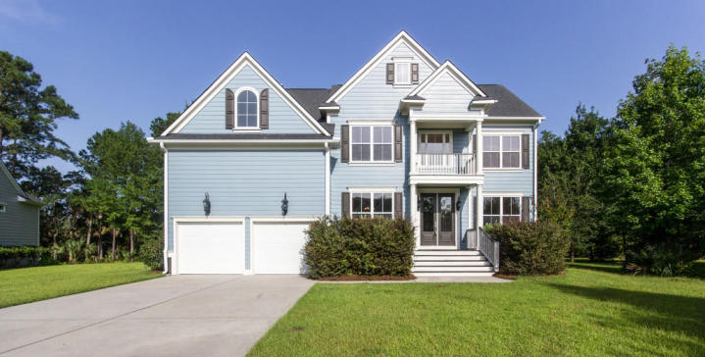
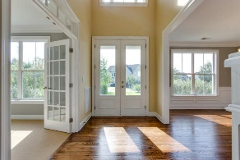
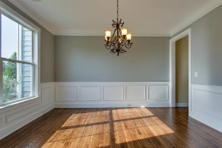
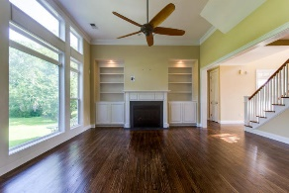
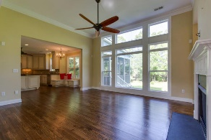
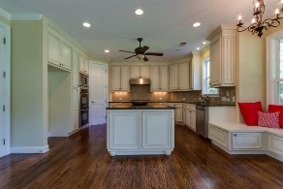
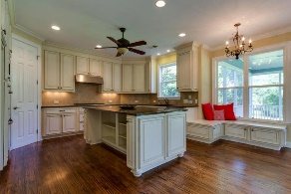
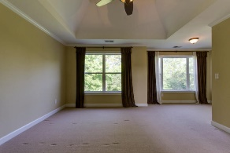
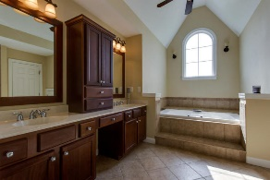
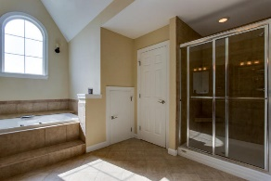
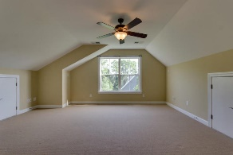
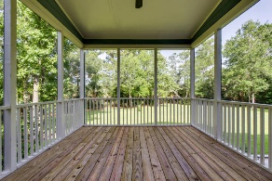
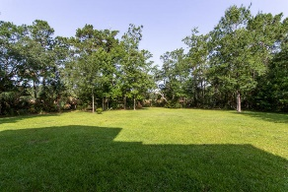

2984 Riverwood Drive Mt Pleasant, SC 29466 MLS# 17018708 $679,000
Dunes West Open House
Sunday 7/16 from 1-3pm
Immaculate 6BR/5BA home is situated on a large, private lot backing up to a tidal-marsh. Main level features high ceilings and an open floorplan with upgraded trim to include a private study, formal dining and a guest suite with French doors to backyard. The family room boasts floor-to-ceiling windows for amazing views of oak and palm trees. The gourmet kitchen features granite countertops, an oversized island, 6 burner gas stove, dual ovens and a large pantry. Second floor has a bonus room, master retreat with sitting area and trey ceilings. Master bath has separate tub/shower, dual vanity with lots of cabinets and 2 walk-in closets. There are 3 guest rooms on the 2nd floor. The 3rd floor has a large bedroom, full bath, and a separate living area perfect for a teen or in-law suite.
In addition to tons of storage (even in the garage), other upgrades include surround-sound and outdoor wiring, irrigation and beautiful hardwoods throughout the main floor living area. There is also a spacious screened porch in the back for enjoying the fabulous marsh views.. Dunes West, a gated community, offers state leading public schools, golf and fitness memberships as well as a boat ramp, and a zero-entry pool with water slide and much more.
Sue Campbell
(843) 864-3471
smcampbell0709@gmail.com
www.movewithsue.com
Coldwell Banker Residential Brokerage
4969 Centre Pointe Dr
Suite 203
Charleston, SC 29418

