Slide 1
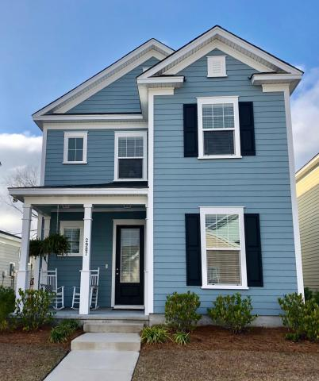
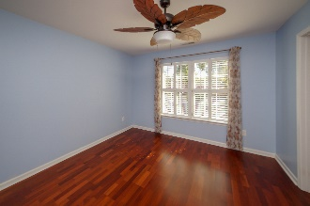
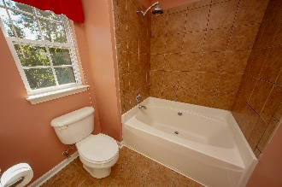
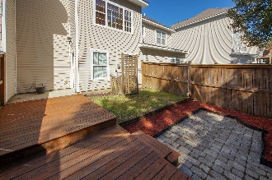
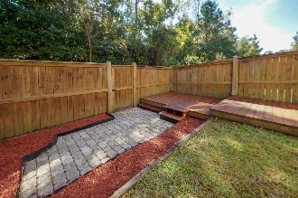
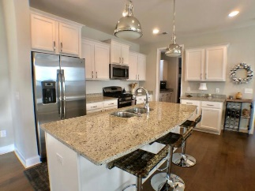
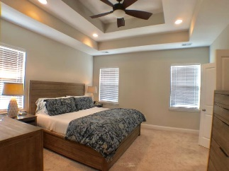
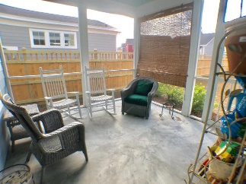
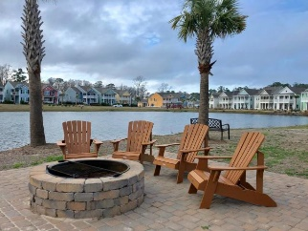
MOTIVATED SELLERS
2987 Sweetleaf Lane
Whitney Lake | Johns Island, SC 29455 | MLS# 19004466 | $344,900
This beautiful custom home, built by the award-winning Sabal Homes, honored in 2016 as Best in America Living Awards, is move-in ready with all the extras and comforts of life. Located on scenic Johns Island in Johnson Pointe at Whitney Lake this beautiful community is built around freshwater ponds, offering lakeside trails, broad grassy parks, and a waterfront fire pit to gather with friends or to simply relax by the water's edge and read a book. When you're surrounded by such natural beauty it is easy to forget that you are only 10 miles from the heart of the Charleston, 20 minutes from the airport and a short drive to beaches. Steps away from your front door is a great view of Whitney Lake, but the true heartbeat of this home comes when you walk into the beautiful ope and great room. Entertain your family or guests in this fabulous area or in the dining room connected by a butler's pantry, a great place to store all those extra plates and glasses for gatherings. High-end features & finishes abound in this great room including gorgeous hardwood flooring throughout the first-floor living space, granite countertops, stainless appliances, custom cabinetry with custom hardware and the kitchen lighting is all upgraded, and off the living room area is a half bath. The white tiled backsplash standouts and is a work of art! Off the kitchen is a small niche for a computer work station and a screened-in back patio leading out to the fully custom fenced-in back yard for extra privacy and is one of the few yards in this subdivision that still has trees for extra shade as you enjoyed your free time in your hammock!
The Anderson model offers a 2-story foyer and open floor plan on the first floor, and the second floor has a large loft for extra playroom space or an office. The oversized 2nd floor owner's suite offers plenty of closet space, dual sinks & a generous 5' walk-in shower. Two well-sized bedrooms, ceiling fans, custom blinds and a bathroom down the hall. Bonus for this floor plan is you'll find the laundry room is conveniently located on the second level, no more up and down carrying heavy laundry baskets.
Additionally, this home is low maintenance as lawn care, OUTSIDE of the fenced area, are included in the HOA fee.
Susan Day
homes@charlestonbyday.com | (843) 900-0477 | www.charlestonbyday.com
Brand Name Real Estate | 4 Carriage Lane, Suite 106 | Charleston, SC 29407

