Slide 1
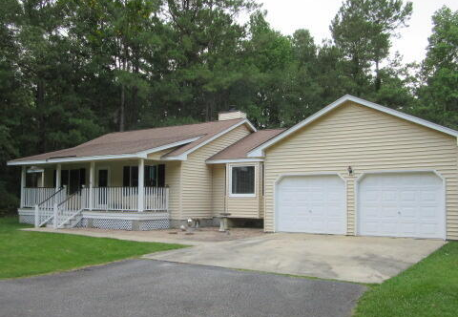
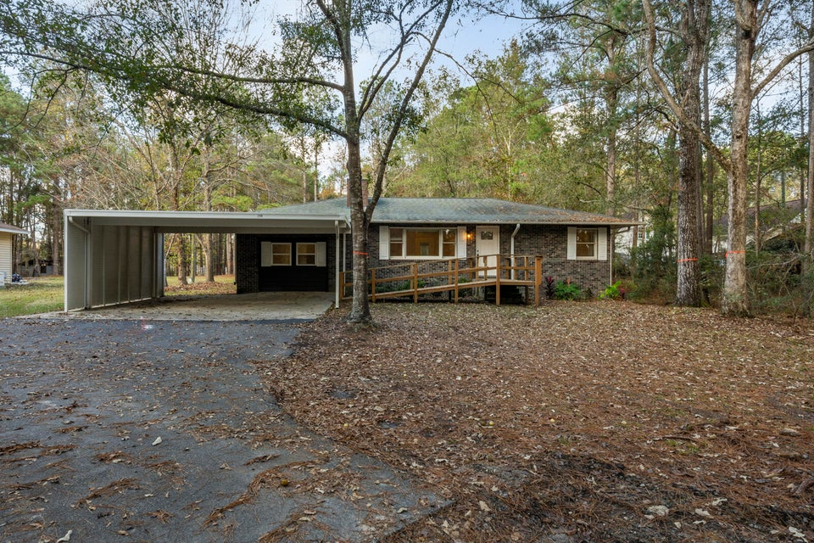
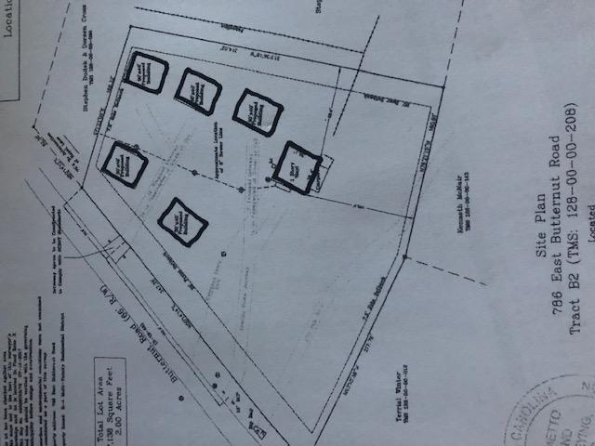
Homes with Acreage
Summerville Near Pinewood Prep
No Restrictions
$40,000
Price Reduction!
DRAFT
302 Summerset Lane
MLS# 24018657 | $539,000
3.1 Acres
298 Summerset Lane
MLS# 23014639 | $438,000
2.1 Acres
2 Blocks from The Crosstown
3 Blocks from The Citadel
6 Blocks from MUSC
Two separate TMS numbers / homes side by side and can build two additional homes on the property (each parcel can have an accessory dwelling unit/ADU) The property is just 15 minutes to downtown Summerville at I-26 Jedburg Road, homes are near Butternut Road. There is no HOA, covenants, or restrictions. So, it’s ok to have horses, chickens, boats, or campers on the property. Each home was updated and upgraded and has a brick fireplace, 3 bedrooms, and 2 baths. The homes combined have over 4,000 square feet. Homes are currently rented, and sellers can give notice for tenants to vacate with 60 days’ notice. Homes currently have well water and septic; however public sewer is available at the road and public water is just 700 feet up the road. 302 Summerset Lane can have a separate driveway on the left side of the property to serve only that home.
2.5% Buyer’s Agent Commission
Contact listing agent with questions.
Rick Willis
843-327-3017 Rick@RickWillis.com The Group, LLC

