Slide 1
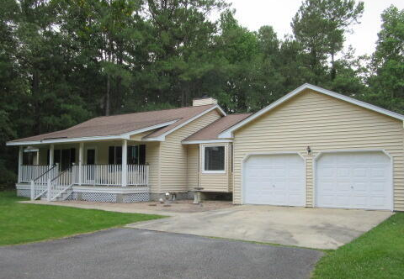
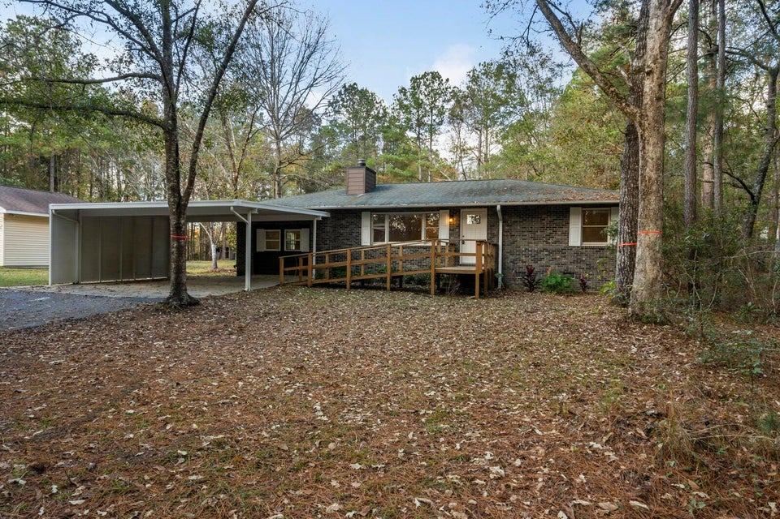
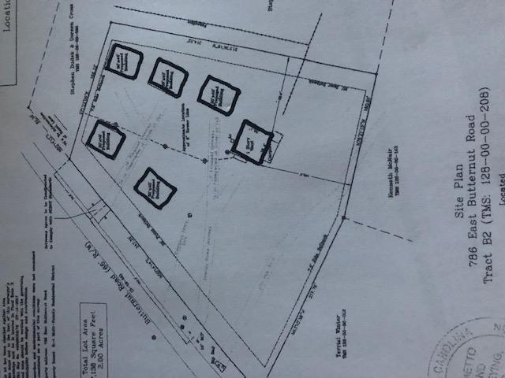
Summerville
2 Houses | 4+ Total Acres
$470,500
302 Summerset Lane
MLS# 25010988
$382,000
298 Summerset Lane
MLS# 25010987
$40,000
Price Reduction!
DRAFT
This home is on 2.59 Acres of high land with the ability to build another home on the property (Accessory Dwelling Unit) and the house next to this is also for sale with 1.83 additional acres (298 Summerset). No HOA, so you can have your horses, chickens, or other animals PLUS park your RV, camper, or boat with no restrictions. This property is just 15 minutes to downtown historic Summerville and also the I-26 at Jedberg Road. The home sits back off of the paved Road and you will feel like you are in a park-like setting This home has been updated and upgraded in every way and includes a brick wood burning fireplace and even a whole house Generac generator The square footage includes a portion of the garage area that can be converted to finished heat and air interior square footage. Public sewer is avail + public water is close by. Separate driveway can be added to the left side of the lot.
Another home can be built on this property (Accessory Dwelling Unit) and existing home an be expanded via finishing the garage into a bedroom o mother-in-law apartment or simply a large flex space where buyer can participate in how it's finished. Existing tenant can vacate with 30 to 60 day notice. Home has a new water filter attached to the well (2023) A separate driveway can be added on the left side of the property. Currently the driveway is shared with the 298 Summerset property. Survey under documents and photos.
This home is on 1.83 acres of high land with the ability to build another home on the property (Accessory Dwelling Unit) and the house next to this is also for sale with 2.83 additional acres (302Summerset). No HOA, so you can have your horses, chickens, or other animals PLUS park your RV, camper, or boat with no restrictions. This property is just 15 minutes to downtown historic Summerville and also the I-26 at Jedberg Road. The home sits back off the paved road and you will feel like you are in a park-like setting. This home has been updated/upgraded in every way and includes a brick fireplace. Public sewer is available. Animals permitted...(horses - chickens) and no HOA restrictions. Additional land is available up to 3 total acres. The rear yard has an oversized 1.5 car garage. (Seller will finish into a bedroom, office or small residence to include a bathroom and basic kitchen to be used by a family member or rent as an Air B&B or long term rental. This property has many options to include a "mother-in-law unit/rental unit or just an area for a "man/women cave" or additional bedroom or living area. The rear yard would be ideal to build another home and use the existing home as a short term or long term rental or for a family member wanting/needing separate living quarters.
Owner is willing to convert the detached garage to a mother-in-law apartment including bedroom, kitchen and bathroom for a small additional fee. Agent has ownership interest Buyer should be informed that lots of value is in the land. Home is currently tenant occupied and owner can give 30 to 60 day notice to vacate. Home has new water filter attached to the well (2023) Public sewer is available in front of property and public water is close by. Survey shows under documents and photos.
2 Blocks from The Crosstown
3 Blocks from The Citadel
6 Blocks from MUSC
2.5% Buyer’s Agent Commission
Rick Willis
843-327-3017 rwillisteam@gmail.com The Group, LLC

