Slide 1
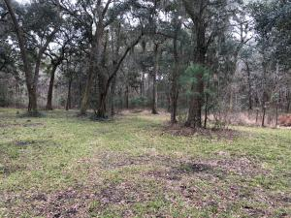
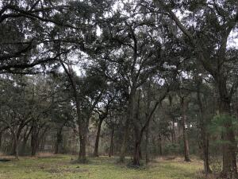
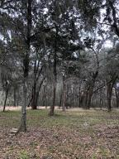
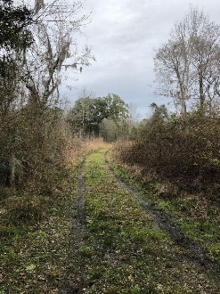
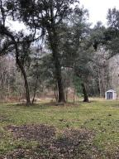
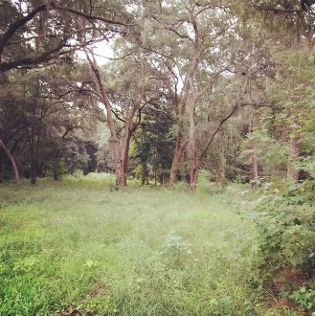
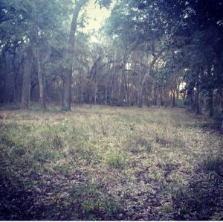
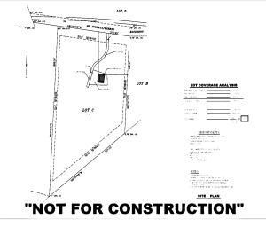
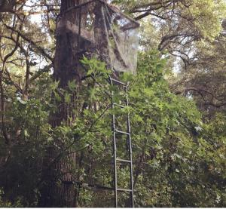
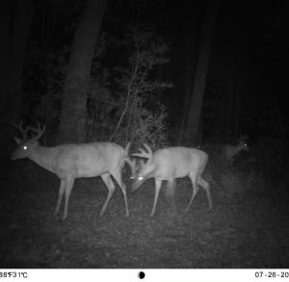


2999 Hut Road
Pt Blacklock ~ Johns Island, SC 29455
MLS# 21004253 ~ $298,000
Beautiful Johns Island Property
If you have been looking for a beautiful piece of property to build your dream home this is it! You can bring your horses too! Over 6 acres to give you the privacy, peace and quiet that you have been waiting for. This is Johns Island! The possibilities are endless here. There are beautiful trees and wild life. The property is currently being used as a camping/hunting getaway. Please call before seeing property. No HOA and public water is already on site.
Kelly Rozier
(843) 209-3129
kellywrozier@gmail.com
Brand Name Real Estate
4 Carriage Lane Suite 106
Charleston, SC 29407

