Slide 1
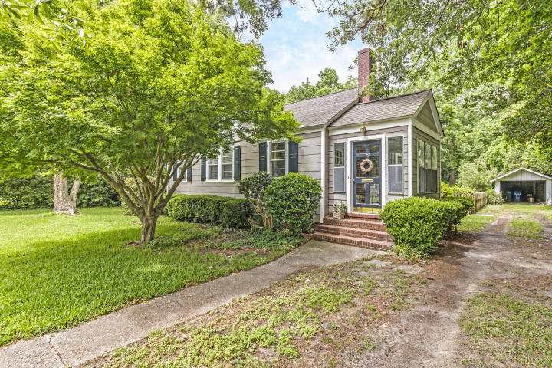
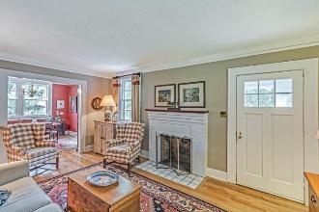
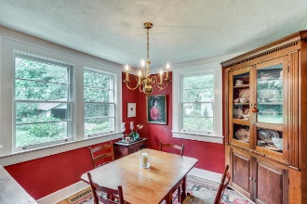
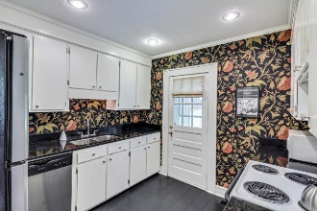
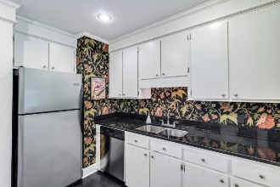
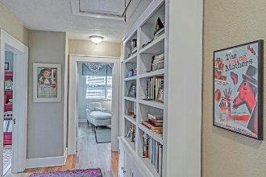
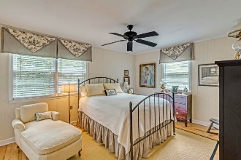
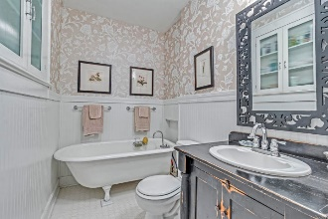
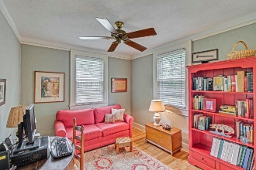
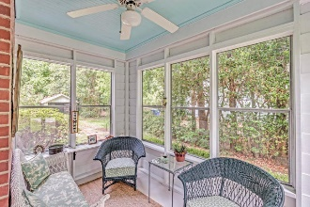
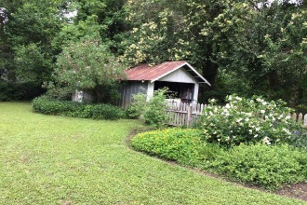

Agent Open 12:30-2:30 ~ Wed June 27
Raffle For A $50 Visa Gift Card
29 Avondale Avenue Avondale ~ Charleston, SC 29407
MLS# 18013971 ~ $418,000
A true gem in the popular Avondale neighborhood, centrally located in West Ashley, 5 minutes from downtown and walking distance to great restaurants and shops. With beautiful original hardwood floors throughout, this home features a charming living room with a wood burning fireplace and a formal dining room. The air conditioner and heating systems were replaced in February along with all ductwork. The kitchen has a brand new dishwasher, electric stove, and refrigerator. The master bedroom was added by the previous owner and is a good sized room with large closet and lots of natural light. The bathroom has been very nicely remodeled with a claw foot tub. The back garden is very private and surrounded by azaleas and many old plants. Includes detached garage.
Barbara Brown Real Estate
1666 St Johns Parrish Way
Johns Island, SC 29455
www.barbarabrownthenameyouknow.com
Barbara Brown
(843) 324-7787
babrown.realty@gmail.com

