Slide 1

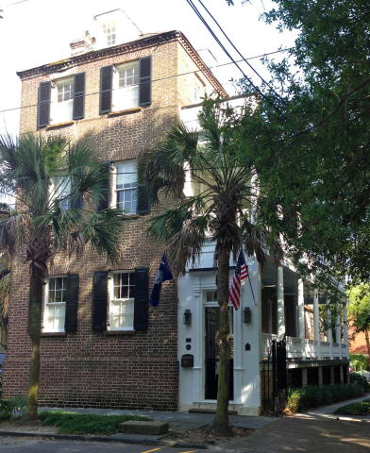
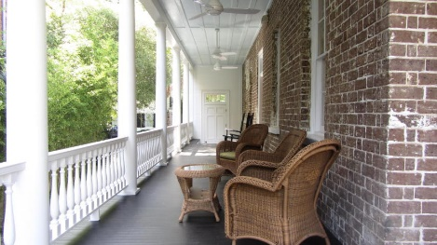
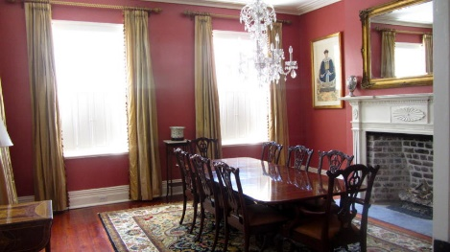
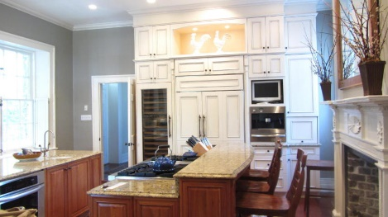
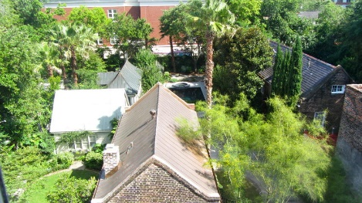
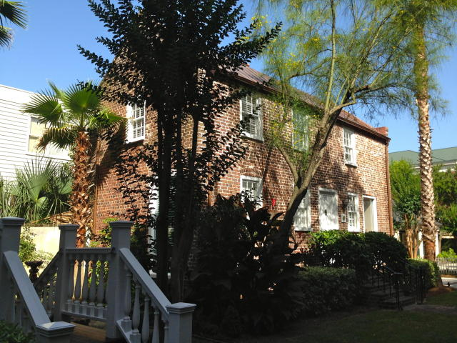
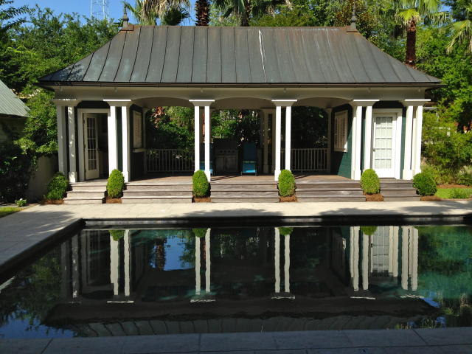
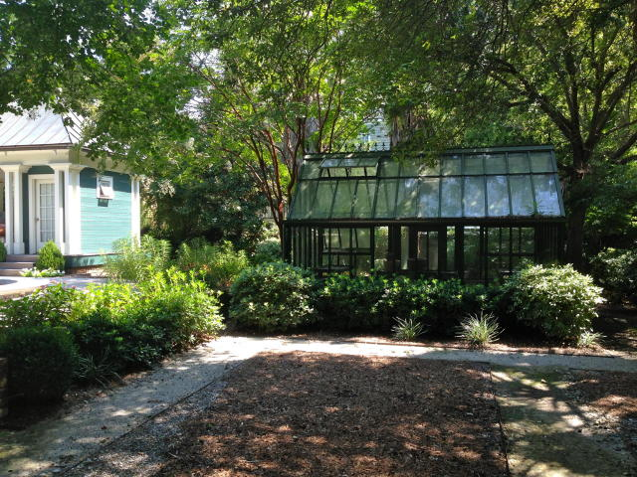
Wraggborough Agent Open House Thursday, July 16th from 11-1:30 29 Charlotte Street ~ MLS# 15015776 ~ $2,895,000
Built c.1828 brick home
1991 Carolopolis award
Renovated to include all the comforts of modern upscale living
Phillip Simmons wrought iron fence
Plenty of off-street parking
3 ½ story main house
2 story carriage house with transferable B&B license
Large in-ground pool and hot tub flanked by a pool house and entertainment deck
The greenhouse and gardens anchor this extremely large private lot
James M Doar REALTOR
Mobile - (843) 437-8715
jimdoar@aol.com
Skye Properties, Inc. of Charleston
1028 LeGrand Blvd.
Charleston, SC 29492
www.skyepropertiesinc.com

