Slide 1
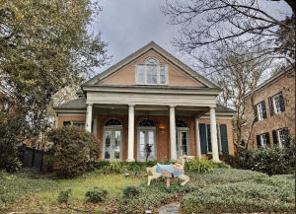
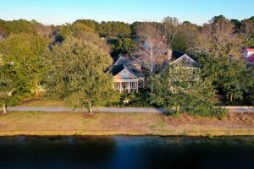
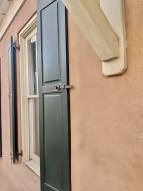
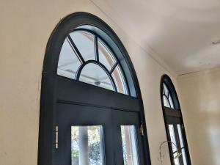
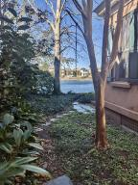
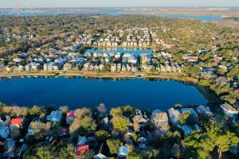
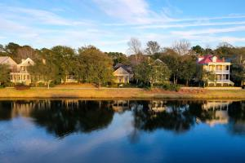

29 Eastlake Dr
I’On ~ Mount Pleasant
Gorgeous Listing
Ion Renovation Opportunity
Open House Saturday & Sunday 1-3
Renovation opportunities do not often come up in ION.
This home has a great floor plan and platform to make it a wonderful home again.
The former owners loved sitting on the porch overlooking Eastlake watching nature, talking to all the neighbors. They truly loved ION and you will too.
Stan Huff
843-670-2835
stan.huff@agentowned.com
Jill Marcacci
843-297-5590
jill@agentowned.com
www.agentownedrealty.com
AgentOwned Realty Co. Preferred Group, Inc. | 824 Johnnie Dodds Blvd | Mt Pleasant, SC 29464

