Slide 1
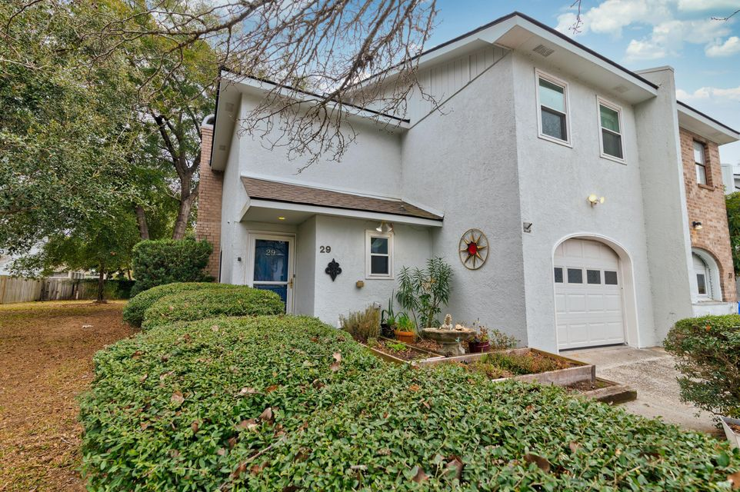
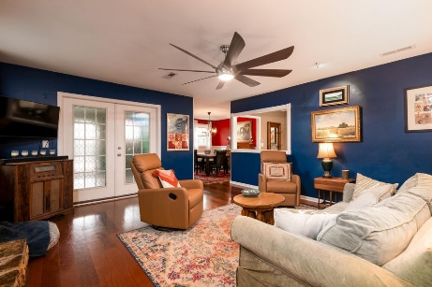
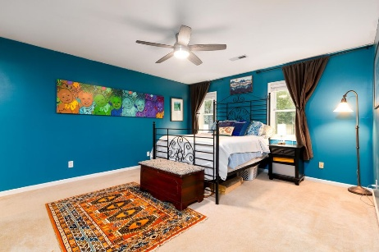
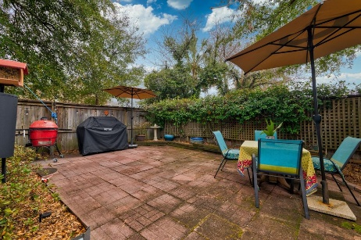
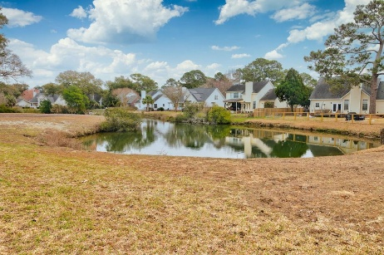



IMPROVED PRICE ON JAMES ISLAND
3 BEDROOMS UNDER $500K!
29 Meander Row
Rivers Point
Charleston, SC 29412
MLS# 25003798
NEW PRICE $470,000
3 Bedrooms :: 2 Baths :: 1,920 sf
Welcome to 29 Meander Row, a charming and functional 3-bedroom, 2-bathroom townhouse nestled in a central location on James Island. This 1,920 square-foot home provides all of the comfort, convenience and space needed for top-notch James Island Living. Enjoy evenings on the back terrace patio with ample space for entertaining or come into the sunroom (not counted in square footage) right off the patio and main living area, optimizing the flow of this great floor plan. The seller's have upgraded all of the important systems to the house.
Recent upgrades include: NEW ROOF 2022, NEW WINDOWS 2023, NEW HVAC & DUCTWORK 2023, NEW 80 GALLON WATER HEATER, ALL NEW TOILETS, NEW GAS LOGS & TANK for Fireplace, NEW Garage Door & Opener, New Fans & Light Fixtures & Upgraded Electric Panel!
The neighborhood pool is one of the largest on the island and has a shady gazebo with bathrooms; perfect for gatherings. Situated on a 1,307 square-foot lot, Its' prime location provides easy access to Historic Downtown Charleston and a quick route to Folly Beach, making it an ideal choice for those seeking proximity to city amenities as well as nature filled escapes! Enjoy walks to the neighborhood ponds that are a stone's throw away.
Don't miss the opportunity to own this awesome townhome in a pinnacle location of James Island!
Jon Moore
(843) 732-3365
jon@charlestonrealestategroup.com
www.charlestonrealestategroup.com
Charleston Real Estate Group | 443 Folly Road | Charleston, SC 29412

