Slide 1
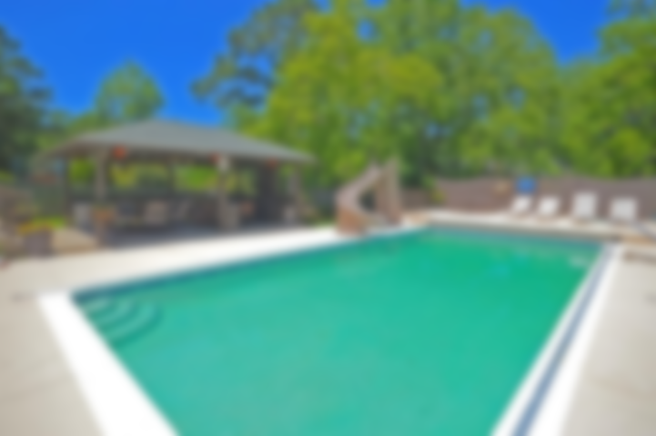
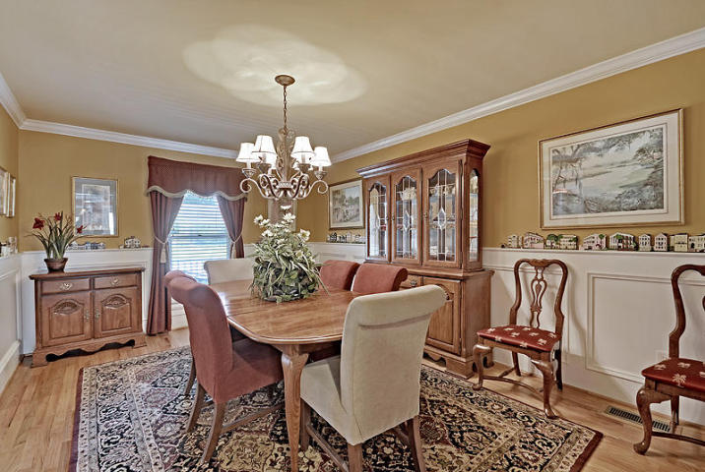
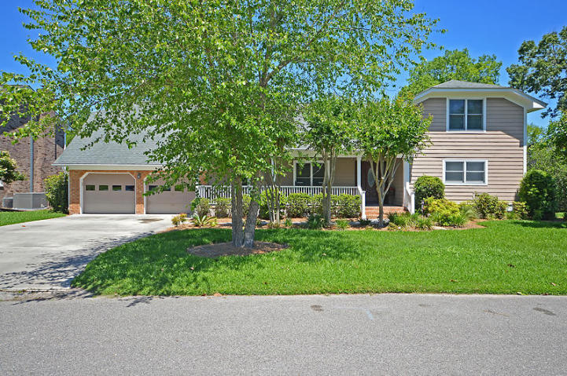
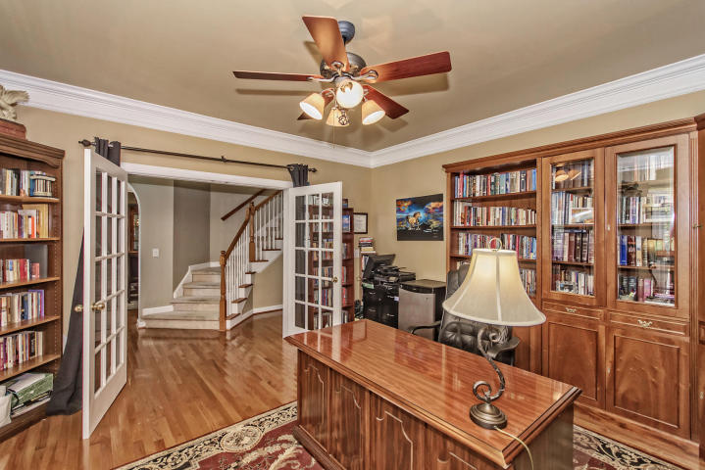
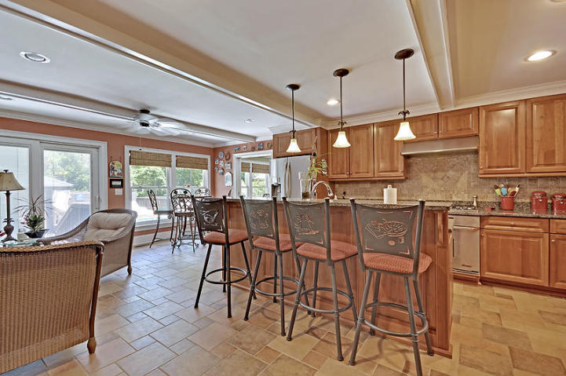
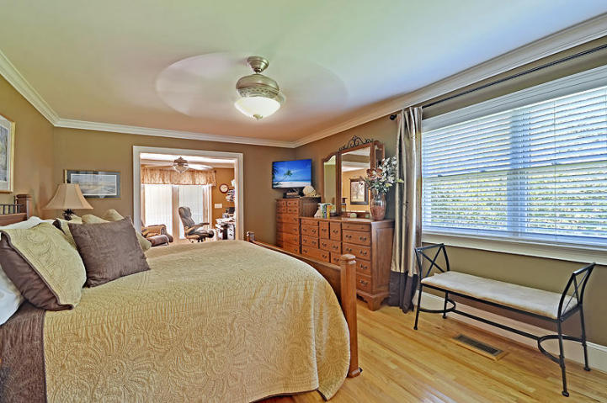
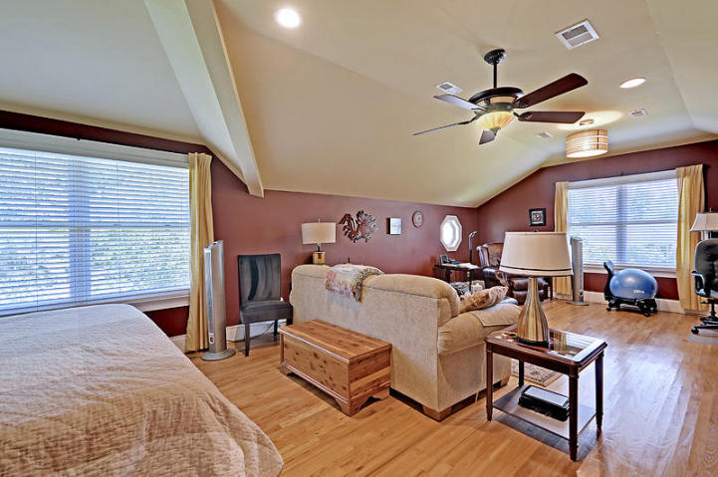
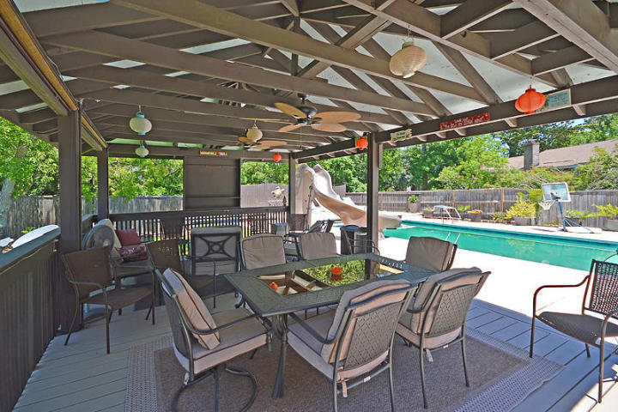
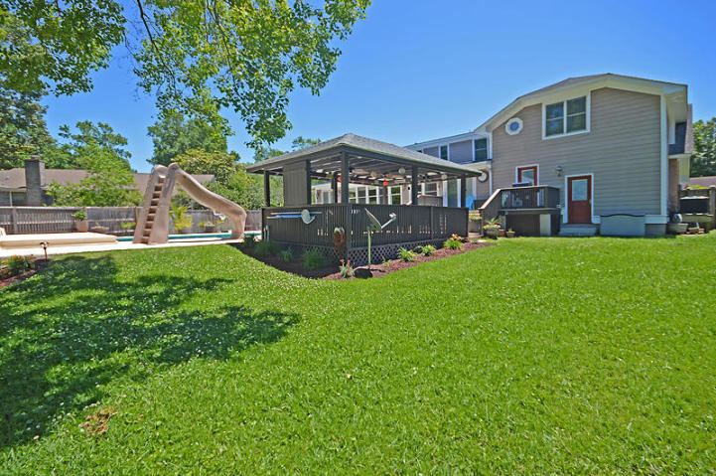

MILLION DOLLAR HOME FOR A BARGAIN PRICE!
2 Avon Court Parkshore ~ Charleston, SC 29407
MLS# 17013343 ~ $699,900
4 Bedrooms ~ 3½ Bathrooms
Absolute Bargain! Unbelievable Price! Priced low and firm for your pre-approved buyer who wants a great deal on the nicest house in West Ashley. This custom home was recently remodeled and no expense was spared. Enjoy your backyard oasis year round complete with in-ground salt water pool. Conveniently located, minutes from downtown and close to all West Ashley shopping. Hurry, it won’t last long at this low, low price. Do your buyer a favor and submit a squeaky-clean full-priced offer today and save yourself all the fun of a full-priced counter offer.
Chip Walsh
843-822-4663
chipwalsh@gmail.com
The Boulevard Company, LLC 35 Broad Street Charleston, SC 29401
www.TeamWalshRealEstate.com

