Slide 1
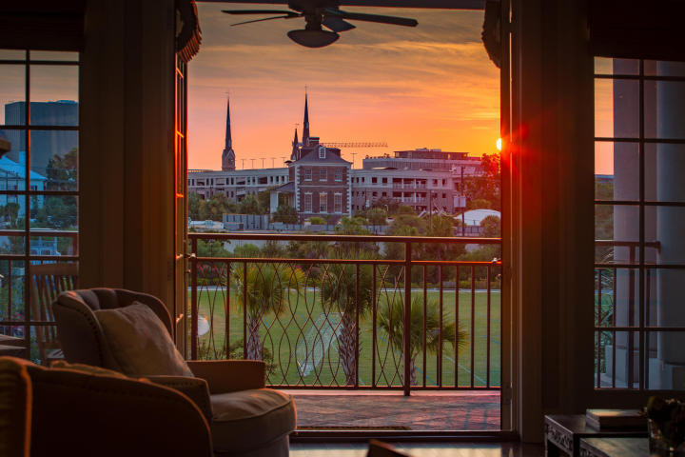
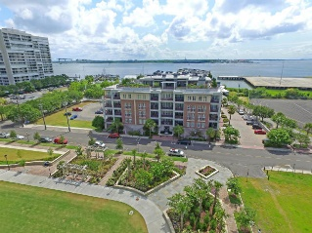
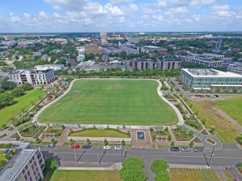
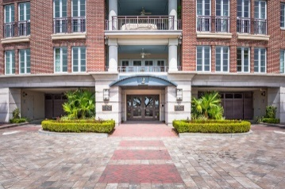
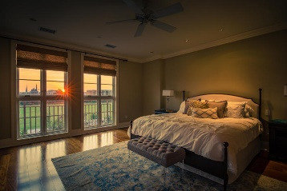
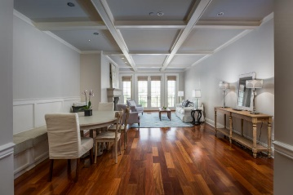
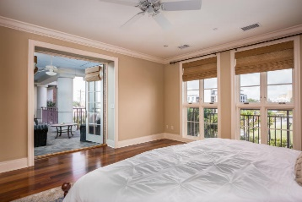
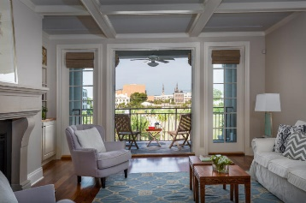
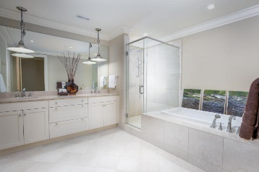
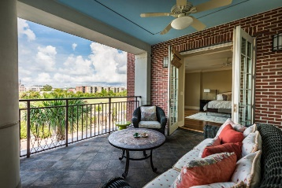
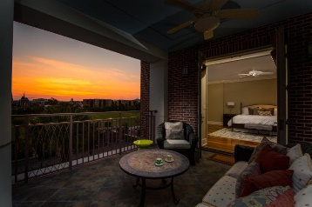
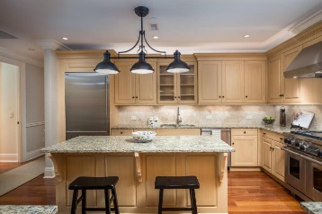
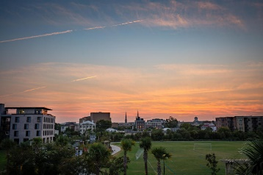
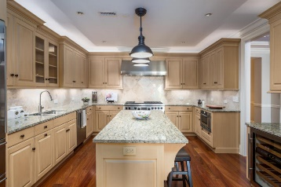
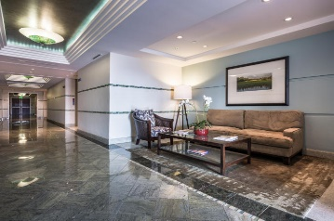

Agent Open House Friday, Oct 14th, from 10a-12p
Price Reduced!
2 Laurens Street 2B
Anson House ~ Charleston, SC 29401 ~ MLS# 16017649 ~ $1,500,000
Perfectly located in downtown Charleston and situated right next to the Gadsdenboro park, the Anson House at 2 Laurens St is simply an amazing property. Charleston's top downtown attractions and dining are just a short walk away. This 2BR, 2BA, 2nd floor (3rd level) condo offers peaceful views of the park from nearly every room and from its oversized piazza. Two deeded parking spots, a secure garage, a doorman & beautifully kept grounds are some of the highlights that add to the allure of living at the Anson House. Inside the unit are high ceilings, crown molding, baseboard molding, gorgeous hardwood floors, a gas fireplace, built-ins and a bench in the dining area & a granite chef’s kitchen. If you’re looking for luxury, downtown, maintenance-free living, schedule an appointment today
Additional features include:
The roomy kitchen features granite counters, marble backsplash, a center island with breakfast bar seating, high end, SS appliances including a Wolf gas range, a Sub-zero refrigerator, a Sharp drawer microwave, wine cooler, and ice maker
The living room has a coffered ceiling, gas fireplace, bench, built-ins and access to the piazza
Double-wide piazza for entertaining and dining; gas hook-up for grill; cool evening breezes
Private access to the unit from the elevator
The master retreat has a massive, U-shaped walk-in, custom closet and en-suite bath with dual vanity, jacuzzi tub and walk-in shower
The 2nd bedroom also has an en-suite full bath, walk-in closet and access to the piazza
Gadsdenboro park has a playground, swings and a walking trail
Enjoy views of Holy City and sunsets
Doorman/concierge (M-F, 9-5) and security
2nd floor unit on the 3rd level (garage on bottom level)
Incredible location: 5 minute walk to Gaillard Performing Arts Center, Harris Teeter (grocery), and Ansonborough Square (butcher, dry cleaner, mail center, frame shop, Pilates, drug store); 10 minute walk through Charleston's famed historic area to many top restaurants and shops; easy automobile commute to Mt. Pleasant, MUSC, West Ashley (no tour carriages to slow traffic)
Book your showing today!
Matt O’Neill matt@mattoneillteam.com 843-532-4220

