Slide 1
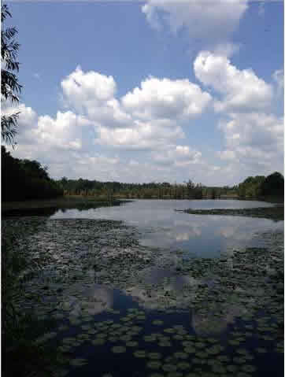
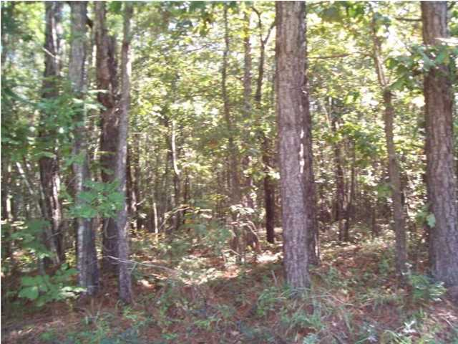
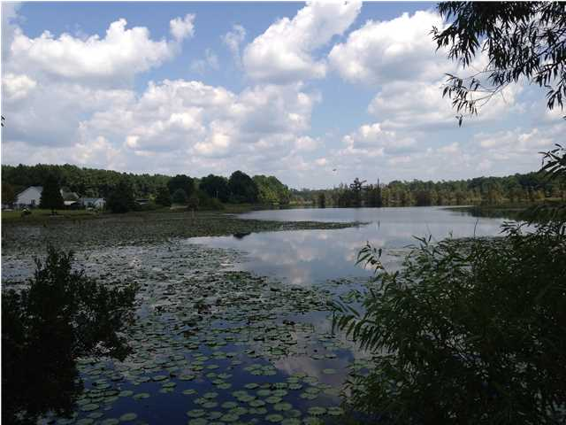
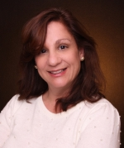

Peaceful Country Setting to Build Your Custom Home
2 Hunt Dr
Huger, SC 29450
MLS# 1323069 ~ $108,000
A Peaceful Country Setting to build your Custom Home.
4-Acre corner lot with a view of Bates Pond (A Cypress Stocked Fishing Pond)!
Walk to fishing & canoeing on 100 Acre stocked Cypress Pond!
Just 15 Minutes to North Mt. Pleasant - shopping!
Easy commute to Nucor Steel and Amoco Chemical!
Carolyn Salzillo
O (843)884.7300
C (843)324.9636
F (843)725.6516
TheCharlestonRealEstateLady@comcast.net
www.thecharlestonrealestatelady.com
824 Johnnie Dodds Blvd.
Mt Pleasant SC 29464

