Slide 1
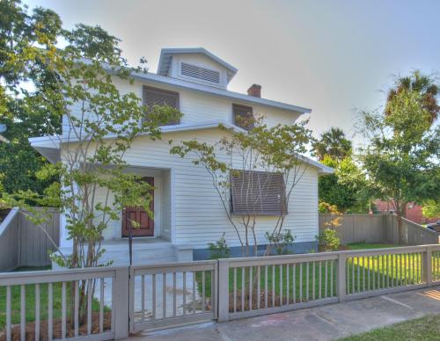
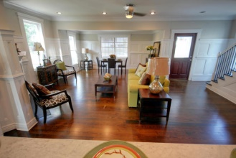
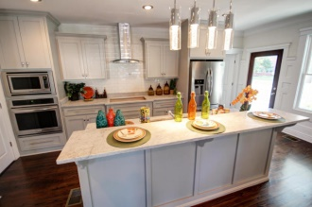
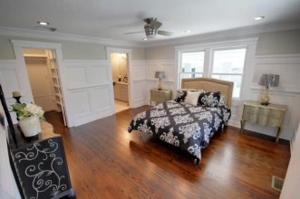
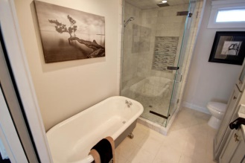
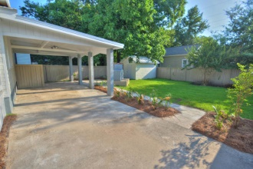

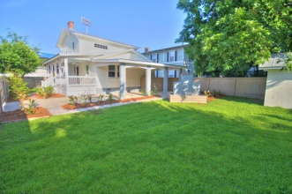
2 Parkwood Ave
Hampton Park Terrace
Charleston, SC 29403
MLS# 15016197
$615,000
4 Bedrooms
2½ Bathrooms
1,887 Sq Ft
2 Parkwood Ave ~ This professional renovation is now complete and ready for you to make your own! No detail has been spared which is evident as soon as you enter. You'll be blown away by how open this floor plan is! The great room features brand new heart of pine flooring, gorgeous custom trim detail plus crown molding, two fireplaces, a gourmet kitchen and a dining room. The kitchen is any home chef's dream with locally hand crafted custom cabinets with no slam drawers, Carrera marble counter tops, high end stainless steel appliances including a wall oven with built in microwave above it, gas cook top and refrigerator. The color selections are phenomenal. You'll love them! Just off of the kitchen is a brand new powder room and laundry room with a pantry. You'll find the master suite located on the back of the home (on the first floor) and also includes all of the gorgeous materials and finishing touches in the great room: hardwood flooring, custom trim etc). There is a brand new custom walk-in closet and a deluxe master bathroom with an antique claw footed tub, custom tiled STEAM shower with seamless glass surround, double sinks with Carrera marble counter tops and a built-in linen cabinet. The mirrors and lighting are beautiful too. Heading upstairs, you'll see that the staircase has open hardwood treads with wrought iron ballisters and that gorgeous trim detail! There are three more bedrooms upstairs, all with hardwood flooring and a brand new full bathroom with custom tile work throughout. The outdoor living space rivals the indoor living space including an enormous side porch, custom patio and outdoor fireplace. The entire lot is fenced in with a brand new wooden fence painted to compliment this newly renovated home. There is also a carport and driveway for ample off street parking. The storage building in the backyard has even been renovated and the yard is so large that there's plenty of room for a 20'x20' building: garage with potentially income generating apartment above / carriage house / greenhouse (buyer to verify all). Updates to the home include new metal roof, all new low e windows, all new wiring, plumbing, ductwork, 2 HVAC units, gas tankless hot water heater, interior and exterior painting. Double sided fireplace in dining area/kitchen and living room - aesthetic purposes only.Come see 2 Parkwood Ave today!
Meg Hopkins Kandik
Cell - 843-814-5137
meg@holycityre.com

