Slide 1
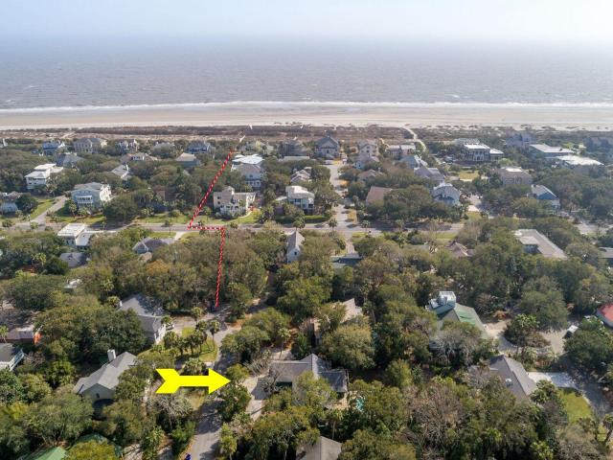
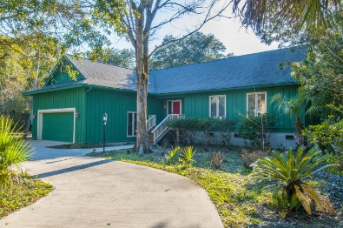
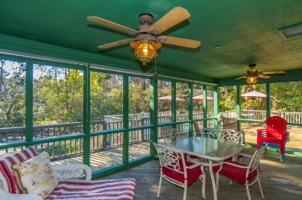
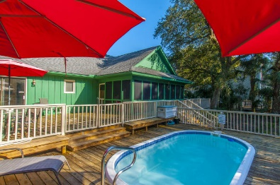
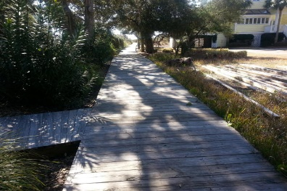
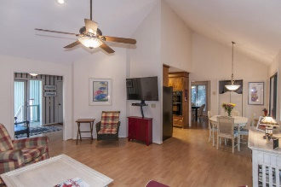
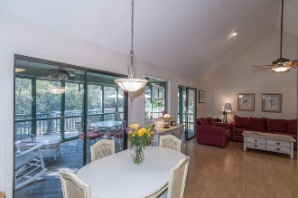
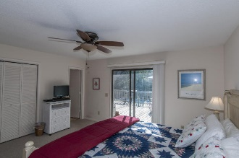
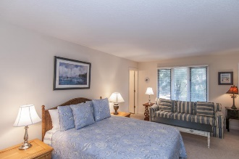
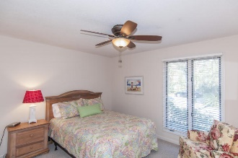


2 Shad Row
Wild Dunes | Isle of Palms | MLS# 16005192 | $789,000
Wild Dunes Beach Home!
Strategically located - 2 Shad Row is right where you want to be! Located in the heart of everything as well as in the heart of mother nature. Absolutely the best of both worlds in the gated community of Wild Dunes! A place of peaceful serenity located on a quiet cul-de-sac in a most sought after location in The Resort. A short walk to one of the widest beaches on The Island. Serene and fortified with plush foliage 2 Shad is teeming with nature and mature vegetation. Walking distance to all amenities. A very private and comfortable beach home with its own swimming pool, huge screened porch and huge decks for entertaining or just relaxing. Open floor plan! Selling furnished.
You will find this home is hard to beat in price and location...!
Barbara Walker
REALTOR
Office - (843) 886-8110
Mobile - (843) 906-5404
bwalker@carolinaone.com
www.barbarawalkerrealtor.com
Carolina One Real Estate
1503 Palm Blvd
Isle of Palms, SC 29451-2280

