Slide 1
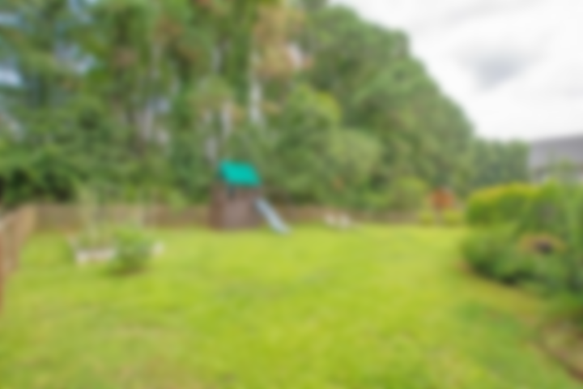
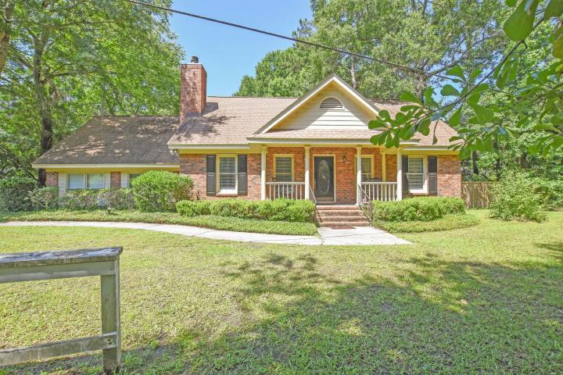
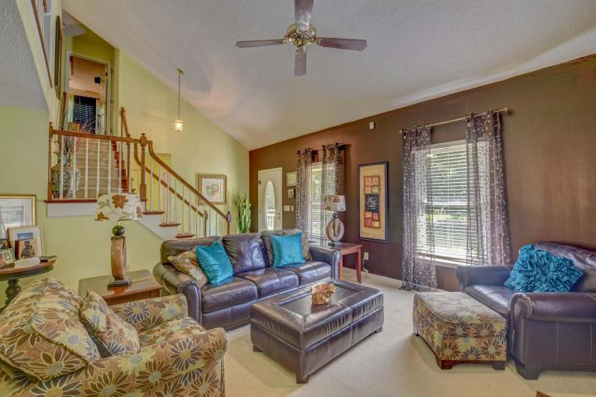
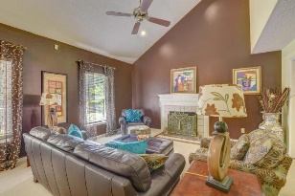
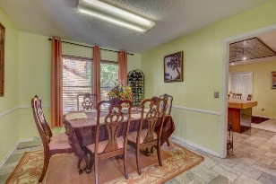
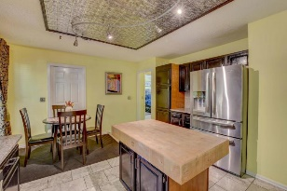
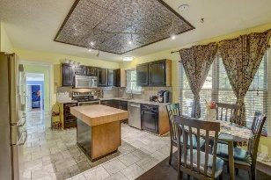
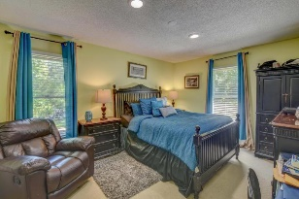
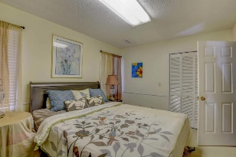
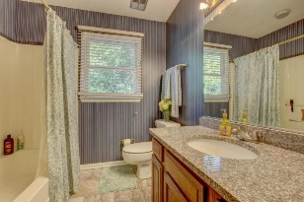
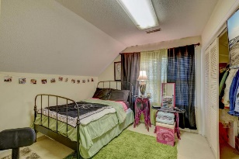
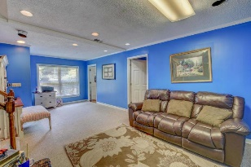
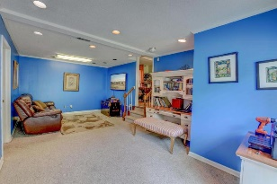

MOTIVATED SELLER- AGENT BONUS
2 Shadowmoss Parkway
Shadowmoss | Charleston, SC 29414 | MLS# 18017233 | $294,000
NO HOA! Spacious brick home that is located in the highly desirable West Ashley area and is walking distance to Drayton Hall Elementary. This inviting 2800 sq foot home has plenty of room for everyone! Spacious 3 bedrooms (master on the first) and oversize bonus room that could be used as a 4 bedroom or guestroom! Gourmet kitchen with granite counter tops and granite in three bathrooms. The BEST part about this house is there is not just a bonus room but in addition a BONUS WING. It is currently being used as 2 additional bedrooms and a huge theater room where this family's small children live and play. Perfect for a big or extended family and great for entertaining. Note these great features-brand new roof, HVAC, including ducts, water heater and stainless steal appliances.
You won't run out of room with this house! Priced to sell.
Marthe Teixeira (917) 325-8033
marthe@kw.com
Keller Williams Realty Charleston
496 Bramson Ct Ste 200
Mt. Pleasant, SC 29464

