Slide 1
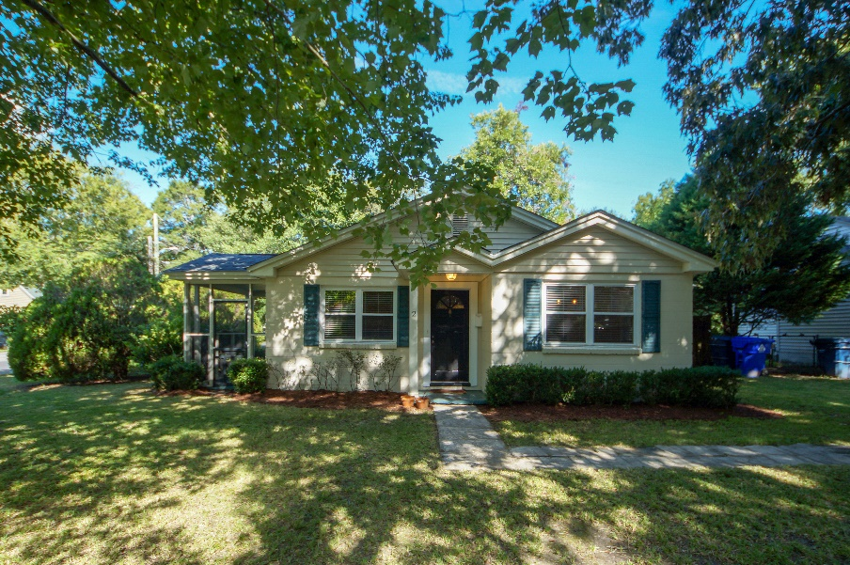

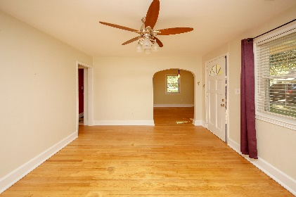
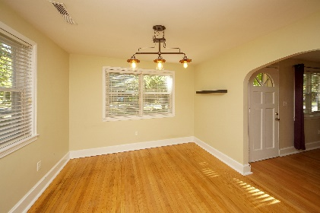
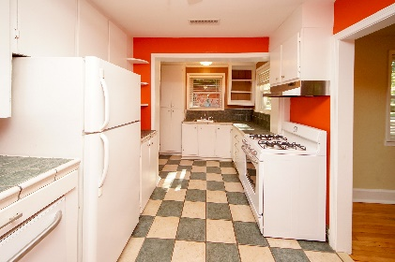
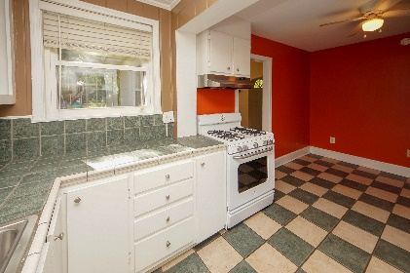
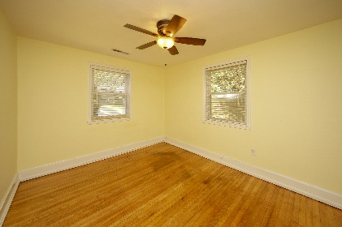
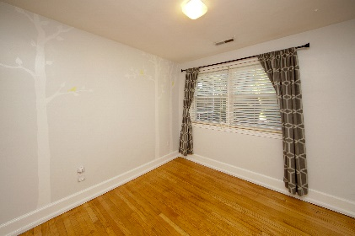
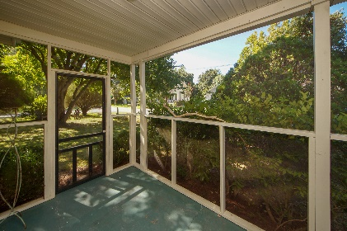
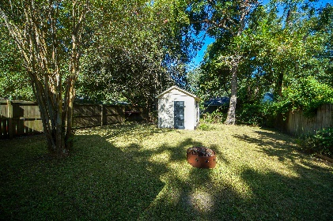



Just Reduced!! Buyers agent commission adjusted to 3%
Walk To AVONDALE Restaurants and Bars!!
2 Tovey Road
Carolina Terrace
Charleston, SC 29407
MLS# 18017688
$299,000
3 Bedrooms :: 1 Bath :: 1,128 sf
Come home to a classic West Ashley home with an AMAZING location; literally minutes to Downtown Charleston!! This single level home is just a short walk to the shops and restaurants in Avondale, and sits on a corner lot with a fenced-in yard. There is a block, detached storage building in the back yard. The home is also just a stone's throw away from The Magnolia Community Garden and Farmer's Market!
Enjoy your mornings and evenings relaxing on the screened side porch, or walking to grab a snack at one of the many surrounding restaurants. Save thousands yearly on flood insurance costs as property is in an X flood zone. Roof replaced in 2010, Windows replaced in 2011, HVAC condenser replaced in 2014.
Eric Draper
(843) 442-7118
eric.draper@gmail.com
Jon Moore
(843) 732-3365
jon@charlestonrealestategroup.com
www.charlestonrealestategroup.com
Charleston Real Estate Group | 443 Folly Road | Charleston, SC 29412

