Slide 1
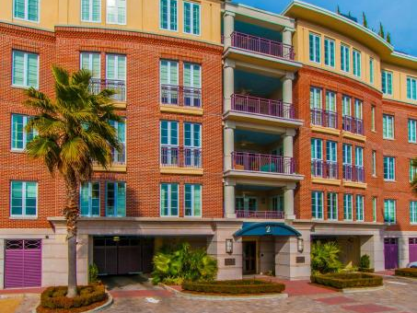
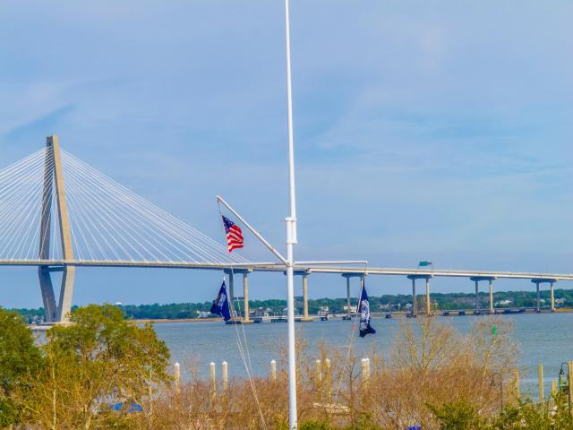

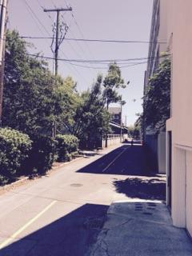
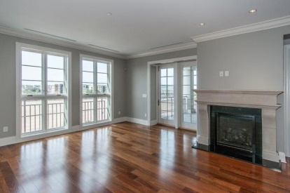
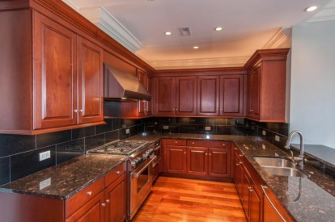
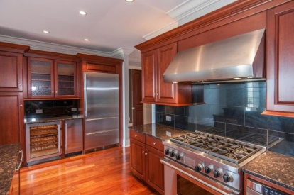
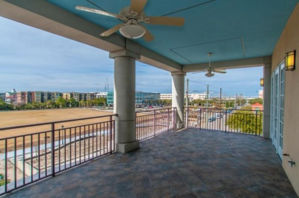
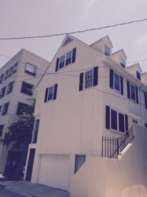
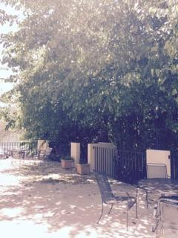
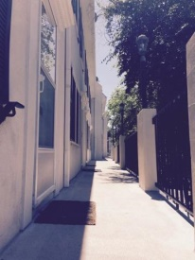
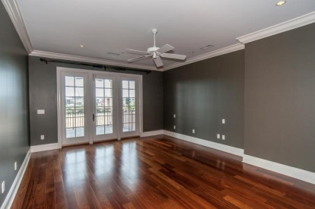
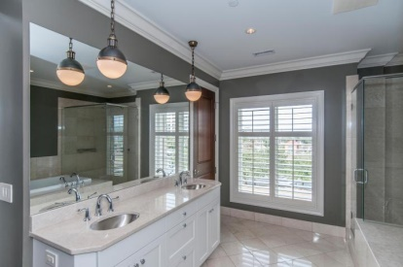
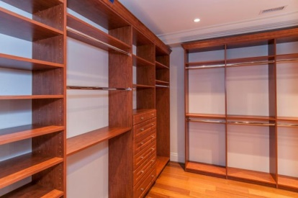
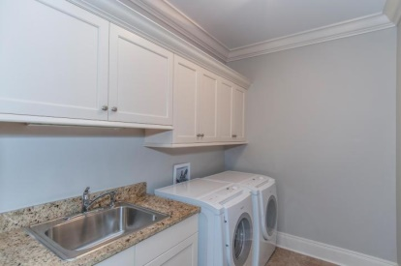


Stunning Condo at Aquarium Wharf
2 Laurens Street #3A
Anson House | Charleston, SC 29401 | MLS# 15005664
As featured on the cover of Charleston Style & Design Winter 2015, this elegant downtown condo on the harbor, has expansive views of the Ravenel Bridge and the newly created Gadsenborough Park!
As you enter the lobby of Anson House you will be greeted by the doorman who is there to assist you and your guests.
The elevator will take you directly into 3A and you will immediately notice the light that pours into the condo from the front windows. The sunsets from the 3rd floor piazza are stunning!
Both the living and dining rooms have masonry fireplaces that will warm you in the colder months. The kitchen has custom cabinetry as well as an ice maker and wine cooler.
WATCH THE VIDEO OF ANSON HOUSE ATTACHED TO THE LISTING!!
Patricia Lehman Byrne
Mobile - (973) 868-1039
Patricia@kwluxuryhomes.com
luxurypropertiesincharleston.com
Keller Williams Realty Charleston West Ashley
1180 Sam Rittenberg Ste 105
Charleston, SC 29407

