Slide 1
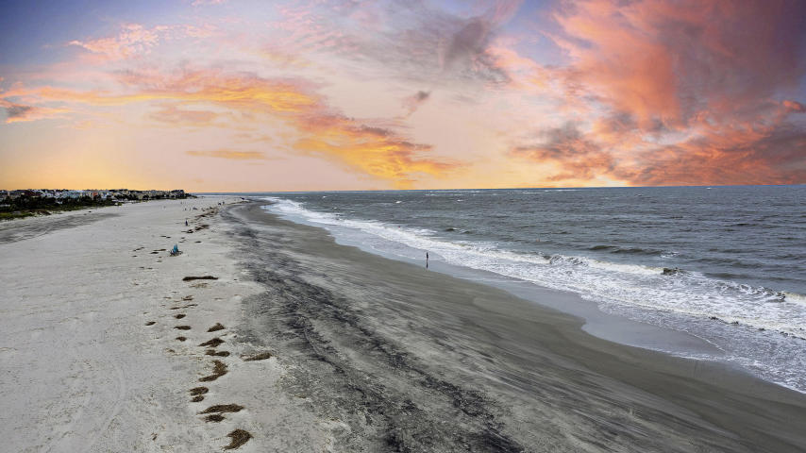

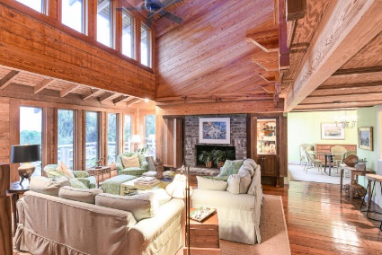
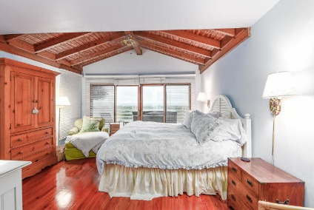
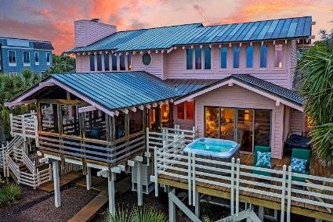
Price Reduced in Dunes West! New A/C Units With Nest Controllers PLUS a 10 Year Warranty
$2,500 Agent Bonus
Oceanfront on Isle of Palms
2 53rd Avenue Isle of Palms, SC 29451 ~ MLS# 20014015 ~ $3,200,000
If you've been searching for the perfect opportunity to own an oceanfront home on beautiful Isle of Palms, then your search is over! This stunning contemporary home built by Hitopoulos was crafted to maximize the stunning ocean views. Built on a corner lot at the end of a cul-de-sac, the dunes and ocean are visible from nearly every room, making it an ideal beachfront property. The impressive architecture and jasmine, sweetgrass, and 40 tall palmettos will immediately catch your eye as you approach this home. Once you enter, you'll notice the gleaming heart pine floors and Pecky cypress walls. The extraordinary two-story family room offers plenty of windows to enjoy the ocean views and includes a wood-burning fireplace with bricks that were used as ballast in sailing ships 200 years ago. The formal dining room has vaulted ceilings, tons of natural light, and access to the deck. The functional kitchen includes white cabinetry, stainless steel appliances, a gas range in a center peninsula, plenty of countertop space for prepping meals, an open pass-through with breakfast bar, and access to the deck. The spacious screened porch and deck are the perfect outdoor living spaces to truly soak in the views of the Atlantic Ocean. The master bedroom can be found on the main level and includes vaulted ceilings, access to the deck and hot tub, and an en-suite bath with dual vanity and a step-in shower. The main floor has two additional bedrooms, both with access to the deck. Head upstairs to the relaxing loft to enjoy the views or step out onto the second floor deck for some lowcounty sunshine. Two additional bedrooms can be found on the second floor, both with great ocean views. This incredible as-is home has lots of other great features including a commercial-grade elevator from the ground level to the first and second floors, decking that surround much of the perimeter of the home, an outdoor shower, a boardwalk from the house to the beach path, a ground level storage room with a workbench, shelving, and electricity, Pella and Anderson double paned windows, and a copper standing seam roof. Two cars can be parked under the home, and the driveway holds approximately seven cars. Located near the entrance to Wild Dunes. This home is close to the commercial center of town where you can find shopping and dining. Isle of Palms also has a recreational center that includes soccer and basketball facilities and a playground. Quite simply, this oceanfront home has everything you've been searching for, so book your viewing today!
Joe Kavanagh joe@mattoneillteam.com 843-345-8506

