Slide 1
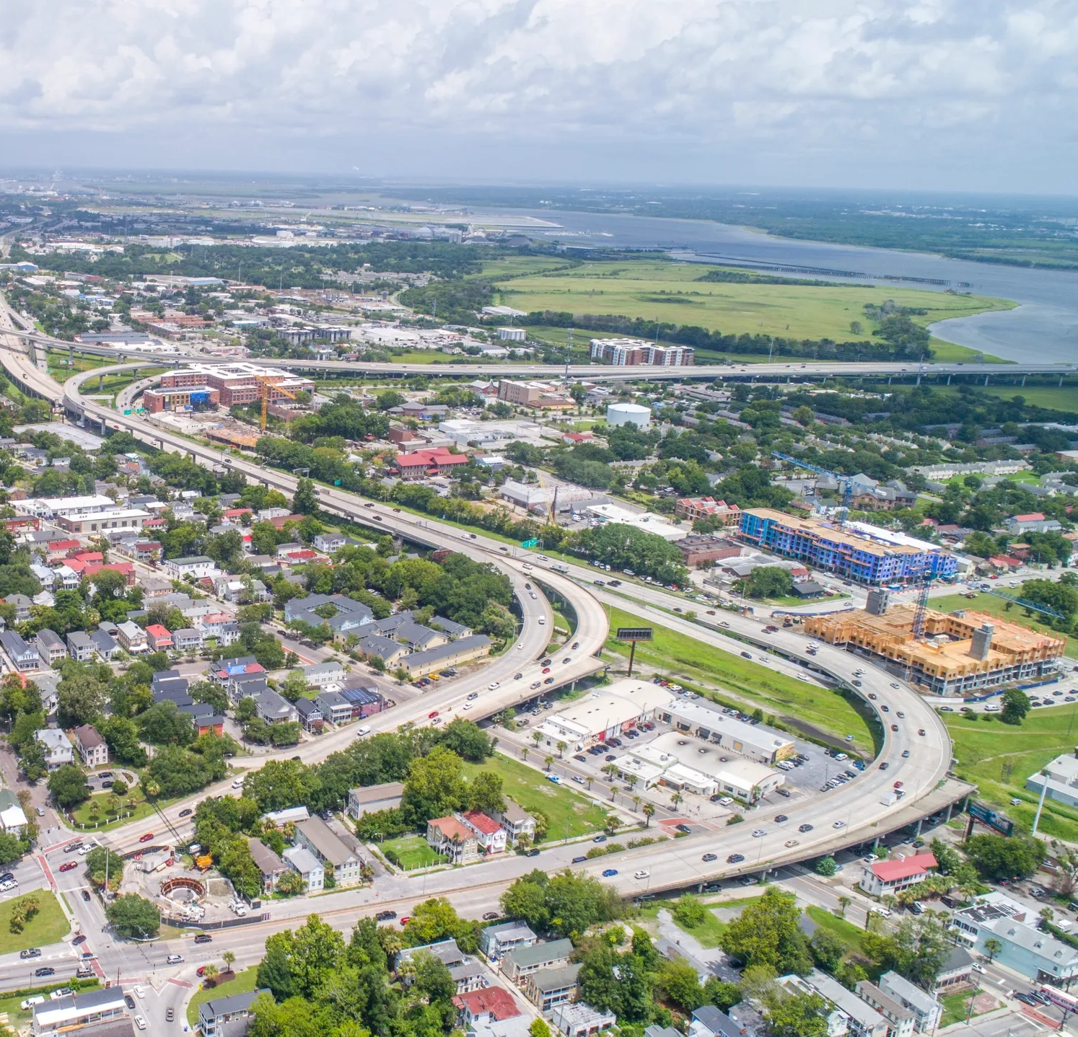
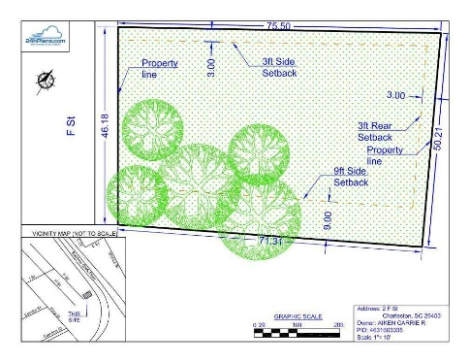
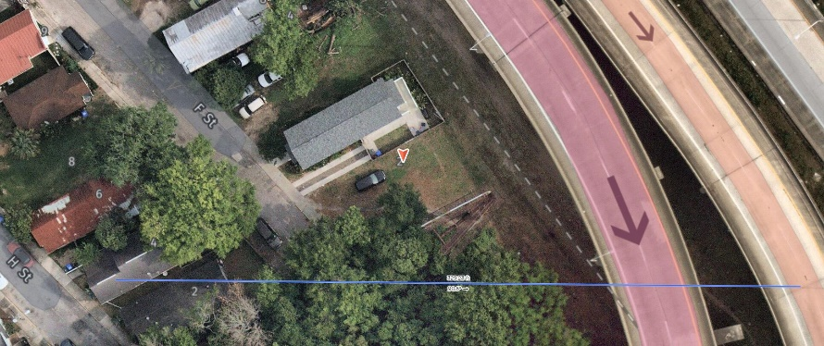
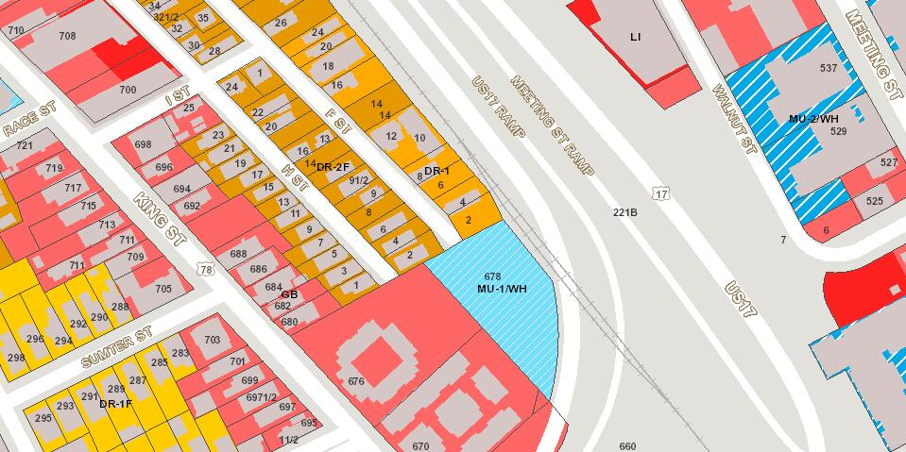


GREAT OPPORTUNITY 2 BLOCKS OFF KING
2 F Street
Westside | Charleston, SC 29403 | MLS# 22030746 | $199,900
Approx
Location
Lowcountry Lowline park project is going right behind this property!
Central Location! Flexible Build Options!
Tapp Palmer
843-408-9456
tapp@residechs.com
residerealestatellc.com
Reside Real Estate LLC
155 Wingo Way Unit 421
Mt. Pleasant, SC 29464

