Slide 1
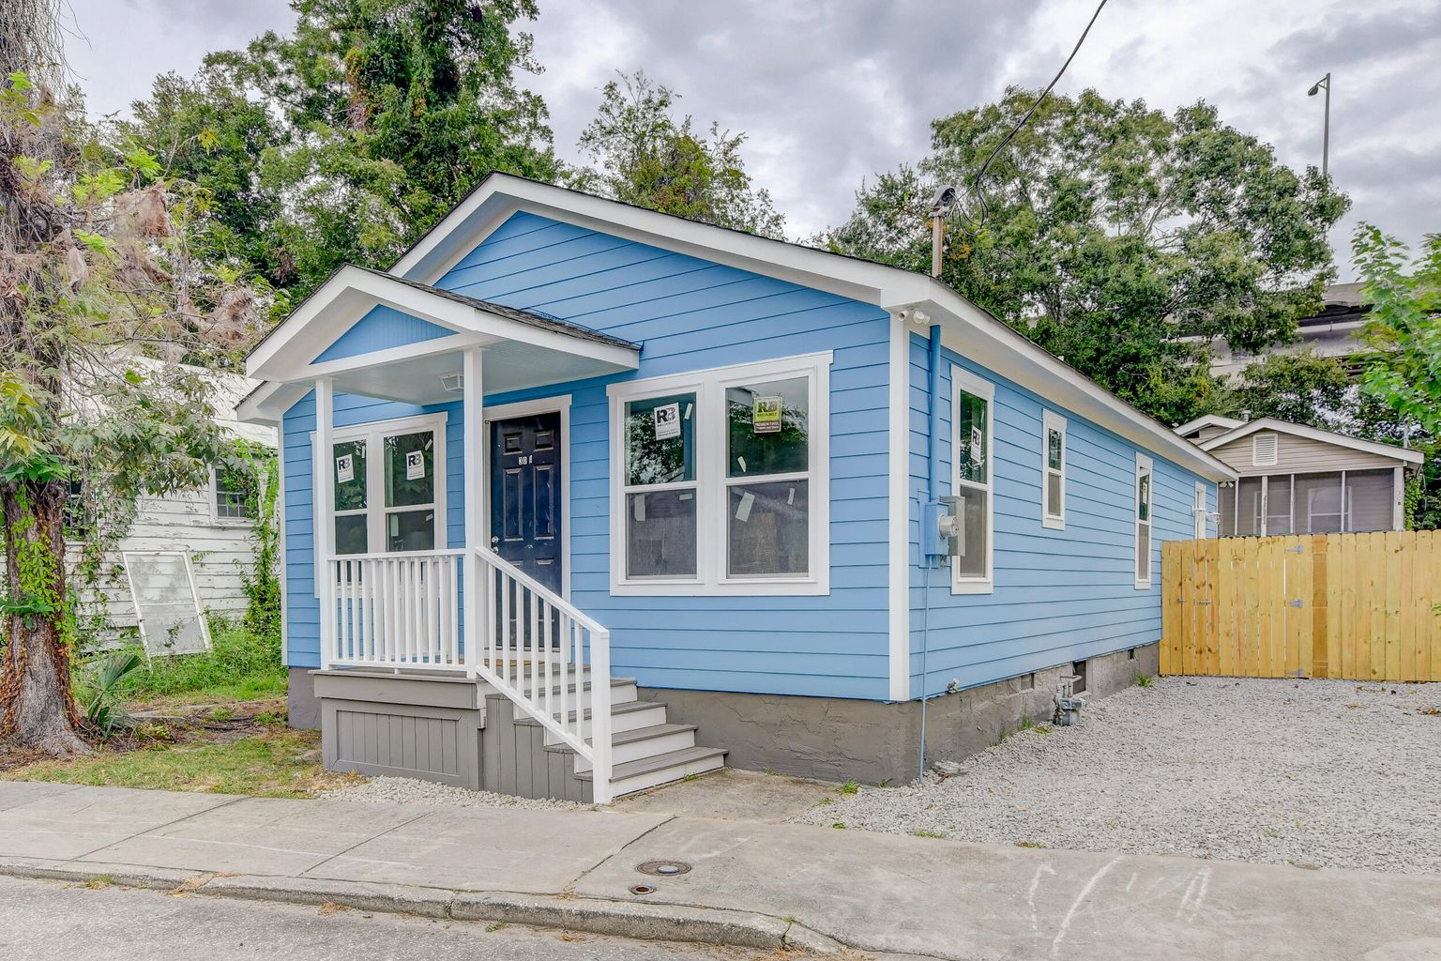

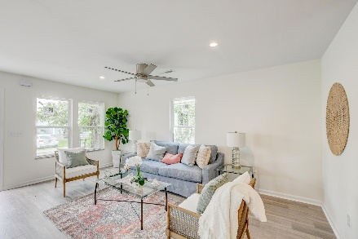
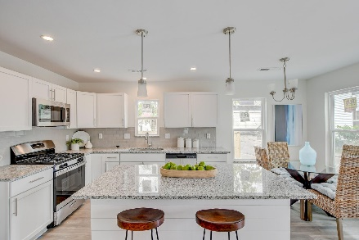
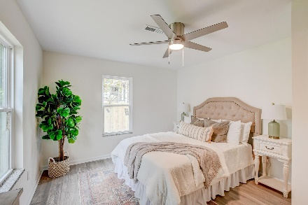
Price Improvement!
OPEN HOUSE
SATURDAY 12-3
Open House Saturday 12-3
30½ F Street
Westside | Charleston, SC 29403 | MLS# 22026951 | $549,900
Talk about move-in ready! This home has been thoroughly updated and is ready for you to move in today! The charming exterior greets you as you enter to the home to discover new flooring, fresh paint, an open floor plan, and great natural light. The family room opens to the updated kitchen with new granite countertops, new white cabinets, new stainless steel appliances, and an island with a breakfast bar. The owner's suite is simply lovely with a roomy en-suite bath with a dual sink vanity, a step-in shower, and a walk-in closet. Two additional bedrooms and a full bathroom complete this home. This home is in a great location! Here you are under a mile from the Crosstown as well as restaurants like Herd Provisions and Rodney Scott's BBQ, 1 mile from Hampton Park, and 1.2 miles from Marion Square. With so much to love, why wait? Book your showing today!
Seller is a licensed real estate agent.
Book your showing today!
Paul Kelton pkelton@mattoneillteam.com 843-460-3173

