Slide 1
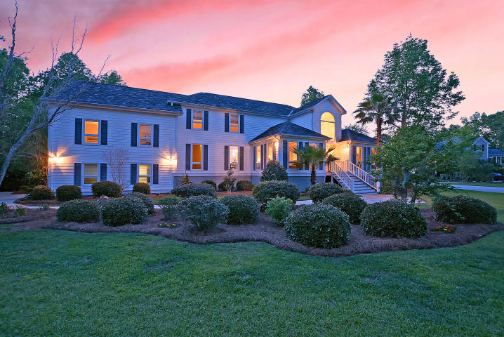



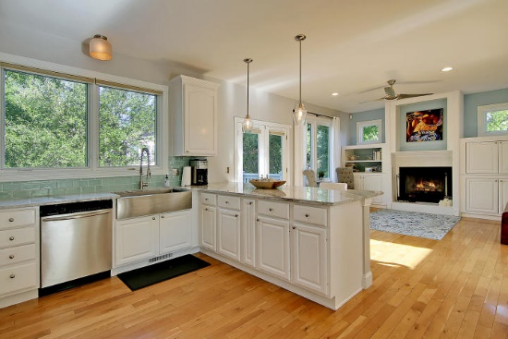
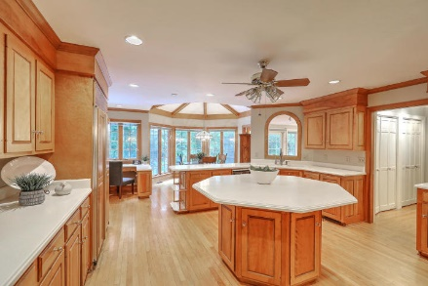




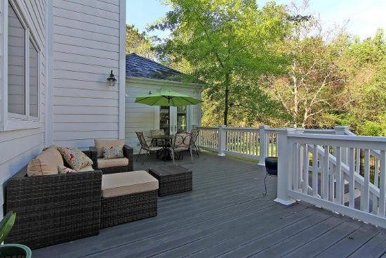

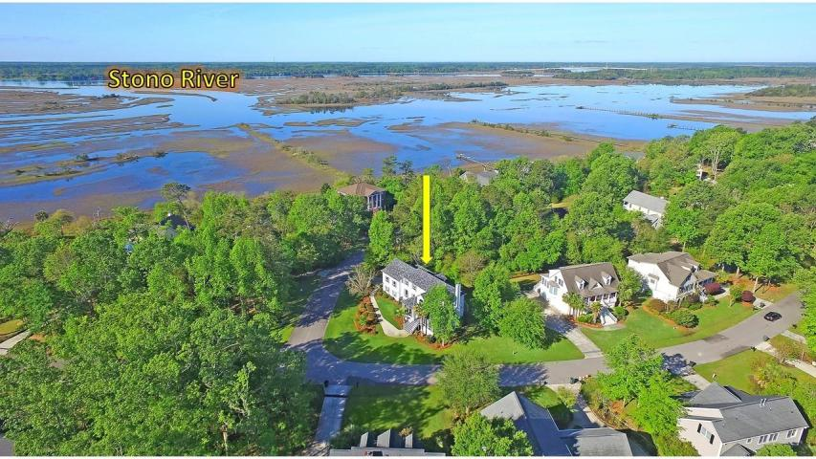
Parkshore Marshfront
Custom Home Close to Town
3002 White Heron Lane
Croghan Landing ~ Charleston, SC 29414 ~ MLS# 19018683 ~ $565,000
Prepare to be absolutely wowed at this renovated custom home in the West Ashley community of Croghan Landing. While close to downtown, shopping & dining, this neighborhood is privately tucked away with a gorgeous dock that has peaceful views of the Stono River. The home is situated on a corner lot that's been beautifully landscaped. This home welcomes you with a two story foyer, an office to the right with built-ins & an en-suite bath & a formal living room on the other side with a stunning sliding barn door. The open floor plan continues with the dining room flowing into the kitchen & family room with its cozy fireplace. The owner's retreat is amazing with a custom walk-in closet, spacious en-suite bath & attached nursery with a ladder leading to the private loft area. Don't miss out!
Additional features include:
Open floor plan with lots of natural light
Office downstairs has a full bathroom and could be used as an additional bedroom
The kitchen features new granite countertops, sink, microwave, vent hood, garbage disposal, tile backsplash and fresh paint
The living room / office has an open feel and includes new French doors / barn door
The master bedroom is over 800 square feet, new wood flooring, freshly painted cabinets, a new custom closet, and access to the third level
Upstairs bathrooms include new flooring
The interior has new paint, new door hardware, lighting fixtures, new fans, door / drawer pulls and plumbing fixtures
Hardiplank siding, elevated constructions with 2 car garage, large Pella windows
Fresh deck and railing paint, new landscaping, and a new wooden ceiling above the front entrance
Neighborhood has social events, an HOA that maintains the neighborhood's integrity, and features a community dock and Greenway access
Close to shopping, dining, I-526, beaches, and Downtown Charleston
Book your showing today!
Christopher Smith christopher@mattoneillteam.com 843-267-0735

