Slide 1
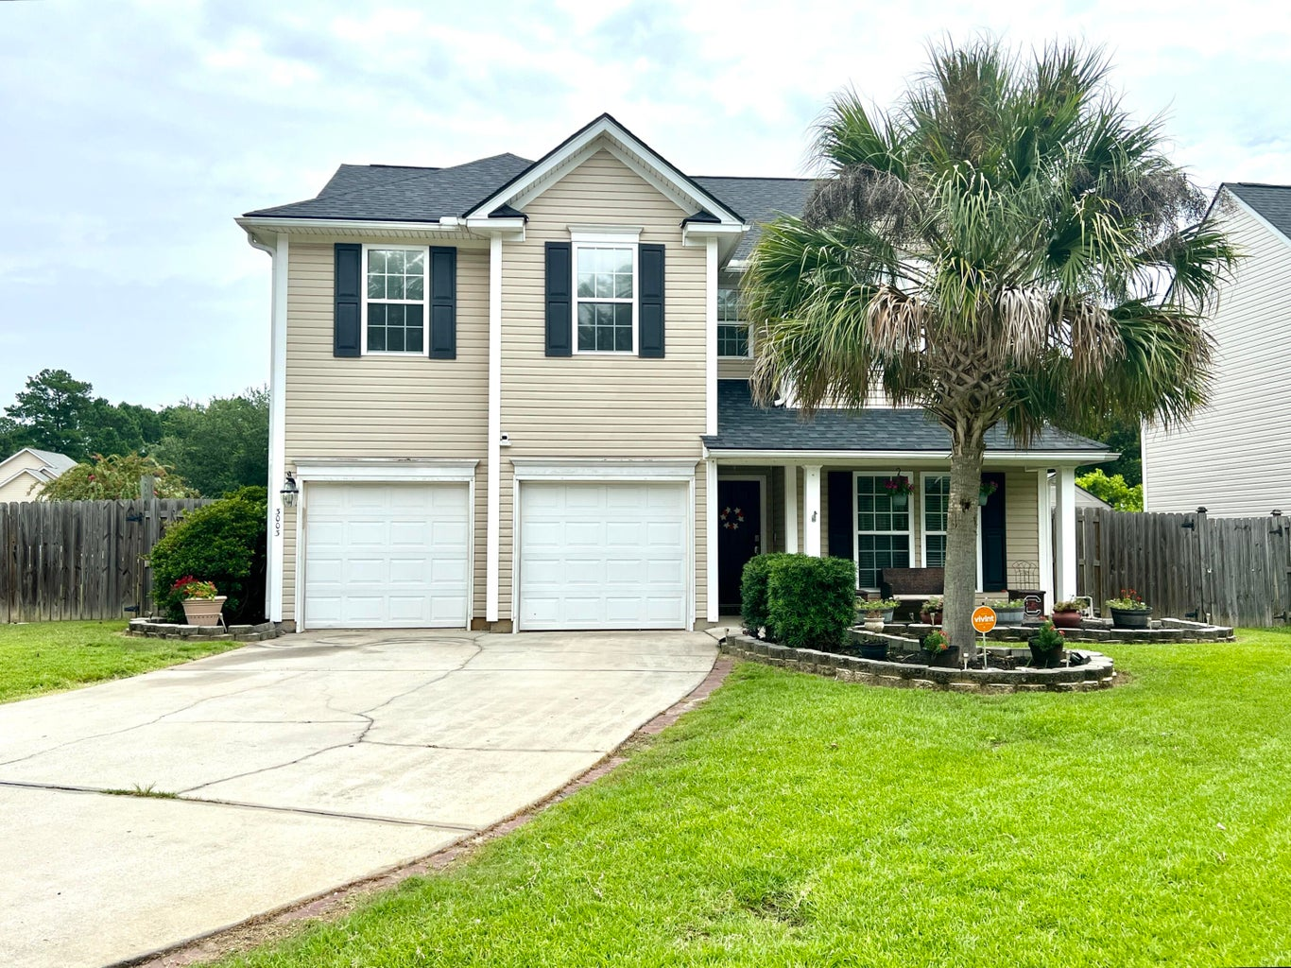
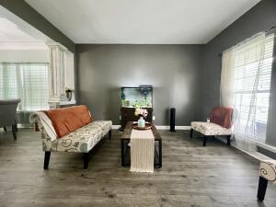
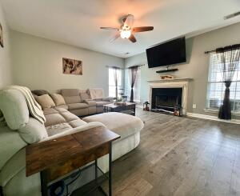
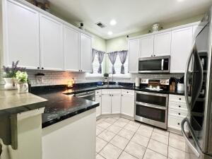
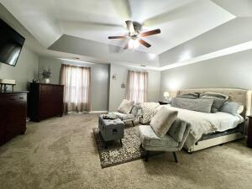
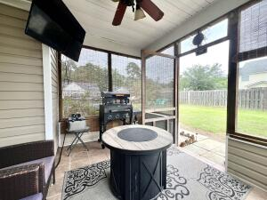
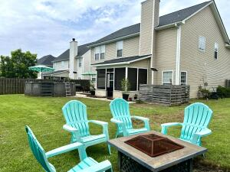


3003 Argyll Drive
The Glen at Summerset | Summerville, SC 29483 | MLS# 24019311 | $399,500
Beautiful Home in Summerville
Welcome to this beautiful, clean, move in ready well maintained home in the desired neighborhood The Glen at Summerset. If you have been searching for a four bedroom, two and a half bathroom, two car attached garage, big yard, new roof in 2023, X Flood zone and in the Dorchester District II school zone this could be your new home! On the main level there are beautiful floors that were installed recently. You have an abundance of space that is perfect for entertaining. The kitchen has stainless steel appliances, beautiful cabinets and counter tops. You have a separate formal dining room and a dining area off the kitchen. There is a formal living and family room. A powder room is also available. The family room has a fire place so you can be warm and cozy during the winter months. All of the spacious bedrooms are upstairs along with a full bathroom and laundry room. The master bedroom will not disappoint with it's tray ceilings, en suite bathroom with double sinks, garden tub, shower and walk in closet. Now let's highlight the outside.... You have a front porch to admire the beautiful landscaping out front. This corner lot allows you to have a huge back yard and the possibilities are endless. There is room to have a garden, workshop, in-ground pool, or outside kitchen that you have always wanted. Already set up is a screened in porch and patio which is great for entertaining and having cookouts! There is an above ground pool and hot tub for you to enjoy but if this is not your thing don't worry the seller's can remove it at your request. Please schedule a showing to appreciate and see how lovely this home is in person.
Kelly Rozier
(843) 209-3129
kellywrozier@gmail.com
Brand Name Real Estate
4 Carriage Lane Suite 106
Charleston, SC 29407

