Slide 1
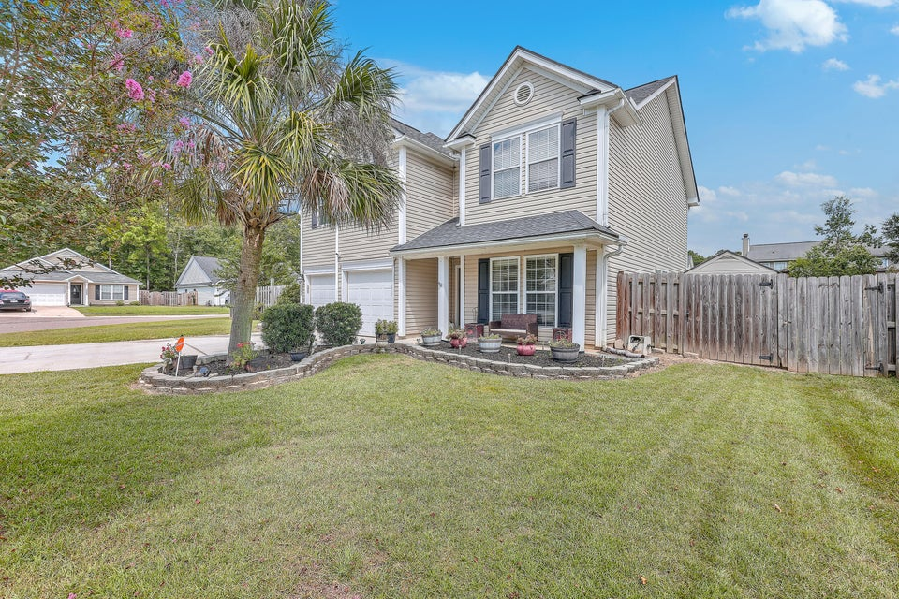
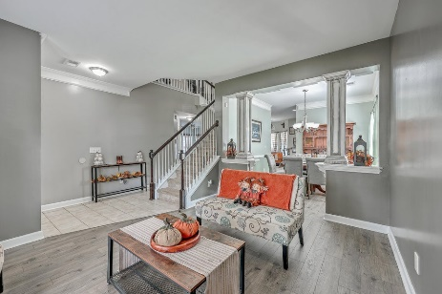
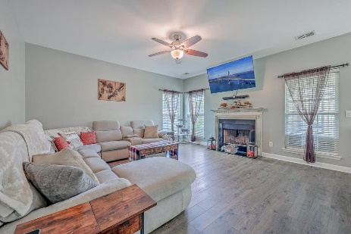
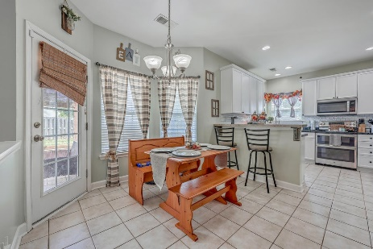
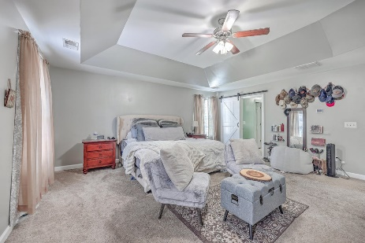
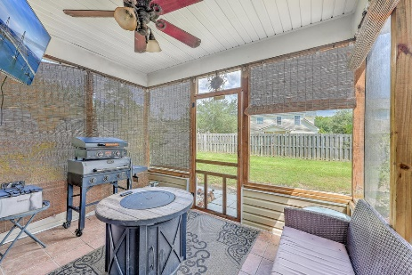
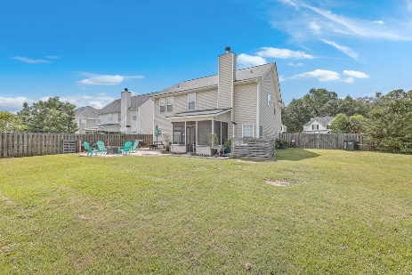


3003 Argyll Drive The Glen at Summerset | Summerville, SC 29483 MLS# 24019311 | $389,000
MOTIVATED SELLER! HAS ONLY HAD ONE SHOWING! GREAT HOUSE!
**Assumable Loan**. Well maintained home in the desired neighborhood The Glen at Summerset. If you have been searching for a four bedroom, two and a half bathroom, two car attached garage, big yard, new roof in 2023, and in the Dorchester District II school zone this could be your new home! On the main level there are beautiful floors that were installed recently. You have an abundance of space that is perfect for entertaining. The kitchen has stainless steel appliances and beautiful cabinets You have a separate formal dining room and a dining area off the kitchen. There is a formal living and family room. A powder room is also available. The family room has a fire place so you can be warm and cozy during the winter months. All of the spacious bedrooms are upstairs along with a full bathroom and laundry room. The master bedroom will not disappoint with its tray ceilings, en suite bathroom with double sinks, garden tub, shower and walk in closet. Now let's highlight the outside.... You have a front porch to admire the beautiful landscaping out front. This corner lot allows you to have a huge back yard and the possibilities are endless. There is room to have a garden, workshop, in-ground pool, or outside kitchen that you have always wanted. Already set up is a screened in porch and patio which is great for entertaining and having cookouts! Please schedule a showing to appreciate and see how lovely this home is in person. There is also an assumable loan with an interest rate of 2.75!
ENJOY A VIDEO TOUR
Kelly Rozier
(843) 209-3129
kellywrozier@gmail.com
Brand Name Real Estate
4 Carriage Lane Suite 106
Charleston, SC 29407

