Slide 1
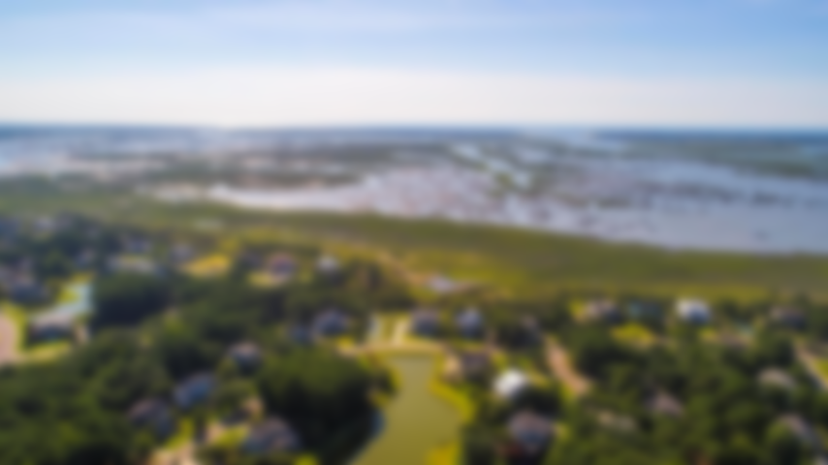
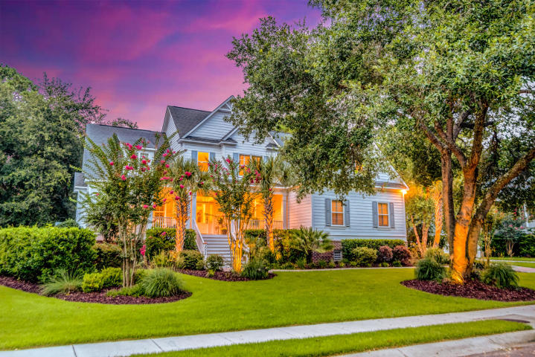
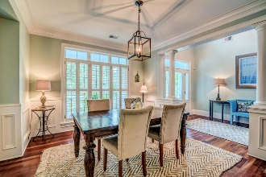
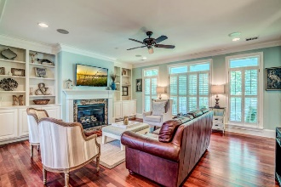
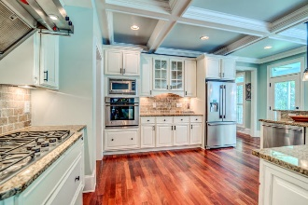
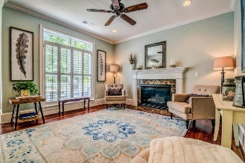
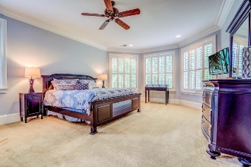
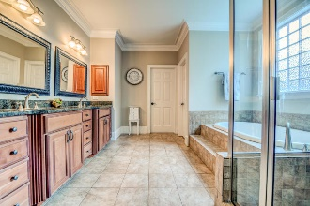
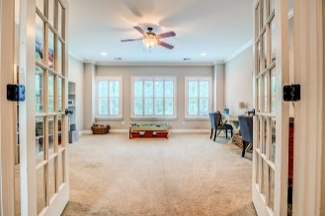
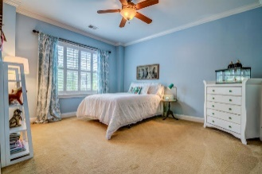
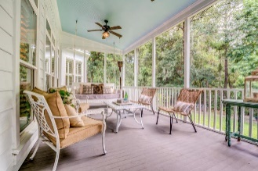
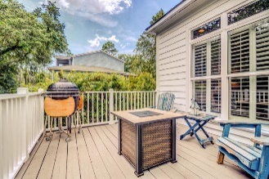
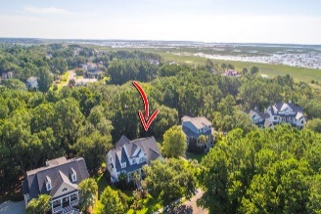



3004 Intracoastal View Drive
Hamlin Plantation | Mount Pleasant, SC 29466
MLS# 19019024 | $850,000
Stunning Home in Hamlin Plantation
Coastal charm meets casual elegance in this stunning Lowcountry home. Nestled into a lush landscape of Live Oaks, Palmettos and mature tropical foliage, this home welcomes you onto its Southern style front porch and begs you to settle in with a glass of tea and wave to neighbors as they pass by. A very spacious living room features a focal-point gas fireplace with granite surround and mantle and is flanked by custom built-in bookshelves with storage cabinets on either side. A wall of windows across the back allows for an abundance of natural light and the easy flow of this space into the kitchen makes this home's floor plan as ideal for entertaining as it is for everyday living. Spend the day lounging on your porch then prepare dinner alfresco while kids and pets play in the private yard below. This home backs up to a protected wetlands greenspace so you'll never lose that peaceful privacy. Located in The Sound at Hamlin Plantation, residents enjoy amenities such as a junior Olympic sized swimming pool with splash zone, grand plantation style clubhouse, tennis courts with an active tennis program, playground, boat storage and neighborhood wide jogging trails. All of this and located just minutes to the beaches, I-526, and all of the world-class shopping and dining of historic downtown Charleston.
Asking $1,200,000
MLS# 17023051
3,692 SqFt
4 Bed/3½ Baths
Short Drive to Historic Downtown Charleston & Beaches
Rees Johnston
(843) 696-7278
rees.johnston@carolinaone.com
Carolina One Real Estate • 2713 Highway 17 North • Mount Pleasant, SC 29466
www.TeamDawsonSC.com

