Slide 1
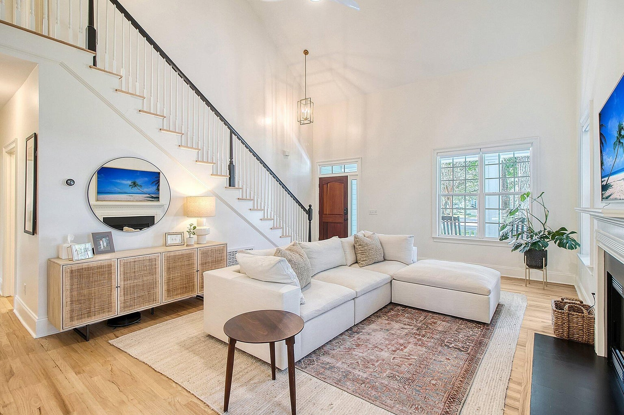

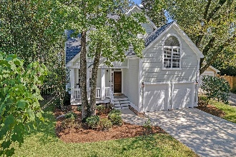
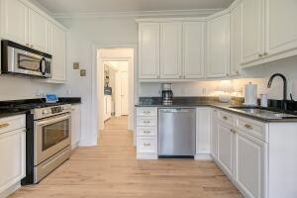
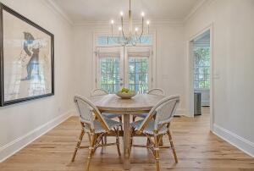
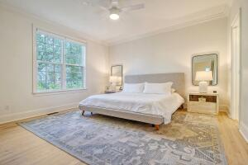
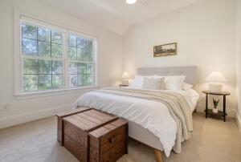
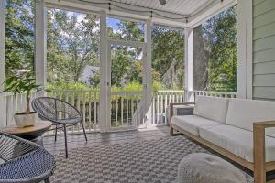
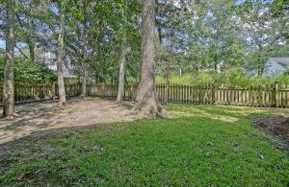
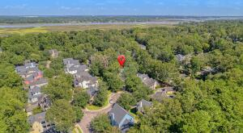
Just Listed in West Ashley
Recently Renovated
JUST
LISTED
3004 Spring Tide Drive Mclaura Bluff | Charleston, SC 29414 | MLS# 23021636 | $639,999
This immaculate, move in ready home is located in McLaura Bluff - a short drive from downtown Charleston, great beaches and the airport. This recently renovated home sits at the end of a cul-de-sac and shows like a model home. Master bedroom is on the main floor, with 3 bedrooms PLUS a large bonus room upstairs over the attached 2-car garage - perfect for a playroom, media room or home gym. Cozy screened in porch overlooks the private fenced in backyard. Recent renovations include: all new light fixtures, refinished hardwood floors, stainless steel appliances, all new interior paint, custom closet system in the master, custom window treatments and motorized shades. This home has too many upgrades and features to list and must be seen to fully appreciate it's location and layout!
TAKE A VIDEO TOUR
Paige Rhodes 843-830-3281 paige.rhodes@carolinaoneplus.com

