Slide 1
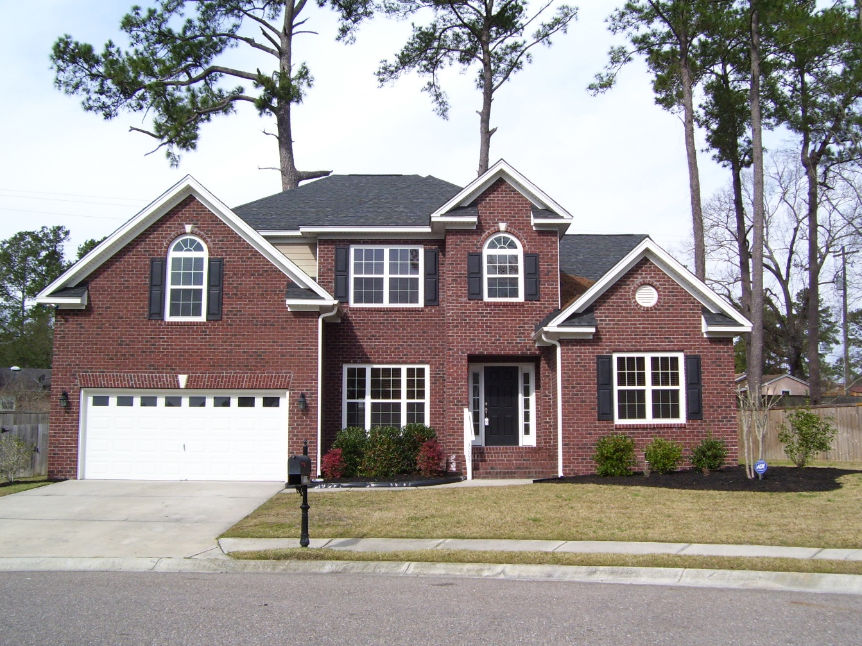
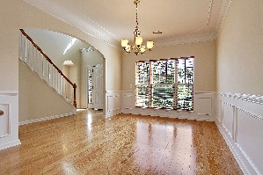
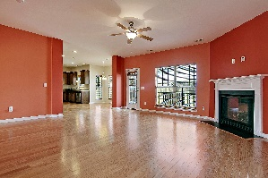
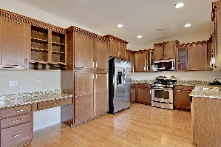
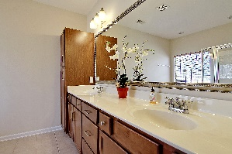


3005 Beauregard Court Summerville, SC 29485 | MLS# 17003416 | $335,000
Recently Reduced in River Birch
A lovely home in one of Summerville’s most desired neighborhoods, River Birch. This two-story home has 4 true bedrooms with a bonus room which can be used as the 5th bedroom. When you step into the foyer, the first thing you will notice is the hardwood flooring throughout the main floor. The master suite is downstairs. It has a tray ceiling, a large walk-in closet, and a master bath equipped with a garden tub, separate shower and water room. The family room, with its cozy fireplace, is open to the kitchen. It also opens to the back yard where you will find a deck waiting for a barbecue. The kitchen has granite counters, 42” maple cabinets with molding, and stainless appliances - including a gas range. There is a formal dining room and living room, which could easily be used as a home office. Additionally, there is also an integrated sound system for music. This is an ENERGY SMART HOME with many energy efficient features including a NATURAL GAS TANKLESS WATER HEATER.
Sharon Sanders
O (843) 494-9284 | M (843) 817-2392
sbricesanders@gmail.com
www.homesolutionreservices.com
Home Solution Real Estate Services | 7679 Dorchester Road | North Charleston, SC 29418

