Slide 1

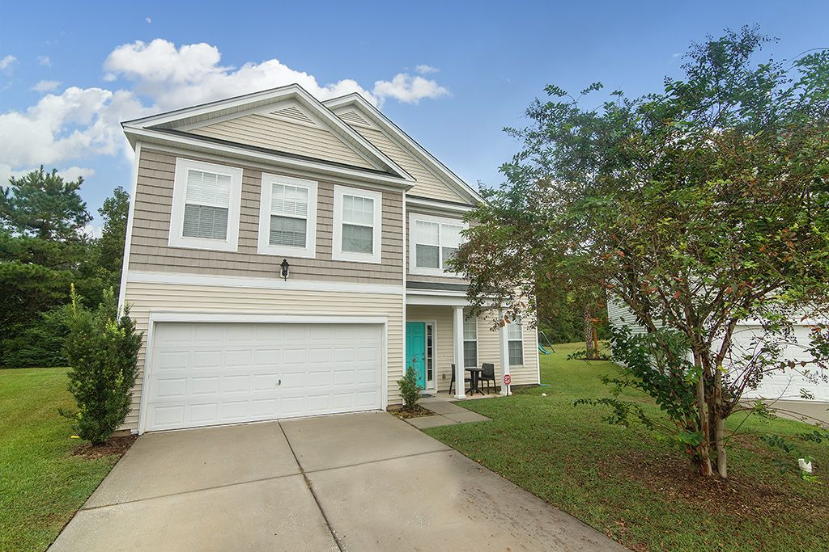

Coming Soon!
Jacqui Swain
Office (843) 871-1710
Mobile (843) 295-9484
jacquiswainc21@gmail.com
www.JacquiSwain.c21.com
3005 Peacher Ct Myers Mill · Summerville, SC 29483 · $245,000
2,709 sq ft
4 beds · 2½ baths
This lovely, four bedroom two and a half bath home is nestled on a quiet cul-de-sac in Myers Mill Community. You will enjoy plenty of space for parking. The front porch is great for enjoying a morning cup of coffee from the comfort of your rocking chairs. Inside the home is an open floor plan, complimented by an abundance of natural light. Enjoy cooking in the spacious kitchen with stainless steel appliances, ample cabinet and counter space. The formal dining room is great for having friends over for special meals. At the top of the stairs is a versatile, open loft area which can be used in any way you want, an office space, entertainment area, play area, etc., your choice. The master bedroom suite features a large walk-in closet, and an en-suite with a dual vanity, garden tub and separate shower. The secondary bedrooms and bathroom, are also on the second level. Myers Mill features a neighborhood pool and pool house. Conveniently located near shopping, dining, and attractions. Schedule your private viewing to see your new home, today!
Century 21 Expert Advisors | 100 Seven Oaks Lane | Summerville, SC 29485-8514

