Slide 1
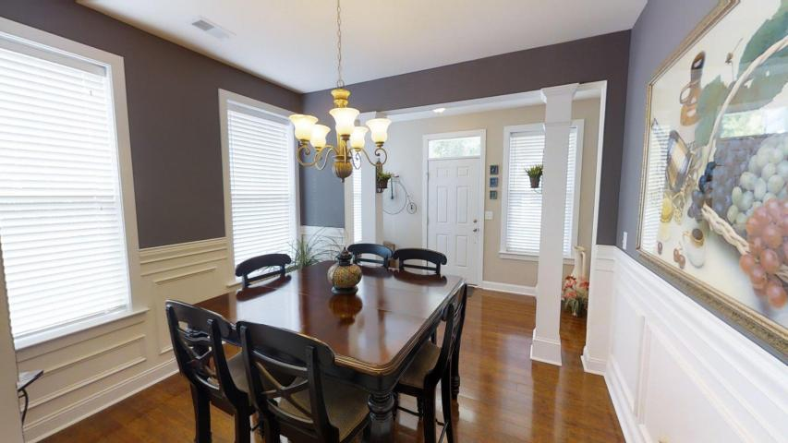
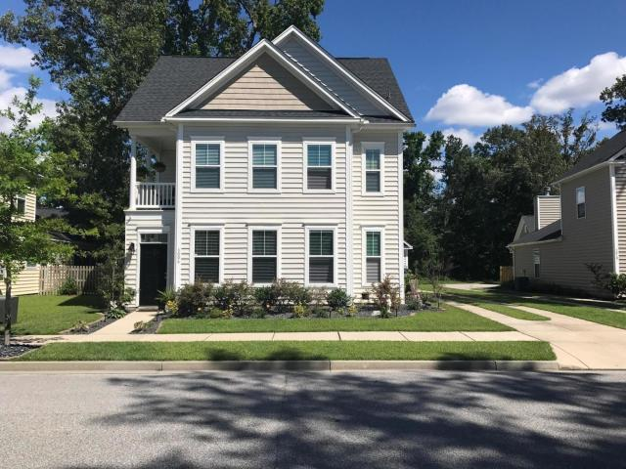
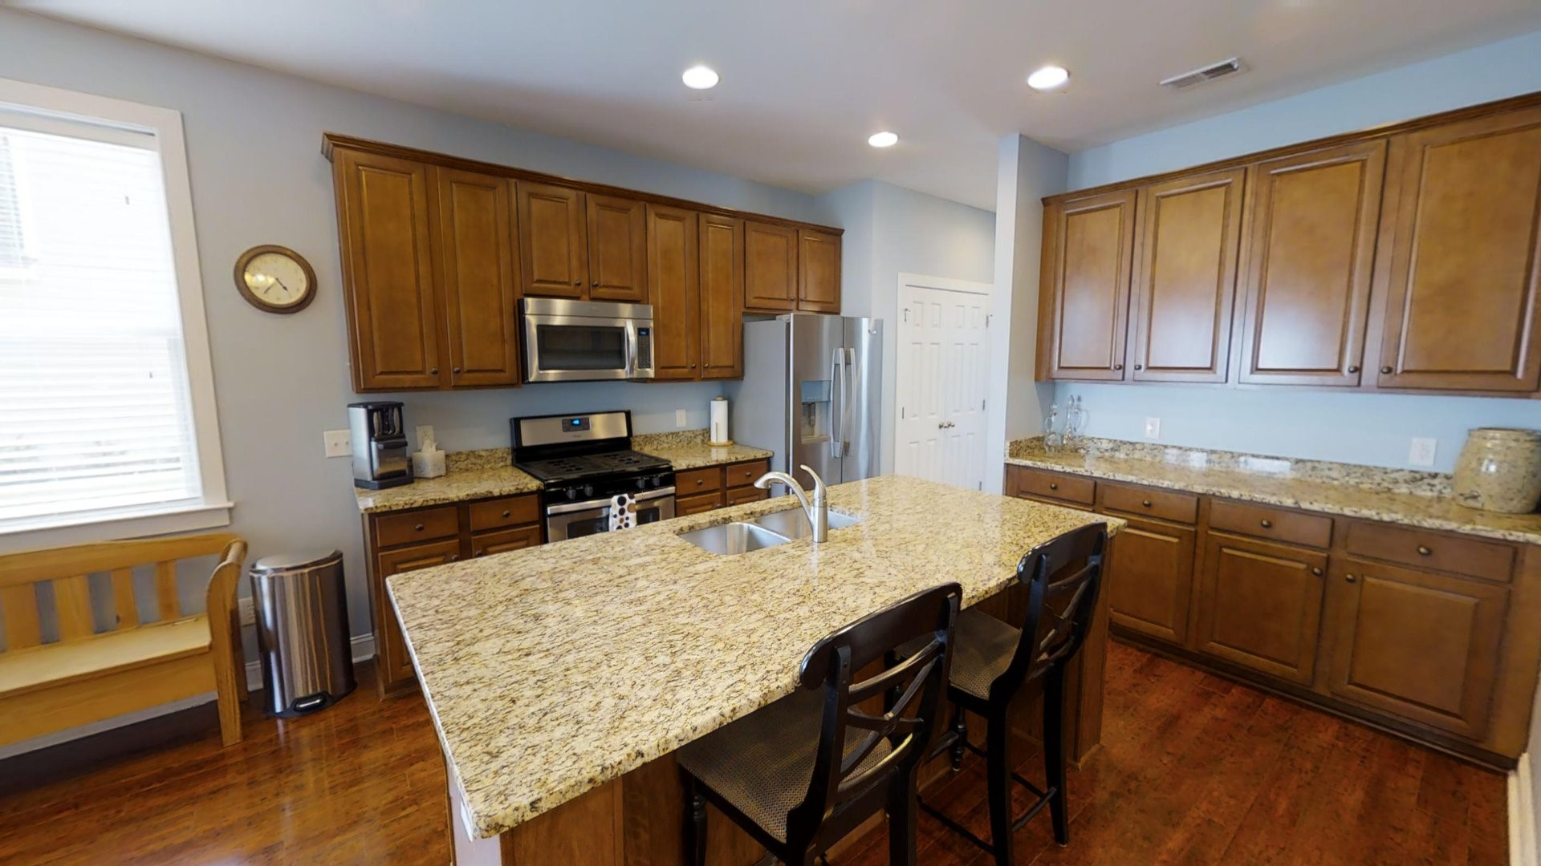
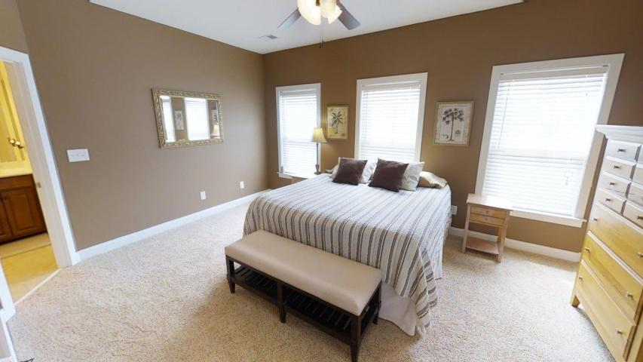
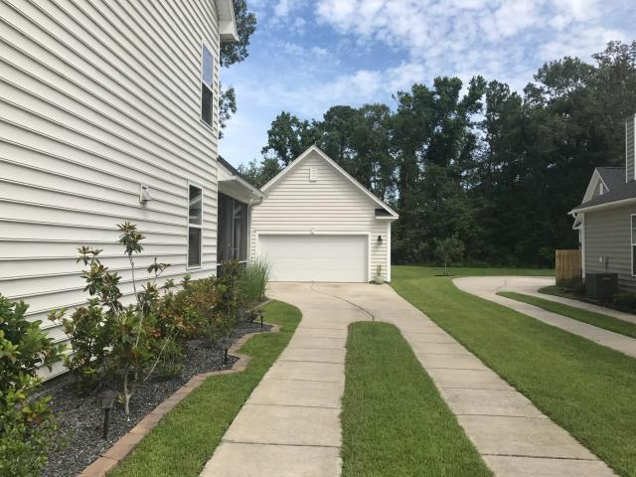
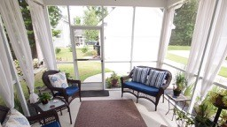

Better Than New in Boltons Landing!
3006 Scuba Drive
Charleston, SC 29414 ~ MLS# 17016913 ~ $319,500
Why wait when you can have a home that is in such pristine condition it feels like new construction! Located in popular Boltons Landing in Charleston, SC this Charming Charleston Style home is a no brainer! The huge kitchen with center island opens to the family room, a perfect layout for families and for entertaining. There are three bedrooms and the bonus room on the third floor could easily be used as a fourth bedroom, office, or guest quarters. The beautiful upgrades, including hardwoods throughout the first floor, new carpeting upstairs, gorgeous granite and more make a great impression. Boltons Landing has a zero entry pool, miles of walking trails and sidewalk lined streets and is a short ride to Historic Downtown Charleston, beaches, public boat launch, shopping and restaurants. Don’t delay in making this move in ready home yours. Check out the 3D Walk Through Tour using the link below and then call to schedule your appointment to see this beautiful home!
Check out the 3D Walk Through Tour: https://my.matterport.com/show/?m=JdpsXLkmnq9
Ellen O'Neil
Broker/Owner
Ellen O'Neil Realty
ABR, e-PRO, CNE
Charleston Realtor of Distinction
(843)300-8530
http://EllenONeilRealty.com

