Slide 1
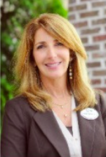
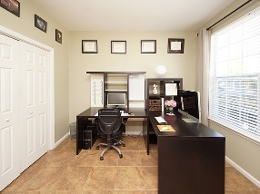
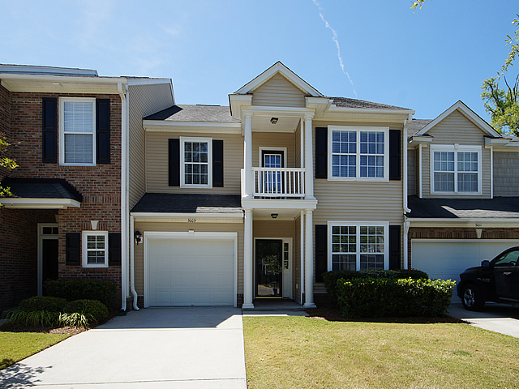
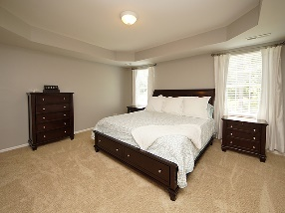
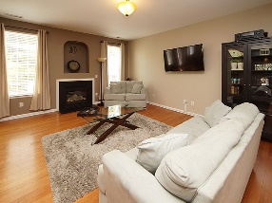
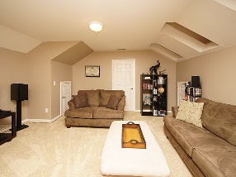
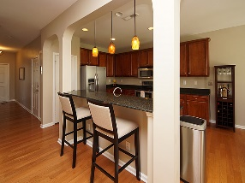
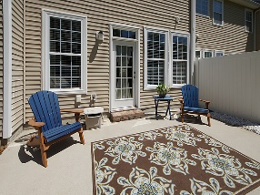
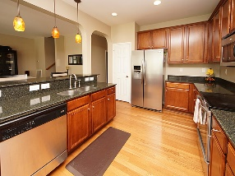
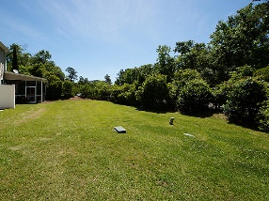

Carolina Bay Open House
Sunday July 8th, 1:00-4:00
Debbie Himebaugh
(843) 324-6959
dhimebaugh@century21properties.com
www.DebbieHimebaugh.com
3009 Candela Grove Drive | Charleston | MLS# 18012013 | $275,000
Brand New Flooring!
BEAUTIFUL 3-story townhouse with Garage and Private Backyard in desirable Carolina Bay subdivision. This extremely spacious 3-story townhome has 4 Bedrooms/3 Full Baths. Loaded with Upgrades - 42'' Maple Cabinets, stainless steel appliances, Silastone countertops, Fireplace with Gas logs, beautiful Hardwood floors throughout first floor, a 3rd floor BONUS room with skylights and MORE!!! The Master SUITE has a tray ceiling, walk in closet, dual sinks, garden tub and separate glass shower. Each level is temperature controlled by its own thermostat. CAREFREE LIVING in this home as the regime fee includes: pest control & termite bond, exterior pressure washing, gutter cleaning, lawn care, shrub/tree trimming, irrigation, pond maintenance. There are 3 neighborhood Pools, Dog Park, Playground, PLUS a 3 acre central park area make this sidewalk neighborhood so desirable. Community has tons of walking/biking/running trails/free work out groups/movies in the park/food truck Friday's
Century 21 Properties Plus | 3301 Salterbeck Ct Suite 100 | Mt. Pleasant, SC 29466

