Slide 1
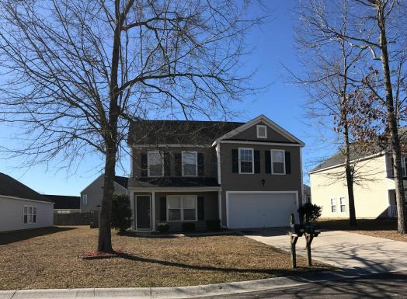
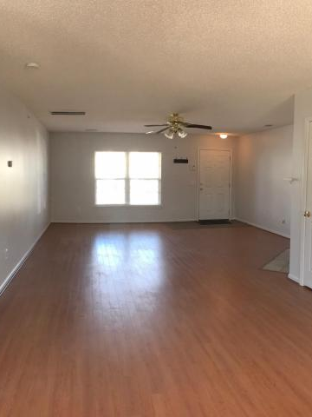
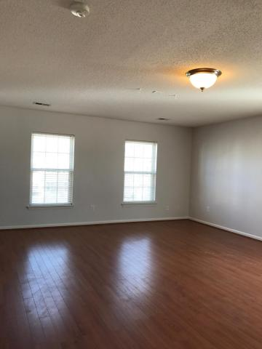
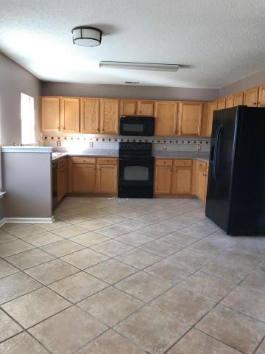
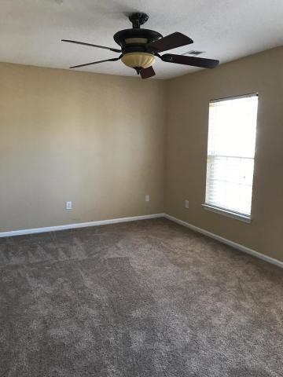
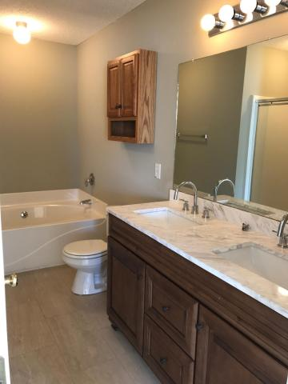
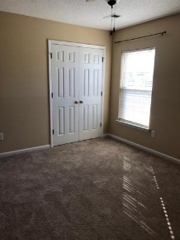
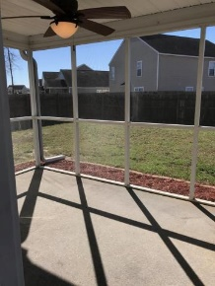
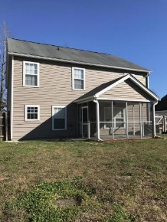


3% in Closing Costs!
$50 Gas Card Drawing
3009 Kinswood Lane
Hunters Bend ~ Ladson, SC 29456
MLS# 17005154 ~ $220,000
Beautifully renovated - laminate floors on main, with tile in kitchen, freshly, professionally painted, walk into a huge spacious and bright great room with a fireplace. Located within walking distance to 3 schools! Full sod - The Madison Plan, two story/two car garage, 3 bedrooms, 2.5 baths and a huge loft area - great flex space. Black appliances in kitchen and upgraded flooring; master suite is a 18' x 15' deluxe master bath with garden tub and separate shower. Front porch elevation! 10 x 12 patio. Sellers will pay 3% closing costs and AHS Home Warranty with acceptable offer.
Susan Woodworth Kraber
Mobile - (843) 779-9655
susankraber1@gmail.com
ERA Wilder Realty, 125-F Wappoo Creek Dr, Charleston, SC 29412

