Slide 1
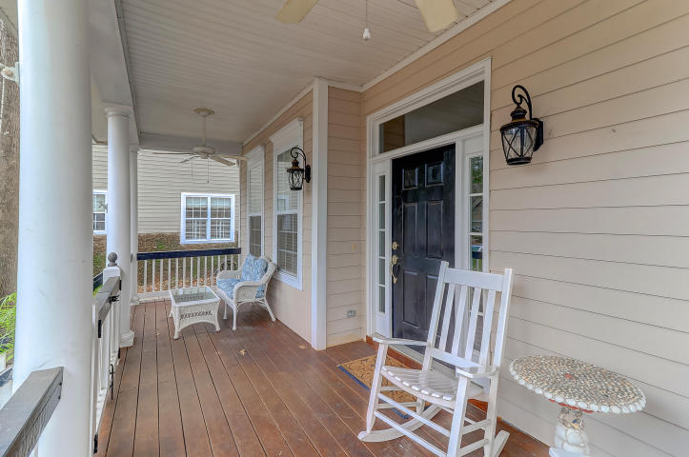
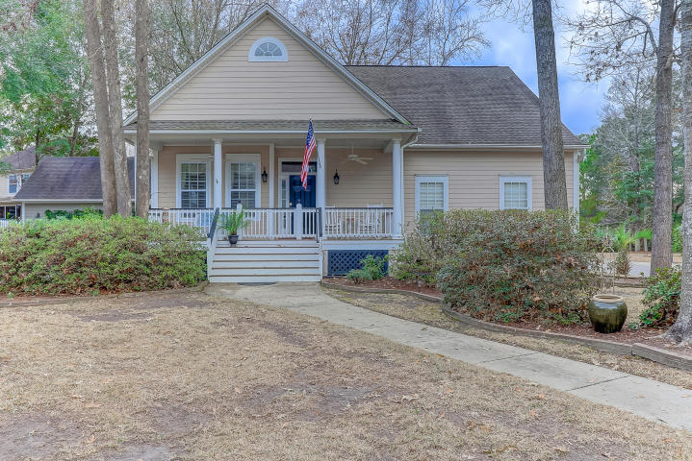
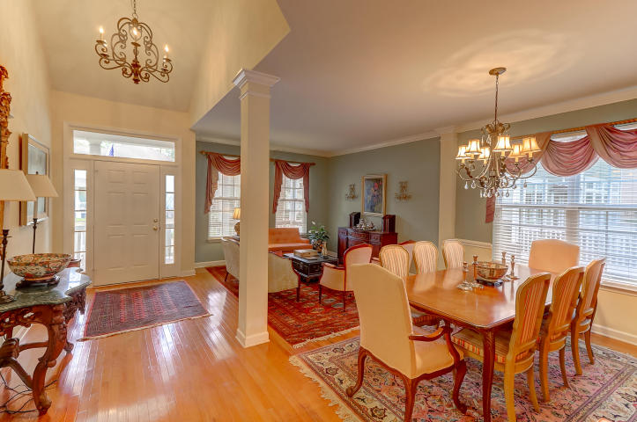
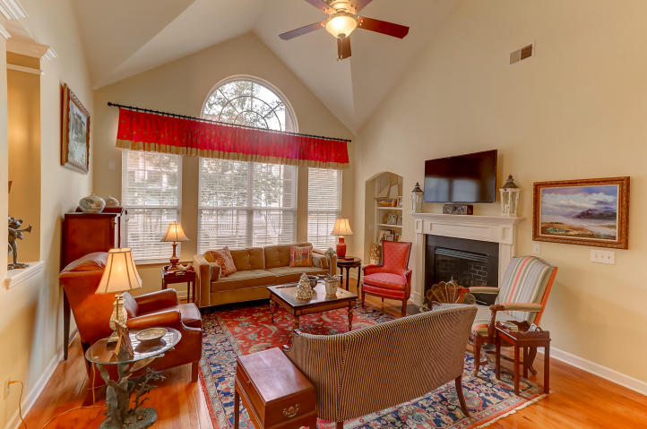
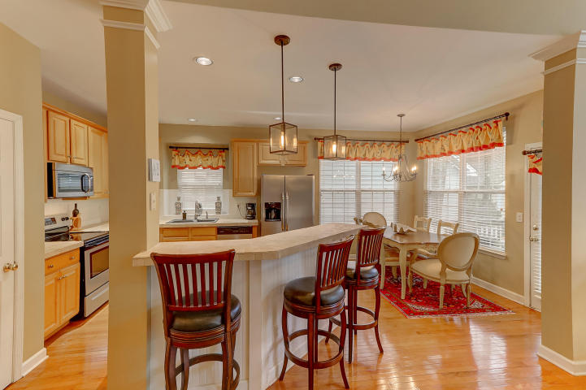
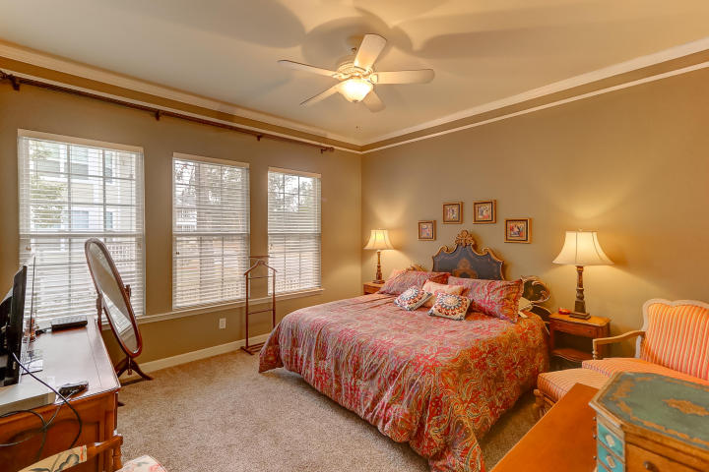
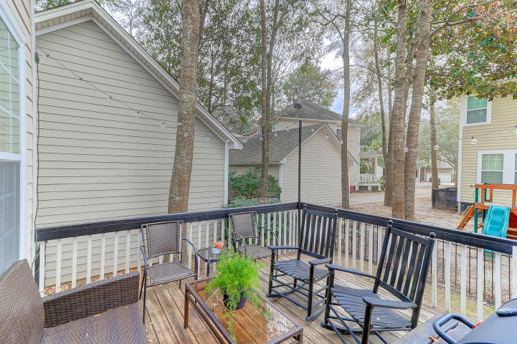
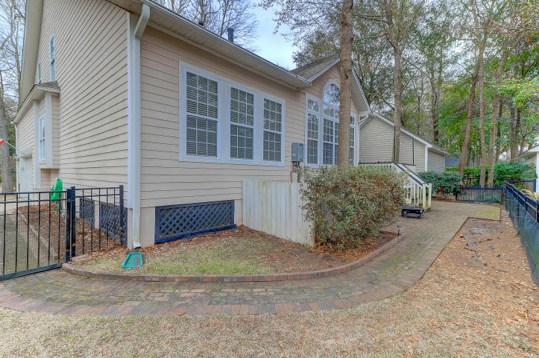
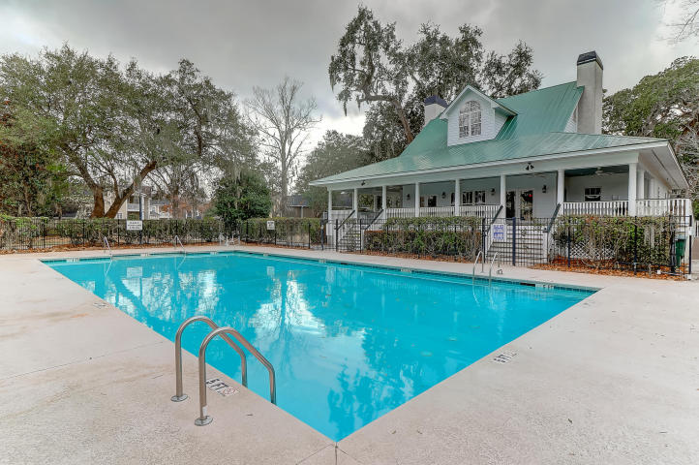

Beautiful New Listing In Schieveling Plantation
DRAFT
3009 Macbeth Creek Drive
Charleston, SC 29414 | MLS# 18001786 | $375,000
Turn into Schieveling Plantation to be greeted by MATURE LIVE OAKS and Spanish moss overhanging the way to your new home. This CORNER LOT has a LARGE FRONT YARD with mature azaleas soon to bloom. As you walk up the front steps to an OVERSIZED FRONT PORCH you will enter the home and immediately noticed the FORMAL DINING AND FORMAL LIVING SPACE at the front of the home. The SHINY WOOD FLOORS compliment this homes floor plan! The KITCHEN OVERLOOKS THE GREAT ROOM and it also has AN EAT IN KITCHEN! HUGE WINDOWS ACROSS THE BACK OF THE HOME make this large 2 STORY LIVING ROOM feel warm & cozy! The FIREPLACE is natural gas and provides the perfect ambience for a cocktail party or family movie night! The master bathroom has a GARDEN TUB & SEPARATE SHOWER as well as TWO VANITIES and a LARGE WALK IN CLOSET. Upstairs are 2 ADDITIONAL BEDROOMS + A LOFT that could make a great office, playroom, or even a 4th bedroom with a little modification! Off the back of the home is a LARGE DECK & A FENCED IN YARD.
Derrick McDuffee
(843) 371-2890
derrick.mcduffee@carolinaone.com
Carolina One Real Estate
2713 Highway 17 North
Mt. Pleasant, SC 29466

