Slide 1
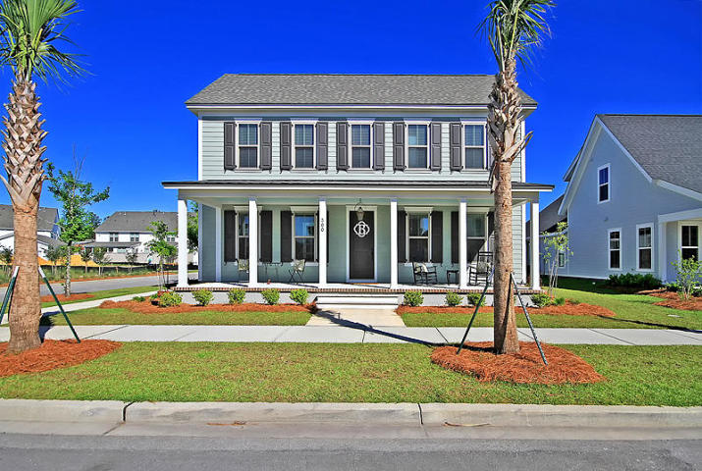
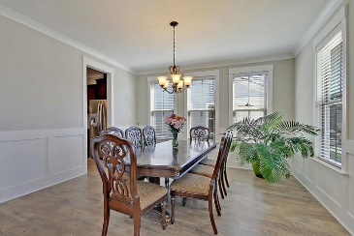
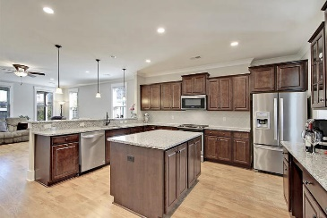
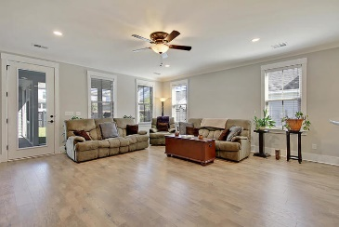
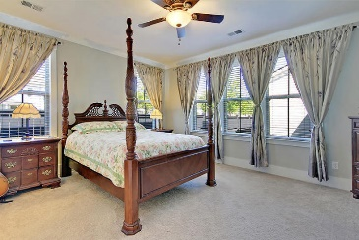
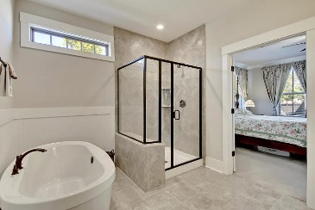
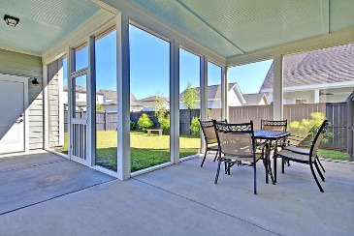
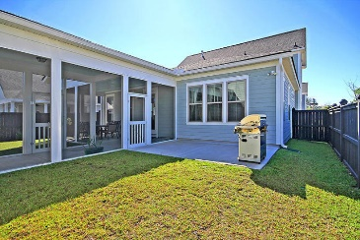
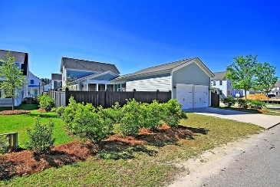

300 Watergrass Street Summerville, SC 29486 · MLS# 19011049 · $425,000
$5,000 Agent Bonus in Nexton!
New Listing in Nexton
STUNNING home in desirable Nexton has it all! This TURNKEY home is better than new and has numerous upgrades included that you do not get with new construction! The home boast STUNNING CURB APPEAL with a beautiful covered full front porch and gas lanterns. Entering the foyer you are greeted with handsome hardwood floors and an abundance of natural light. A large dining room is to the right and an office/flex/guest room to the left. Continuing in is the GORGEOUS CHEF-INSPIRED GOURMET kitchen with gas cooktop, granite counter tops, island, breakfast bar, tons of cabinets with soft close and pull out drawers. This kitchen is large enough to have multiple cooks in the kitchen at once while entertaining family and friends! The kitchen is OPEN to the generous sized family room.
The master bedroom suite is on the first floor with a SPA-LIKE master bathroom featuring a LUXURIOUS SOAKING TUB, separate shower, granite counters, and dual sinks. The master bath has plenty of space for two people to get ready at the same time! Finishing off the first level is a powder room and large laundry room. The second floor is spacious and has two large bedrooms that share a full bath with dual sinks. The fenced backyard has a screen porch, grilling patio area with gas hook-up, and a FANTASTIC COVERED BREEZEWAY that protects you from the weather when leaving the detached garage and entering the house. The 2 car finished garage is nicely sized and has high ceilings. Nexton in Summerville is a wonderfully landscaped community with a play park, community pool, and walking trails! The neighborhood is close to local shopping and grocery stores and is a short drive to downtown Charleston with 5-star restaurants, world class shopping and iconic history as well as a short drive to the beaches, the airport, Boeing, Volvo, and Daniel Island. Come take a look because you will not find another home that offers as much as this one!
Seller will pay buyer's agent $5,000 at closing
with accepted offer by noon June 7, 2019!
Stan Huff
843-670-2835 stan.huff@agentowned.com
Jill Marcacci
843-297-5590 jill@agentowned.com
www.agentownedrealty.com
AgentOwned Realty Co. Preferred Group, Inc. | 824 Johnnie Dodds Blvd | Mt Pleasant, SC 29464

