Slide 1
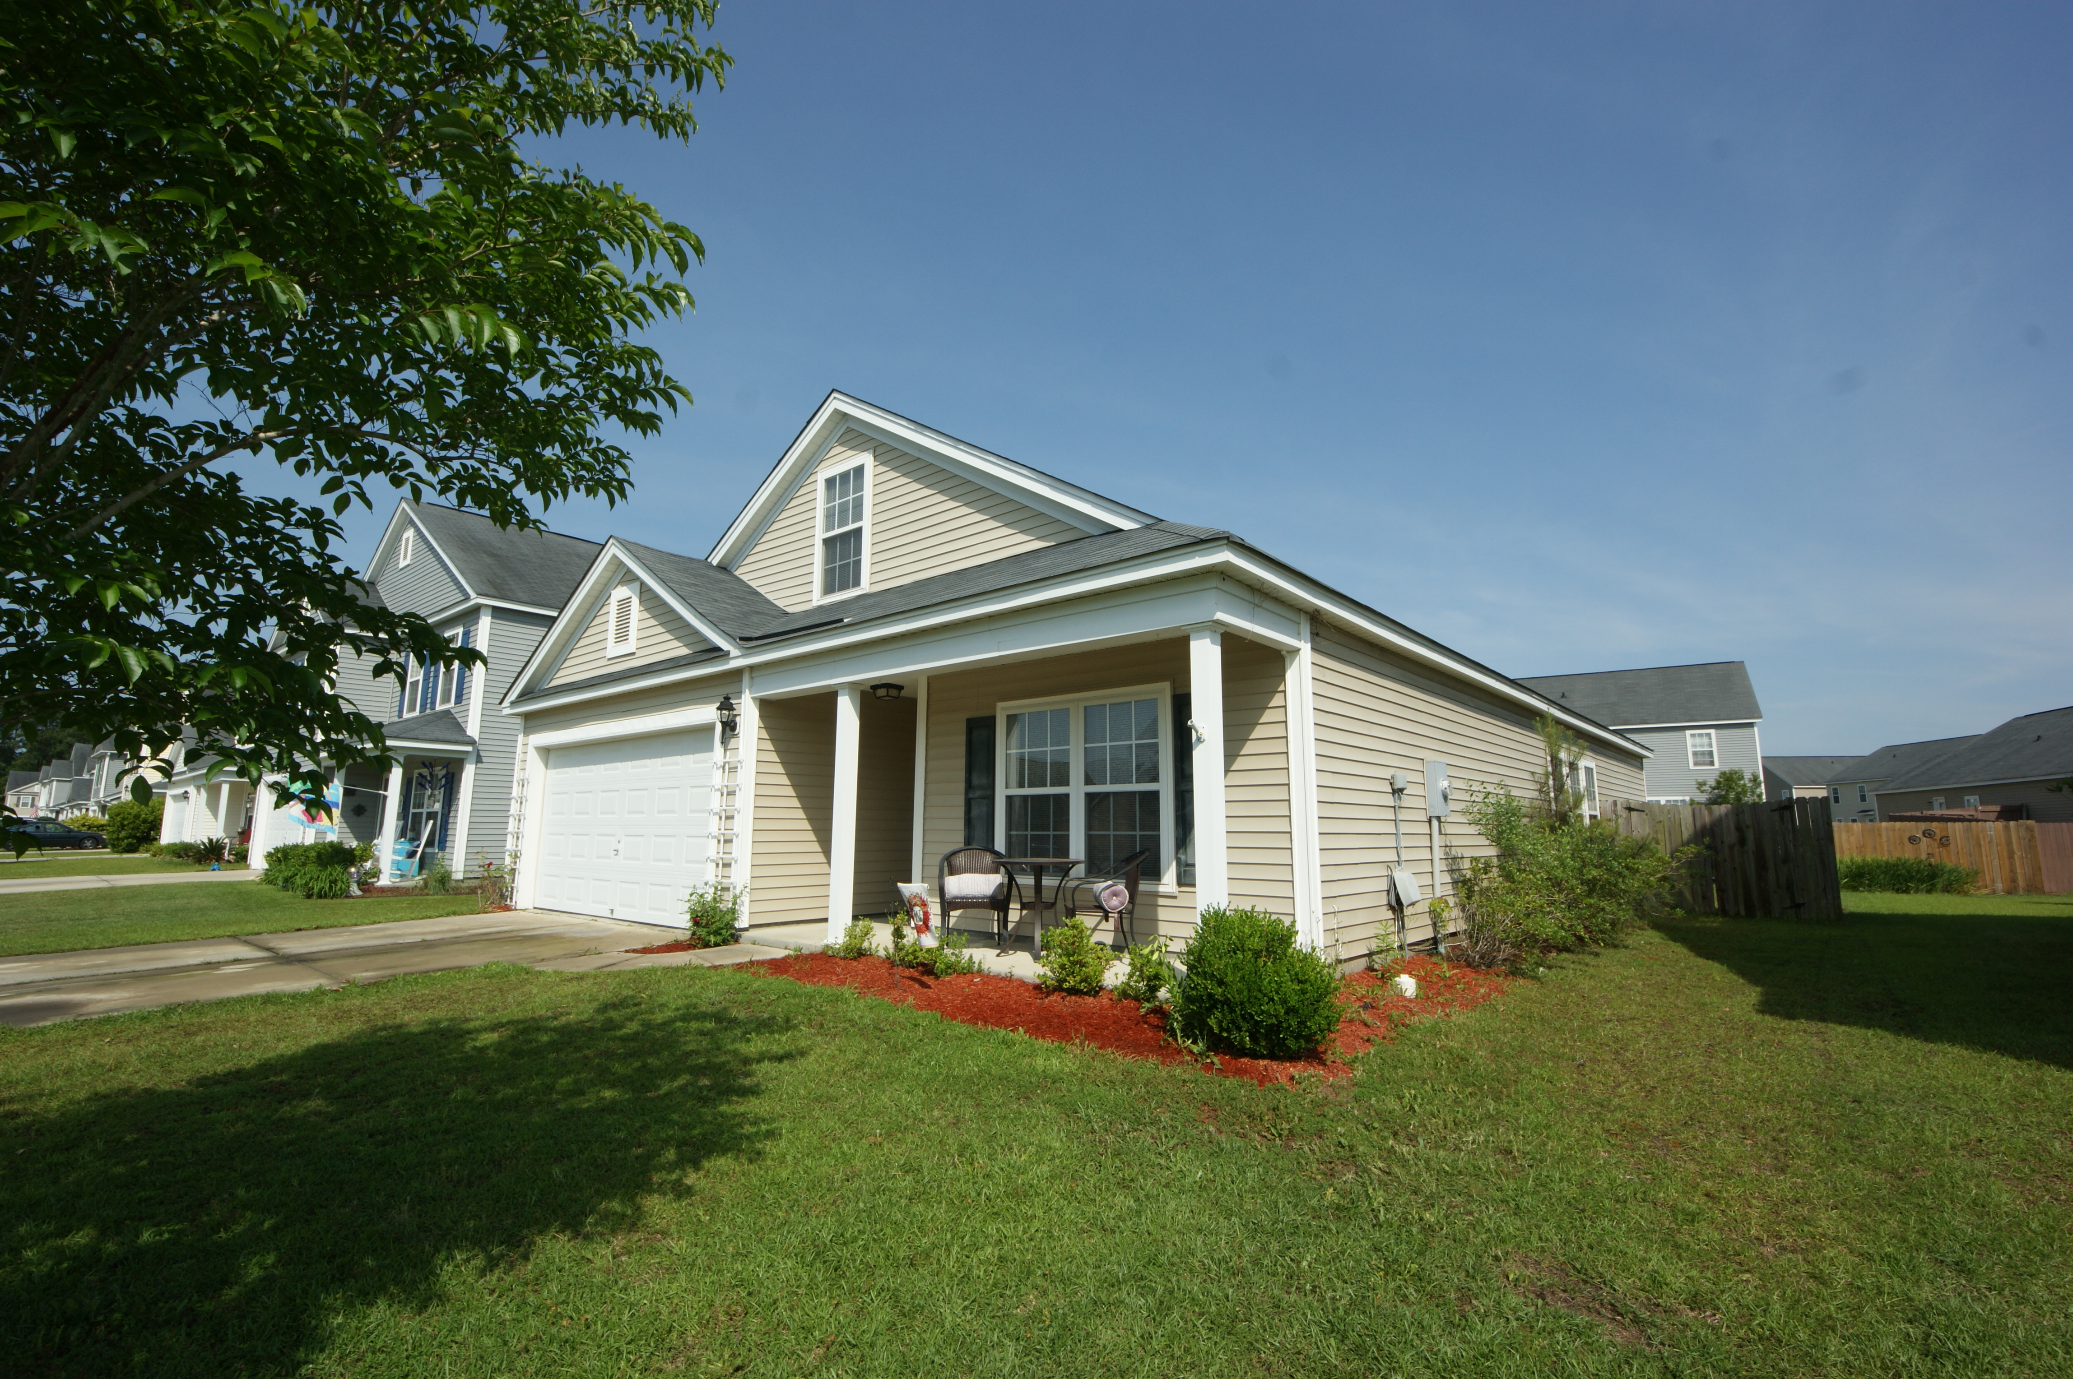
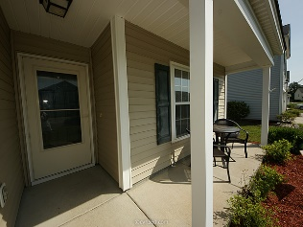
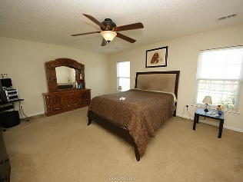
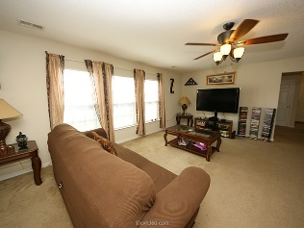
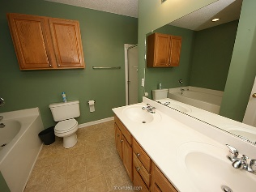
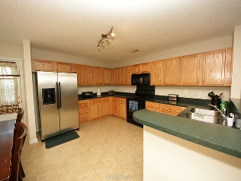
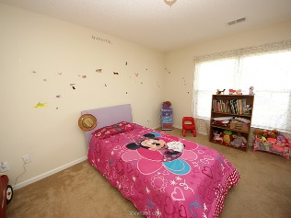
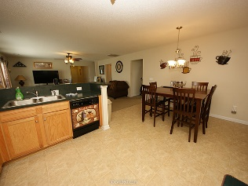
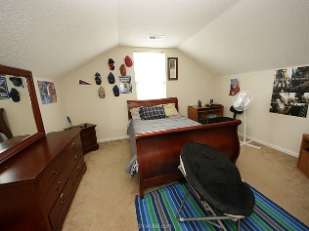


3010 Crusades Street Hunters Bend ~ Ladson ~ MLS# 15013208 ~ $175,000
Just Reduced in Hunters Bend
Move in ready in desirable Hunter’s Bend! This 4 bedroom, 2 bath home is located within walking distance of 3 schools. There is a large kitchen which is open to the family room. The master suite has walk-in closets and a deluxe master bath. The secondary bedrooms are separated for maximum privacy, including one finished bedroom over the garage perfect for guest room, office, or a teenager’s bedroom! Enjoy the lovely front porch to relax or chat with friendly neighbors, or retreat to the fully fenced and private backyard.
Kristin Schatmeyer
Cell - (843) 697-7370
kristin.schatmeyer@carolinaone.com
www.KristinSchatmeyer.com
Carolina One Real Estate
2713 Highway 17 North
Mt. Pleasant, SC 29466

